Slide 1
Financial wellness
Kimberly Young

Slide 2
Question 1
What percentage of your budget should go toward savings and investments?
50%
30%
20%
10%

Slide 4
Question 2
What type of account is ideal for an emergency savings because it earns higher interest, but doesn’t lock up your money?
Checking account
Money Market
Savings account
Certificate of Deposit

Slide 6
Question 3
According to the snowball method, which of these debts should be your first priority to pay off?
The one with the highest balance
The one with the highest interest rate
The one with the most annoying debt collectors
The one with the lowest balance

Slide 8
Growing your wealth

Slide 9
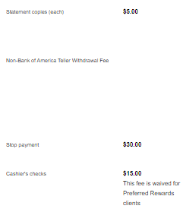
Account types
Checking Account
Savings Account
Money Market
Certificate of Deposit
Everyday spending
Low minimum balance
Interest + liquidity
Long-term investing
Look for accounts with rewards
Watch out for fees

Slide 10
Choosing a money market
How much money can you keep in the account at all times?
What is the interest rate?
Are there any fees?

Slide 11
Choosing a money market
Account 1
1
$5,000 minimum balance
.05% APR
Account 2
2
$10,000 minimum balance
.10% APR
Account 3
3
$25,000 minimum balance
.10% APR
No fees
No Fees
No fees
Notes:
Which would you choose?
Things to keep in mind:
although accounts 2 & 3 have the same rate right now, if rates start to increase, account 3 will most likely see higher/earlier increases
Even though there are no maintenance fees, you will always be charged a fee if you drop below the min. balance

Slide 12
Choosing a CD
How much can you afford to invest?
How long can you keep the money locked up?
What is the interest rate?
Are there any fees?

Slide 13
Choosing a CD
Bank 1
1
$500 minimum balance
.50% APR
Bank 2
2
$500 minimum balance
.55% APR
Bank 3
3
$750 minimum balance
.55% APR
No fees
$25 yearly fee
No fees
60 month term
60 month term
60 month term
Notes:
Which would you choose?
Things to keep in mind:
Bank 2 is giving you a higher APR, but charging a fee; depending on how much you’re investing, it may be worth it to pay the fee because you’ll earn more interest.
Bank 3 has the higher APR and no fees, so if you were planning to invest at least $750, this is your best option (remember that you can’t withdraw the money after the initial investment without paying a penalty)

Slide 14
Your turn to try!
Bank A
$1,000 minimum balance
.70% APR
Bank B
$1,000 minimum balance
.75% APR
Bank C
$1,000 minimum balance
.75% APR
No fees
$5 annual fee
No fees
60 month term
48 month term
60 month term

Slide 15
Bank A
$1,035.61
Bank B
$1,010.44
Bank C
$1,038.20

Slide 16
Retirement accounts

Slide 17
Choosing a retirement account
When do you plan to retire?
Do you want to declare your contributions on your taxes?
What are the interest rates?

Slide 18
Roth v. traditional IRAs
*
*limits have remained unchanged since 2019

Slide 19
Choosing an IRA
Bank 1
1
$1,000 minimum deposit
1.7% APR
Bank 2
2
$50 minimum deposit
2.00% APR
Bank 3
3
$1,000 minimum deposit
1.75% APR
No fees
No fees
No fees
72 month term
60 month term
60 month term
Notes:
Different IRA options will have generally the same considerations as a CD account

Slide 20
End of term
What happens when the term on an IRA or CD ends?
Roll over
Close account
Choose a new account type

Slide 21
How to research a stock?
Notes:
There are 3 key financial metrics/multiples that we can apply to our analysis, but the very first thing to check is the company’s earnings per share (EPS). This will tell us if the company is profitable.

Slide 22
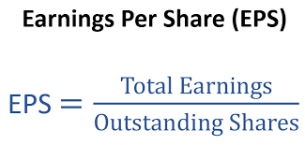
Earnings per share (EPS)
Earnings per share (EPS) is calculated as a company’s net profit divided by the outstanding shares of its common stock.
EPS specifies how much money a company makes for each share of its stock
A higher EPS indicates greater value, because investors will pay more for a company's shares if they think the company has higher profits relative to its share price.
Notes:
EPS gives us a clear picture of whether or not a company is profitable.

Slide 23
Notes:
The adjusted/actual earnings are positive, therefore the company is profitable. The column on the right shows us that Apple is consistently beating the forecasted expectations each quarter, which signals a strong company. A comparison of Q2 2022 vs. Q2 2021 shows 8.57% growth, which is another green flag.

Slide 24
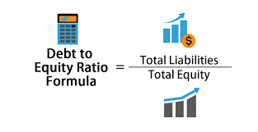
Debt to Equity ratio (D/E)
The D/E multiple is a ratio for measuring how much a company is financing its operations through debt versus wholly owned funds.
A high D/E multiple may indicate that a stock is high-risk.
Will the company have the ability to cover all outstanding debts in the event of a business downturn?
Notes:
A stock with a high D/E ratio may signal a red flag.

Slide 25
D/E Multiples: Low-Risk vs. Neutral vs. High-Risk
Low-Risk | Neutral | High-Risk
Any number < 1.00 | About 1.00 | Any number > 2.00

Slide 26
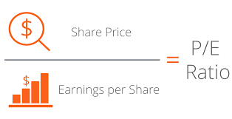
Price to earnings ratio (P/E)
The P/E multiple is a ratio for valuing a company that measures its share price relative to its earnings per share (EPS).
A low P/E multiple may indicate that a stock is undervalued.
Notes:
We want to look beyond the price of the stock. The price, alone doesn’t give us the full story. So we use multiples to dive deeper.

Slide 27
P/E Multiples: Undervalued vs. Neutral vs. Overvalued
Undervalued | Neutral | Overvalued
Any number < 20 | About 20 | Any number > 20
Notes:
Identifying undervalued stocks helps us to potentially earn higher returns with our investments. On the other hand, investing in an overvalued stock has less earnings potential.

Slide 28
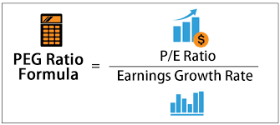
Price/Earnings-to-Growth (PEG) Ratio
The PEG ratio enhances the P/E ratio by adding in expected earnings growth into the calculation.
While a low P/E ratio may initially make a stock look undervalued, factoring in the company’s growth rate to get the stock’s PEG ratio may tell a different story.
The lower the PEG Ratio - the cheaper the stock truly is in regard to its valuation
Notes:
The PEG ratio helps us to look more closely into a stock’s valuation. Although it takes the P/E ratio into account, it provides a clearer picture than the P/E ratio since it factors in the growth rate. In other words, the PEG ratio enhances the limitations of the P/E ratio.

Slide 29
PEG Ratio: Undervalued vs. Neutral vs. Overvalued
Undervalued | Neutral | Overvalued
Any number < 1.00 | About 1.00 | Any number > 1.00
Notes:
Identifying undervalued stocks helps us to potentially earn higher returns with our investments. On the other hand, investing in an overvalued stock has less earnings potential.

Slide 30
Tesla (TSLA) | Ford (F) | General Motors (GM)
Price: $711.11 | Price: $11.46 | Price: $32.64
D/E: 0.21 | D/E: 3.05 | D/E: 1.77
P/E: 63.62 | P/E: 5.97 | P/E: 4.74
PEG: 2.12 | PEG: 2.00 | PEG: 0.48
Notes:
Just looking at the price doesn’t give us the full story.
The D/E ratio shows any potential red flags.
The P/E ratio gives us insight to understanding the valuation.
The PEG ratio enhances the limitations of the P/E ratio. For example, Ford’s stock has a lower price and P/E out of all three companies. However GM has the lowest PEG ratio, which accounts for the growth rate. As a result, GM appears to be the most undervalued stock.

Slide 31
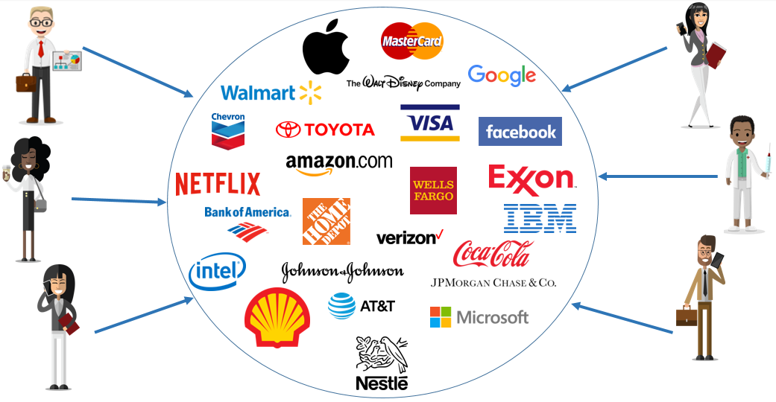
Mutual funds
Notes:
Mutual funds pool money from many investors and invest the money into a variety of securities such as stocks, bonds, and short-term debt.

Slide 32
Active investing vs passive investing
Notes:
Active investing involves applying financial metrics to seek out the best investments, much like the exercise that we just did as a group. Whereas passive investing is more about tracking/matching the market.

Slide 34
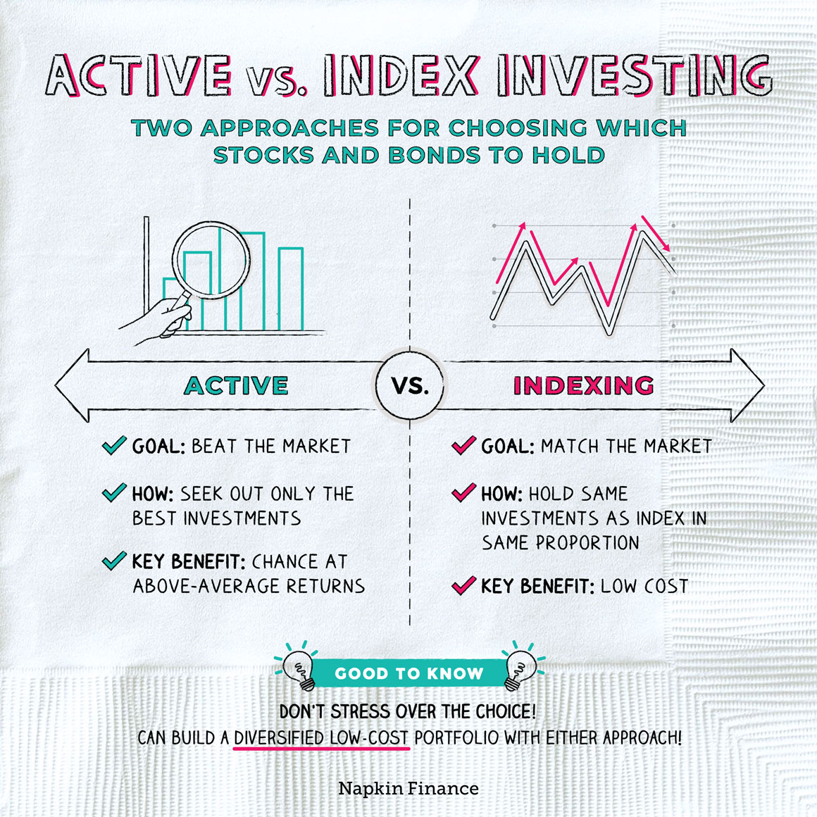
Notes:
The main thing to remember is that choosing the right approach is far less important than actually getting started. Both approaches aim to accomplish the same goal, but it is important to start now since the power of time/compound interest allows us to earn higher returns. Let’s take a closer look into the power of compound interest. (Next slide)

Slide 35
Compound interest

Slide 36
Now it’s your turn!
D/E: | Any number < 1.00 | About 1.00 | Any number > 2.00
P/E: | Any number < 20 | About 20 | Any number > 20
PEG: | Any number < 1.00 | About 1.00 | Any number > 1.00

Slide 37
A) Apple | B) Home Depot
D/E: | Any number < 1.00 | About 1.00 | Any number > 2.00
P/E: | Any number < 20 | About 20 | Any number > 20
PEG: | Any number < 1.00 | About 1.00 | Any number > 1.00

Slide 38
Apple (AAPL) | 2017 Price $36.01 | 2022 Price $141.44 | Difference +292.89%
Home Depot (HD) | 2017 Price $153.40 | 2022 Price $277.08 | Difference +84.43%

Slide 39
A) Nike | B) Disney
D/E: | Any number < 1.00 | About 1.00 | Any number > 2.00
P/E: | Any number < 20 | About 20 | Any number > 20
PEG: | Any number < 1.00 | About 1.00 | Any number > 1.00

Slide 40
Nike (NKE) | 2017 Price $59.00 | 2022 Price $108.08 | Difference +83.19%
Disney (DIS) | 2017 Price $106.25 | 2022 Price $100.31 | Difference -5.59%

Slide 41
A) Microsoft | B) PepsiCo, Inc.
D/E: | Any number < 1.00 | About 1.00 | Any number > 2.00
P/E: | Any number < 20 | About 20 | Any number > 20
PEG: | Any number < 1.00 | About 1.00 | Any number > 1.00

Slide 42
Microsoft (MSFT) | 2017 Price $68.93 | 2022 Price $262.26 | Difference +282.56%
Pepsi (PEP) | 2017 Price $115.49 | 2022 Price $167.60 | Difference +45.62%

Slide 43
Investment performance over A 5-year time
Apple (AAPL) | 2017 Price $36.01 | 2022 Price $141.44 | Difference +292.89%
Microsoft (MSFT) | 2017 Price $68.93 | 2022 Price $262.26 | Difference +282.56%
Home Depot (HD) | 2017 Price $153.40 | 2022 Price $277.08 | Difference +84.43%
Nike (NKE) | 2017 Price $59.00 | 2022 Price $108.08 | Difference +83.19%
Pepsi (PEP) | 2017 Price $115.49 | 2022 Price $167.60 | Difference +45.62%
Disney (DIS) | 2017 Price $106.25 | 2022 Price $100.31 | Difference -5.59%
Notes:
This is why it is so important to diversify your investments. As you can see - picking different investments allows us to spread out our risk, while also improving long-term portfolio performance.

Slide 44
Thank you for coming!

