Slide 1
Sexism in Literature
Kimberly Young

Slide 2
Lusus Naturae
She “was a lovely baby”: what possible explanations do the family give for her condition?
The family decides that she’d better off dead: what does this suggest about views/expectations of womanhood?
“Now that I was dead, I was freer”: what does this quotation tell us about the lives of women?
She doesn’t recognize own reflection: how does she see herself? What does this tell us about the idea of self-image?
Why does she “attack” the two lovers? What does this tell us about her? About women?

Slide 3
The BirthMark
How does Georgiana initially feel about her birthmark? Why? Why is this significant?
Why does Aylmer want to remove it? What does this suggest about gender and relationships?
What symbolic associations does the author make with the birthmark?
Why does the birthmark change color? Why is this significant?
Why do you think Hawthorne wrote the ending the way he did?

Slide 4
Social media group activity
Choose two people you are connected with on a social media site (one male, one female).
Look through their pictures, comparing and contrasting the types of images that you see and the comments that people make.

Slide 5
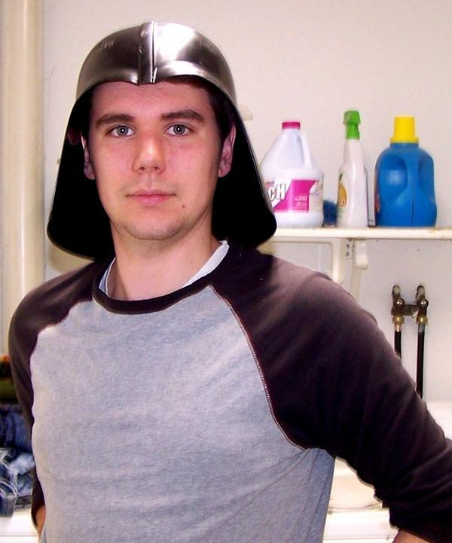
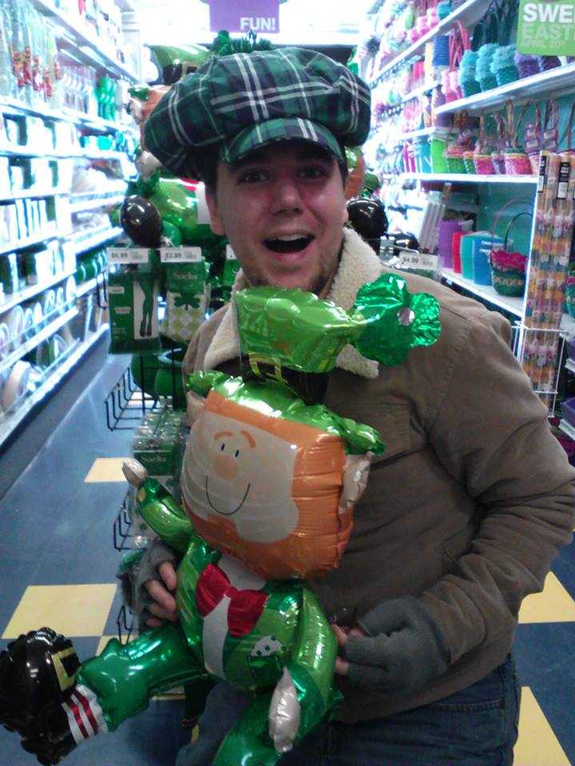
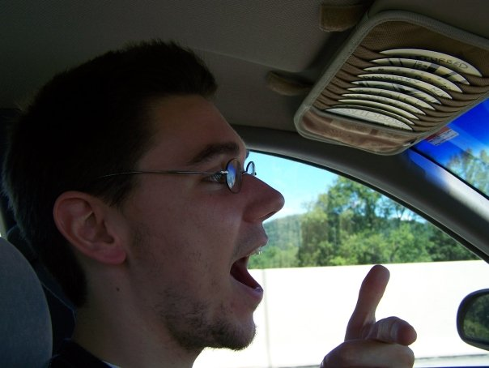
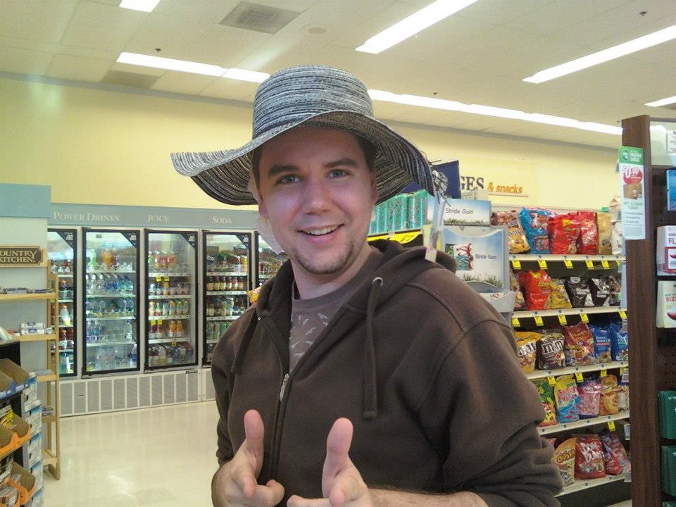

Slide 6
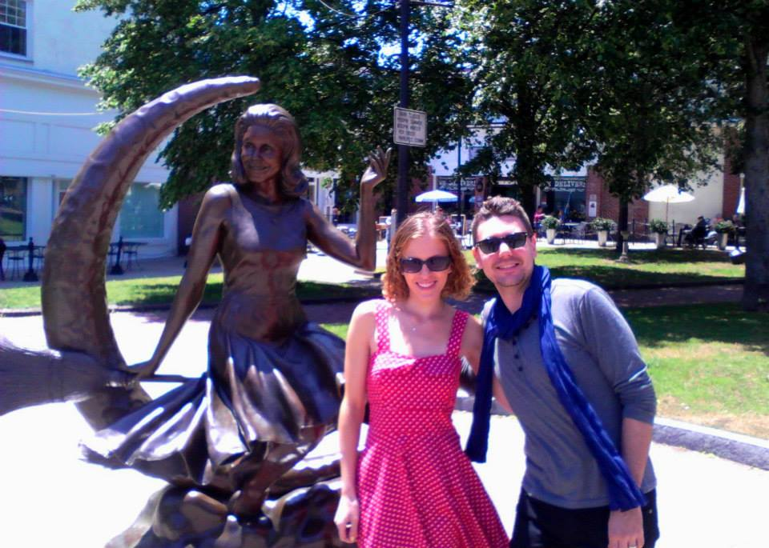
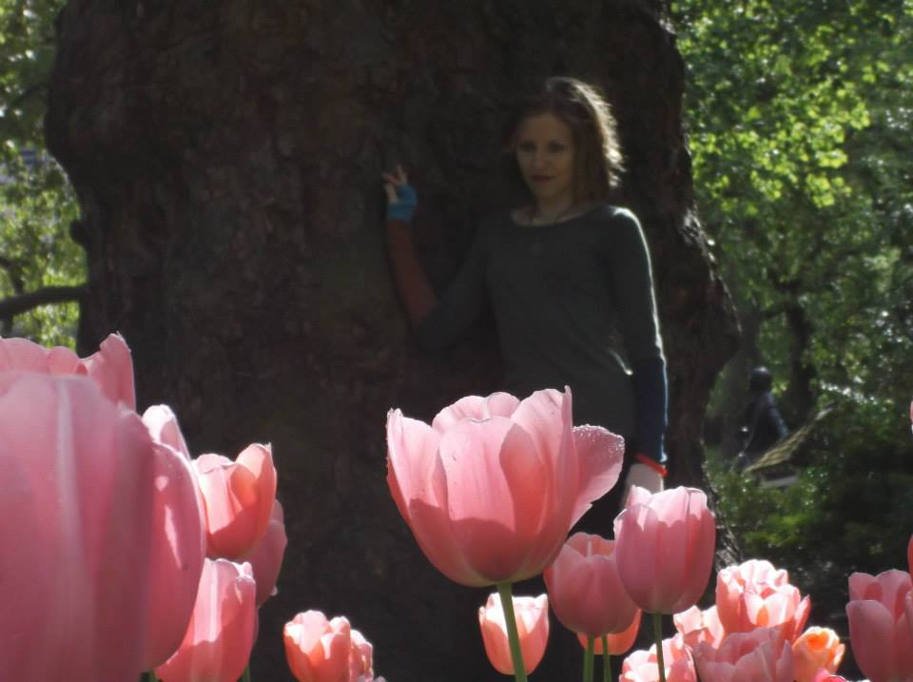
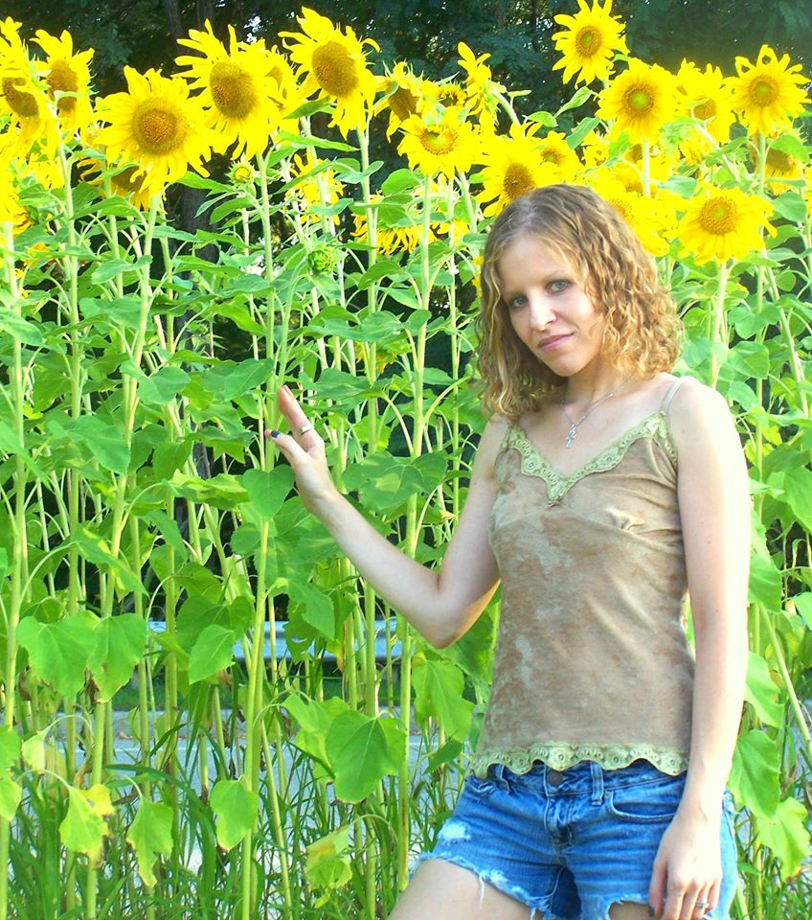
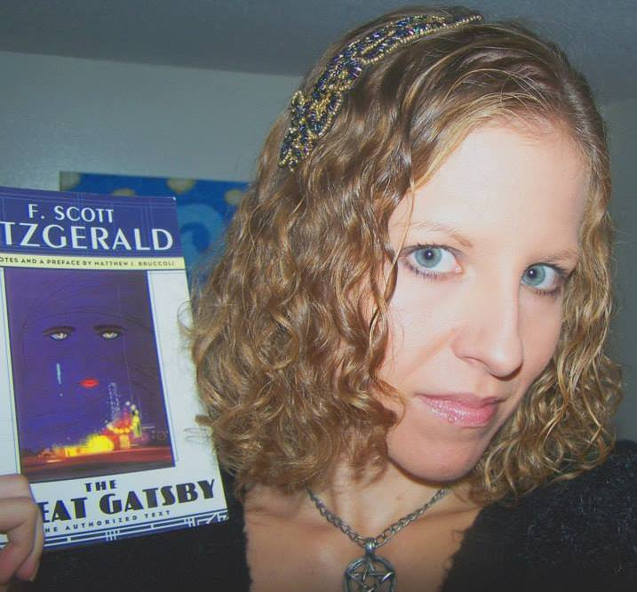

Slide 8
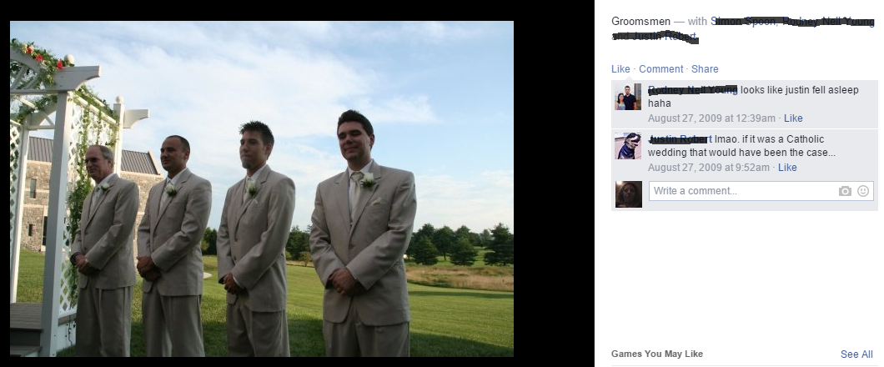

Slide 9
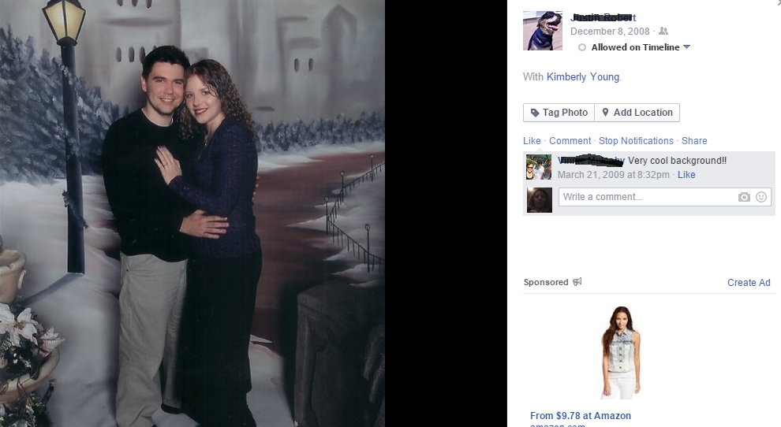

Slide 10
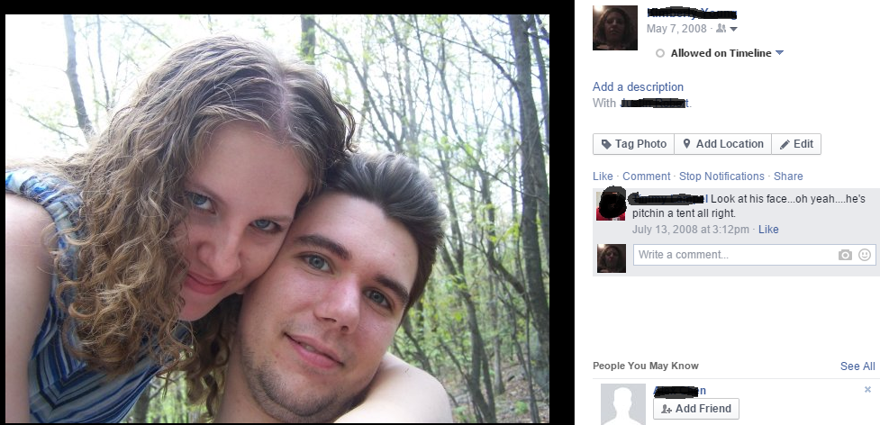

Slide 11
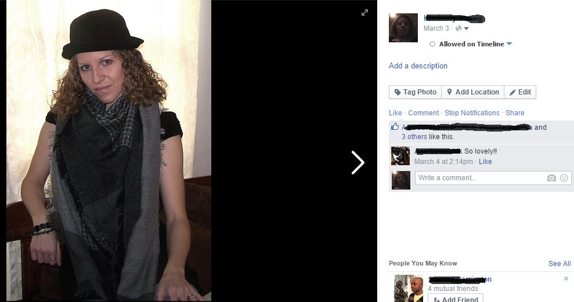

Slide 12
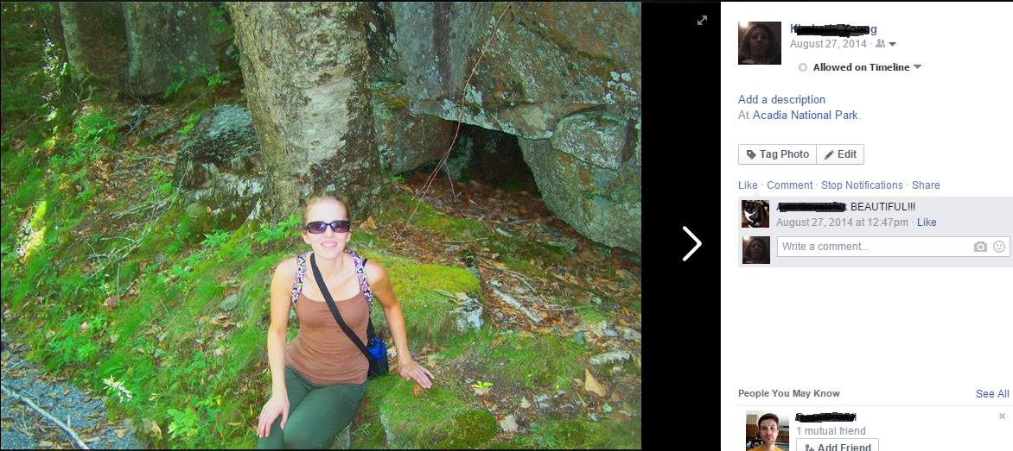

Slide 13
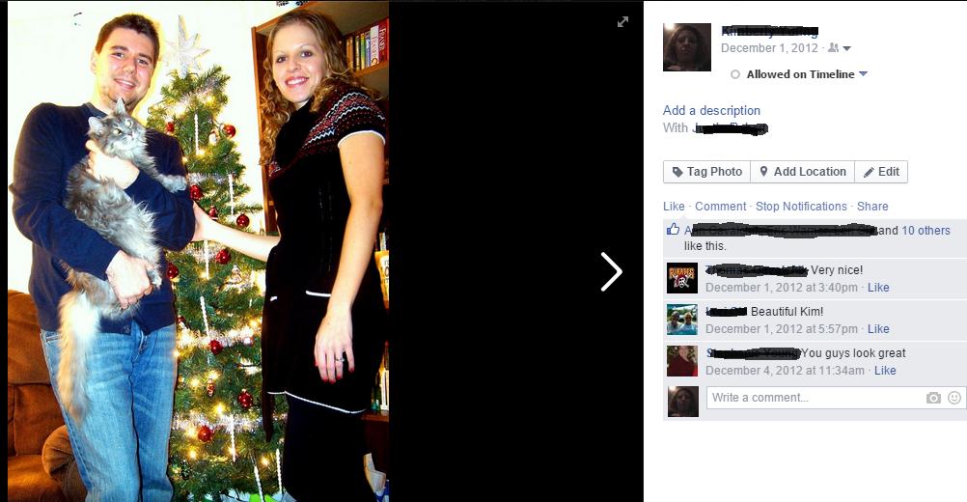

Slide 14
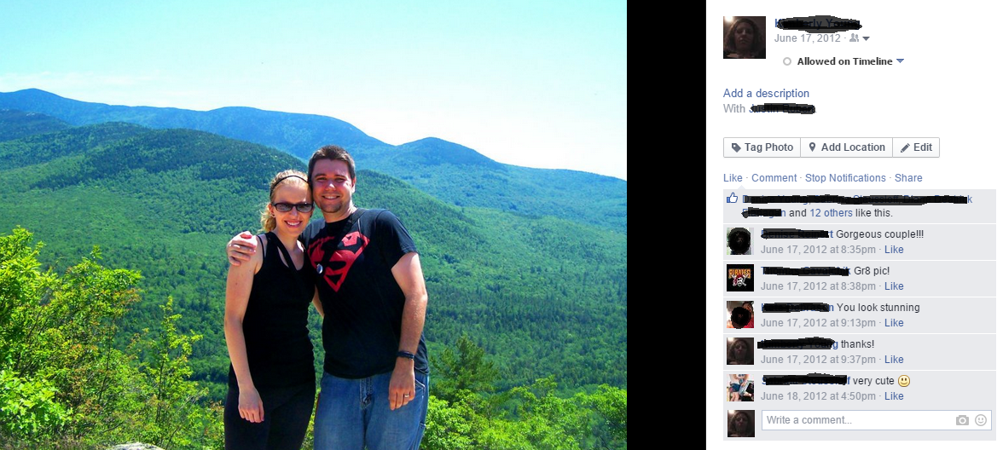

Slide 15
Perceptions of attractiveness

Slide 16
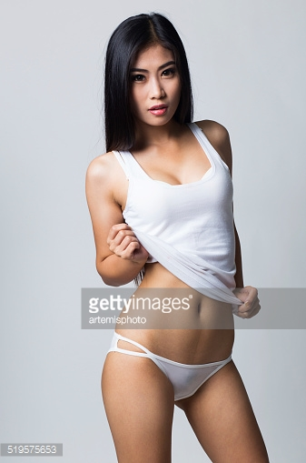
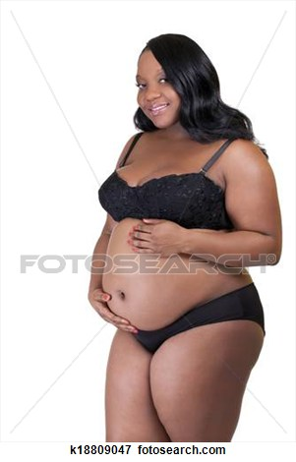
The problem with
beauty standards
The “ideal woman” has changed frequently over time.
This ideal is only realistic for a small number of people.
It suggests that only one type can be attractive.

Slide 17
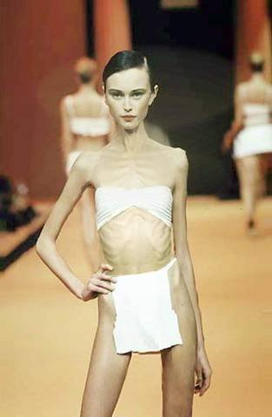
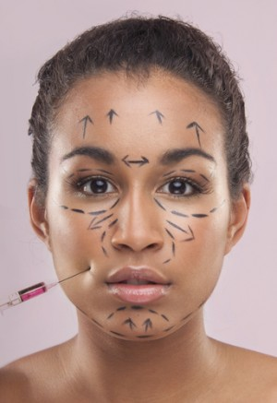
Taking it to extremes
15.6 million cosmetic procedures, including both minimally-invasive and surgical, were performed in the United States in 2014, an increase of 3 percent since 2013.
Up to 30 million people of all ages and genders suffer from an eating disorder (anorexia, bulimia and binge eating disorder) in the US.
Approximately 91% of women are unhappy with their bodies

Slide 18
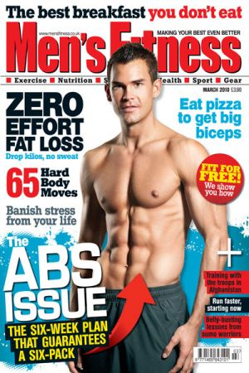
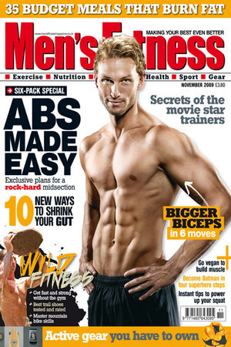
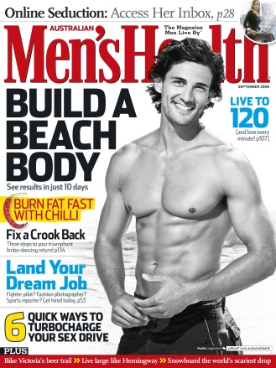
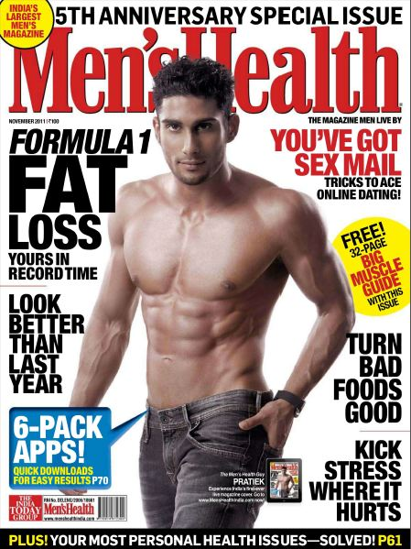
Not just a problem for women!
According to a survey…
63 percent of guys said they always feel like they could lose weight
53 percent don’t like having their picture taken
41 percent said they worry that people judge their appearance
44 percent feel uncomfortable wearing swim trunks

