Slide 1
Interview Skills
Kimberly Young

Slide 2
Before the Interview
Is it necessary to prepare before you interview a candidate, or can you just wing it?
Notes:
If you’re looking for the best candidate for the position, here are some ways that you can best prepare for the interview.
There are a variety of reasons why it is a better idea to prepare before going into the interview.

Slide 3
Before the Interview
Be familiar with the job description
What aspects of the job description are the most important to you?
What are your goals for the position and which pieces of the job description reflect that?
Try talking to others who currently work in the role about which parts of the job description are the most essential to success.
Notes:
HR matched the candidate to hand them off to you based on the qualifications section of the job description (Hand out copy of application questions.) You need to determine what in the job description is the most important to you.
Can get a copy of the job description from HR if you weren’t the one who originally wrote it.
Mark up the job description with a few key phrases describing your ideal candidate.

Slide 4
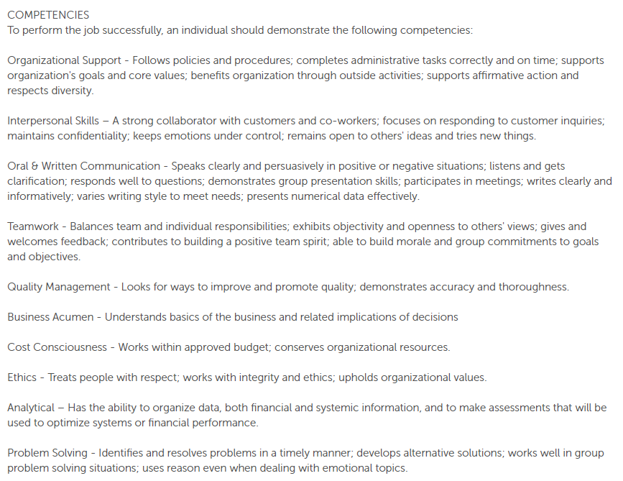
Notes:
Use the information that you’ve marked to build your questions and assess the candidates as you interview them.

Slide 5
Before the Interview
Review the
candidate’s
resume and
cover letter
What skills might they have gained from previous experiences that make them a good fit?
What might they have accomplished?
Are their job experiences different from those of a typical candidate?
Does the way they describe themselves give any indication of their priorities or accomplishments?
Notes:
Read between the lines; there’s often more to the resume than what’s there in black and white.

Slide 6
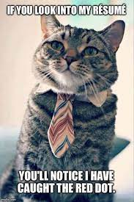
Activity: Resume Review
Find a partner.
Take a resume.
With your partner, review the resume.
Use the methods we discussed to “read between the lines.”
Prepare 3 questions you would ask this candidate during an interview to learn more about how their experiences would apply to the attached job description.
Notes:
Students should think about what skills the candidates might have, what they may have accomplished in previous positions, if their job history makes them different from a typical candidate, if the way they present themselves gives any indication of their priorities or accomplishments, etc. Have each group share at least 1 question that they came up with.
Allow 10 minutes for activity and sharing

Slide 7
Before the Interview
Look up the
candidate’s
LinkedIn
profile
There’s a lot more you can learn about a person from their LinkedIn profile:
Skills
Interests
Volunteer experience
You can ultimately use this information to make your decisions about them but be cautious bringing it up during the interview.
Notes:
Not always a good idea to directly mention something that you saw on LinkedIn because it may come across as creepy and it may not directly relate to the job they are interviewing for.

Slide 8
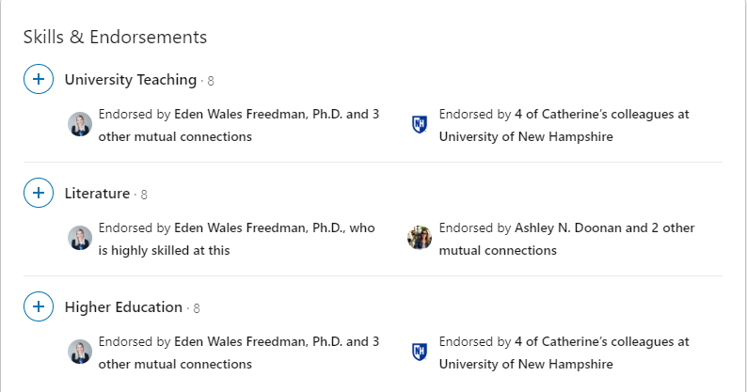
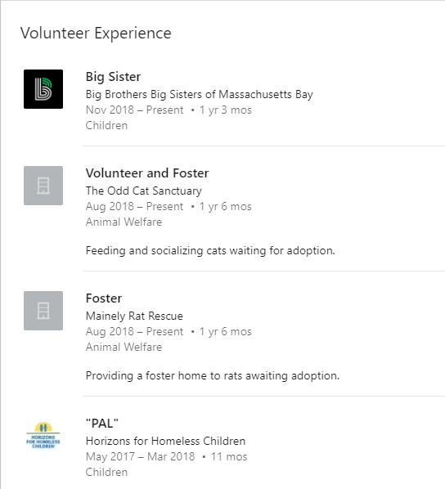
Notes:
Examples of the additional information you can find on a LinkedIn page.

Slide 9
Developing Interview Questions
Everywhere you look online, there are lists of the best and most commonly asked interview questions. How do you know how to come up with questions that will get you the best candidates for the job?
Notes:
Are questions that are used often necessarily the best ones? What makes an interview question good?

Slide 10
What Questions CAN’T You Ask?
Application covers desired salary range
Includes graduation dates and years in the military
Can only ask about ability to perform job duties safely
Be wary of questions about life outside of work
Application asks if eligible to work in USA
Notes:
Handout: Copy of chart and Word doc from HR

Slide 11
What Questions CAN’T You Ask?
If it doesn’t directly relate to the job they’re applying for, DON’T ask!
Notes:
Are we all clear on the things that you are not allowed to ask?

Slide 12
Developing Interview Questions
Start with
less challenging
questions
Interviews can be stressful, so starting with questions that will relax the candidate will set a good tone.
Tell me about your first job.
What was your favorite class in college?
What interests you about Salem Five?
Why did you apply for this job?
Notes:
Remember that the candidate is interviewing Salem Five as well, so we need to make a good first impression, too. This is also a good opportunity to clear up any misconceptions about the job duties and provide information about the company,

Slide 13
Developing Interview Questions
Some questions may seem ok, but because they don’t relate to the job the candidate is interviewing for, you can’t ask.
Tell me about your hobbies.
What do you do for fun?
What’s your favorite thing to do outside of work?
Notes:
These questions seem harmless, but are technically illegal.

Slide 14
Developing Interview Questions
Examples of open-ended questions:
Tell me about a time when you had to overcome a major obstacle.
Tell me about a time when you had to work with a difficult person.
Give me an example of a time when you contributed to a project that had a measurable impact on the organization.
Open-ended
Questions
Notes:
Ask class: what is an open-ended question?
Answer: any question that can’t be answered in just a sentence or less. We want to invite the candidate to talk and tell a story. This is how we will get the most relevant information that will help us determine if they are the best for the job.
The majority of your questions should be open-ended.

Slide 15
Developing Interview Questions
Questions should ideally prompt candidate to provide information about:
Skills
Specific experiences and accomplishments
This is a good time to focus on the skills you highlighted in the job description.
What questions might you ask if you were looking for an employee good at persuading customers?
How about an employee with enthusiasm?
Dig into candidate’s
background and
experience
Notes:
Possible answers: Tell me about the most difficult sale you ever made. / What’s the most exciting project you were ever a part of?
Handout: effective interview questions

Slide 16
Developing Interview Questions
What are some other skills/traits that we might want our employees to have?
What questions could we ask to help assess those skills?
Notes:
Write skills on the board first and then have class work on generating questions to match the skills.
Allow 5-10 minutes for activity

Slide 17
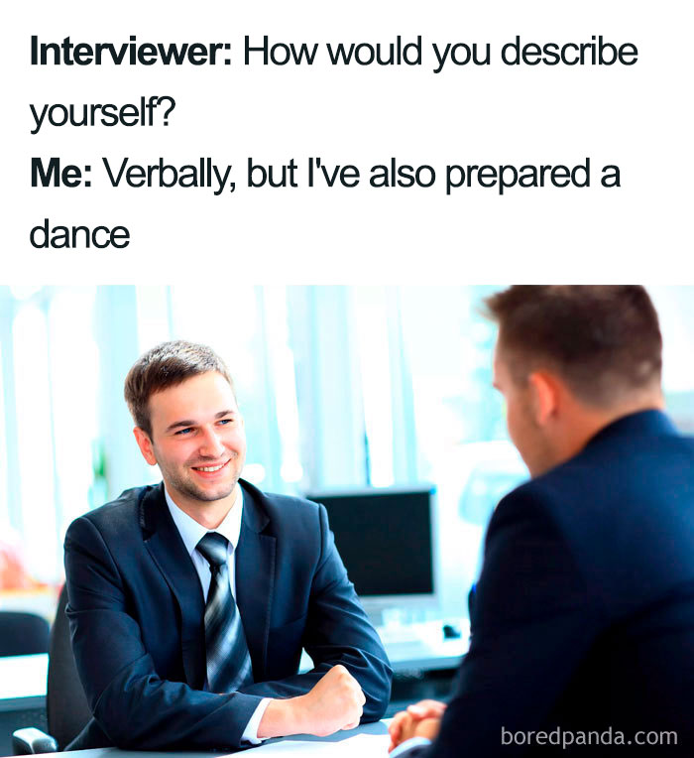
Activity: Compose Questions
Find a partner. Preferably, a different partner than in the first activity.
Take a job description.
With your partner, review the job description.
Develop 3-5 open-ended questions that you would ask the candidate during an interview to prompt them to reveal additional information about their skills, experience, and accomplishments.
Notes:
These questions should be ones that could be asked of any candidate applying for this particular job. Can use question that we developed in last activity.
Allow 10 minutes for activity

Slide 18
Developing Interview Questions
When the interview ends, how do you decide who to hire?
One way is with interview scorecards
Objective rubrics listing the important skills/traits you are looking for in a candidate
After each interview, rate the candidate on those attributes
Will allow you to objectively compare candidates and give HR more specific feedback on the candidates.
Interview
scorecards
Notes:
Scorecards can vary depending on the job you’re hiring for. Can be looking for different things at different times.

Slide 19
Developing Interview Questions
Ability to collaborate | 1 | 2 | 3 | 4 | 5
Professional when responding to questions | 1 | 2 | 3 | 4 | 5
Positive attitude | 1 | 2 | 3 | 4 | 5
Organization | 1 | 2 | 3 | 4 | 5
Creativity | 1 | 2 | 3 | 4 | 5
Logical/Analytical | 1 | 2 | 3 | 4 | 5
Notes:
Ask class: what qualities might show up on the scorecards for the candidates whose resumes we’ve been working with?

Slide 20
Developing Interview Questions
REMEMBER
While some questions and follow ups will need to be personalized (e.g. why did you leave your job at Bank of America?) it is important for legal reasons that each candidate is afforded the opportunity to answer the same set of questions. This will prevent the appearance of bias in our interview process.
Notes:
Any questions on developing interview questions before we move on?

Slide 21
During the Interview
As you are doing the questioning and listening to the candidate’s answers, there are things that you can do to make sure that you are getting all of the best information from the candidate.
Notes:
Once you are prepared, there are still things that you need to do once you sit down with each candidate.

Slide 22
During the Interview
Follow up on
what the candidate
tells you
If the candidate mentions a topic, job, or person that seems particularly important, follow up.
If a candidate gives answers that are too vague, you can ask follow-up questions to get more specific, detailed answers.
Tell me more.
What happened next?
How did you feel about that?
Notes:
Sometimes, people have pre-packaged answers they are prepared to give. Sometimes they are nervous about babbling too much so they give answers that are too short. Sometimes they just don’t know what to say. Prompt them to tell you more by asking follow-up questions.

Slide 23
During the Interview
Too many common interview questions ask candidates to list favorable attributes.
Have candidates demonstrate attributes by asking for examples.
If you had 5 projects to work on and only time for 3, how would you decide which to work on?
Tell me about a difficult coworker you’ve had. How did you manage to work with them?
What is the most complicated project you’ve ever had to work on? Explain it to me.
Ask for
examples
Notes:
Have students guess which skills the questions are trying to get at
Organization, communication/teamwork, critical thinking

Slide 24
During the Interview
If candidates try to reply to questions with hypotheticals, redirect to ask for specific scenarios.
How have you handled that situation in the past?
Have you ever dealt with a situation like that?
Give me an example of when that has happened in your previous jobs.
Ask for
examples
Notes:
Prevent the candidate from telling you what they think you want to hear. Urge them to tell you what they’ve actually done in the past. This is where you’ll learn what they will actually be like as an employee.

Slide 25
During the Interview
We need to know if candidate has adequate technical knowledge.
Find out by slipping in relevant jargon and paying attention to response to make sure they understand context
How would you go about selling a customer on the benefits of a HELOC?
What would you say to a customer who was concerned about FDIC coverage?
Use
jargon
Notes:
Can they use jargon correctly in context? Simply asking, “are you familiar with X” isn’t going to test their knowledge.

Slide 26
During the Interview
What is some banking jargon we could use in an interview?
How might we slip it into the conversation?
Notes:
Write list of terms/acronyms students come up with on board then have students jot down questions they could use to work the terms into the conversation and test the candidate’s knowledge in context. Allow 5 minutes for activity.

Slide 27
During the Interview
Use your
listening
skills
You can learn a lot if you really pay attention to what a candidate is saying during the interview, especially if you start connecting the dots.
If they only tell stories about difficult customers, what might you infer from that?
Notes:
Important to pay attention to patterns in how they are answering questions
Answer: they place too much focus on what is difficult, or they themselves have a poor attitude

Slide 28
During the Interview
Use your
listening
skills
In addition to what they say, pay attention to how they say it.
Common red flags:
Overly scripted
Interrupting
Unprofessional
Avoid answering certain questions
Give too much or not enough information
Notes:
A good interview should come across like a conversation: professional, but not overly stiff
The candidate should make every effort to thoroughly answer each question. Pay close attention if they seem to be avoiding a certain question by talking around it.

Slide 29
During the Interview
Pay attention to
nonverbal
communication
Nonverbal red flags:
Little or no eye contact
Poor posture
Crossed arms
Too much fidgeting
These could indicate lack of confidence, professionalism, or enthusiasm.
Remember: this goes both ways!
Notes:
Keep in mind that the candidate might be nervous, so a little bit of this could be blamed on nerves.
We are in a candidate’s market. We want the candidate to be excited about the possibility of working here, so the interviewer needs to come across as professional and enthusiastic.

Slide 30
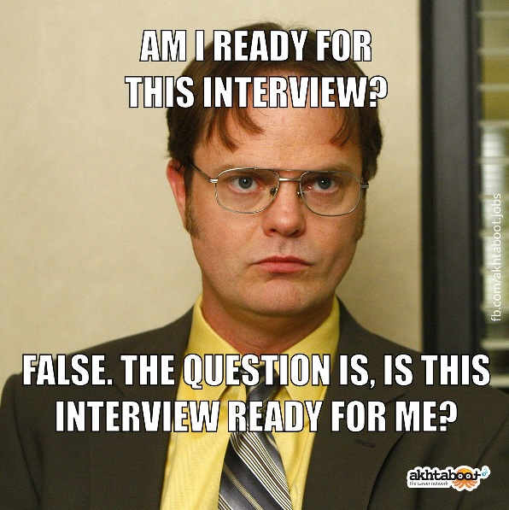
Activity: Role Play
Find a partner. Preferably, a different partner than in the other activities.
Take a resume and job description.
One partner will act the part of the candidate. The other will be the interviewer.
Role play a brief interview using the skills you’ve learned today and the questions you developed in earlier activities.
Observers will provide feedback.
Notes:
Allow each pair a few minutes to look over the resumes and job descriptions. Have as many pairs as possible perform their mock interviews in front of the class as time allows. Have the other members of the group provide feedback that could make the interview stronger. (This activity should be finished with at least 15-20 minutes of class time remaining)
Any questions on what to do during the interview before we move on to our final section?

Slide 31
After the Interview
When the interview is over, it’s time to make your decision. How do you take the information you’ve gathered and use it to choose the best candidate?

Slide 32
After the Interview
Remember that technical knowledge can be taught, but some skills, traits, and characteristics cannot.
It isn’t easy to teach someone to be personable, persuasive, or enthusiastic!
Focus on the skills they have, not what they lack.
Think about them as a whole person instead of focusing on small flaws.
Assessing the
candidate
Notes:
Use the scoring rubric to determine who has the most of the skills that you are looking for and determine if their shortcomings are in areas that can be filled in with Salem Five training or other on-the-job training.

Slide 33
After the Interview
Think about what skills or roles are missing from your current team; could any of the candidates you interviewed fill the gap?
Predictive Index could be a great asset for helping to create a well-rounded team.
Assess your
team
Notes:
Hiring isn’t just about one person. As a manager, you need to surround yourself with a team that is going to help you get the job done. Find a candidate that will fill in any skill gaps currently missing from your team.

Slide 34
After the Interview
You must have a specific reason for declining a candidate.
“Bad fit” or “too vanilla” isn’t adequate.
Good place to go back to your job description / interview scorecard to think about the skills/traits you need
Important not to show any bias during the interview & assessment process
Declining a
candidate
Notes:
If none of the candidates you have interviewed are right for the position, you need to be able to tell HR exactly what it was about each candidate that wasn’t right for the job (not enough banking experience, poor attitude, no leadership qualities, etc.) This will give you a solid basis for rejecting them and improve the candidates that HR sends through in the next round. This will also prevent you from showing any bias by making sure that your reasons for rejecting the candidate are based solidly on their background and skills.

Slide 35
QUESTIONS?

