Slide 1
A lesson in poetry appreciation
Kimberly Young

Slide 2
Imagery
Symbolism

Slide 3
Imagery
Uses language to represent objects, people, actions, settings, and ideas
Appeals to one (or more) of our 5 senses

Slide 4
Examples
The sun was as hot as if it shone in the first week of September, but a tumbling sky threw great clouds before the wind, and when the sun was obscured then all the promise of winter was in the air. (Barbara Williams, Sprig of Broom)
Her skin glistening in the neon light coming from the paved court through the slits in the blind, her soot-black lashes matted, her grave gray eyes more vacant than ever. (Vladimir Nabokov, Lolita)
It was the kind of voice that the ear follows up and down, as if each speech is an arrangement of notes that will never be played again. (F. Scott Fitzgerald, The Great Gatsby)

Slide 5
Symbolism
Descriptions that give the object, people, settings, etc. meanings that go beyond the literal
The meaning of the symbol is typically dependent on the context
Symbols can suggest important themes, motifs, and character traits

Slide 6
Archetypal symbols
Universal symbols that have common meanings
Evoke ideas or feelings that are common to the human experience

Slide 9
Symbolism
Example:
Ah Sunflower, weary of time,
Who countest the steps of the sun;
Seeking after that sweet golden clime
Where the traveler's journey is done;
Other symbols are more abstract
No commonly accepted meaning
Reader needs to use context to interpret the meaning
Different readers can read symbols differently (that’s one of the things that makes literature so fun!)
What does the sunflower symbolize?

Slide 10
Is it a symbol or an image?
Some questions to ask yourself:
Does the author seem to emphasize a particular image or come back to it frequently?
Does the image remind you of anything else or evoke a certain feeling?
Is the description of the image strictly “necessary” to understanding the text?

Slide 11
Symbolism/imagery in poetry
Poets have used symbolism and imagery in numerous different ways over the course of history
Let’s take a look at a few of the basics….

Slide 12
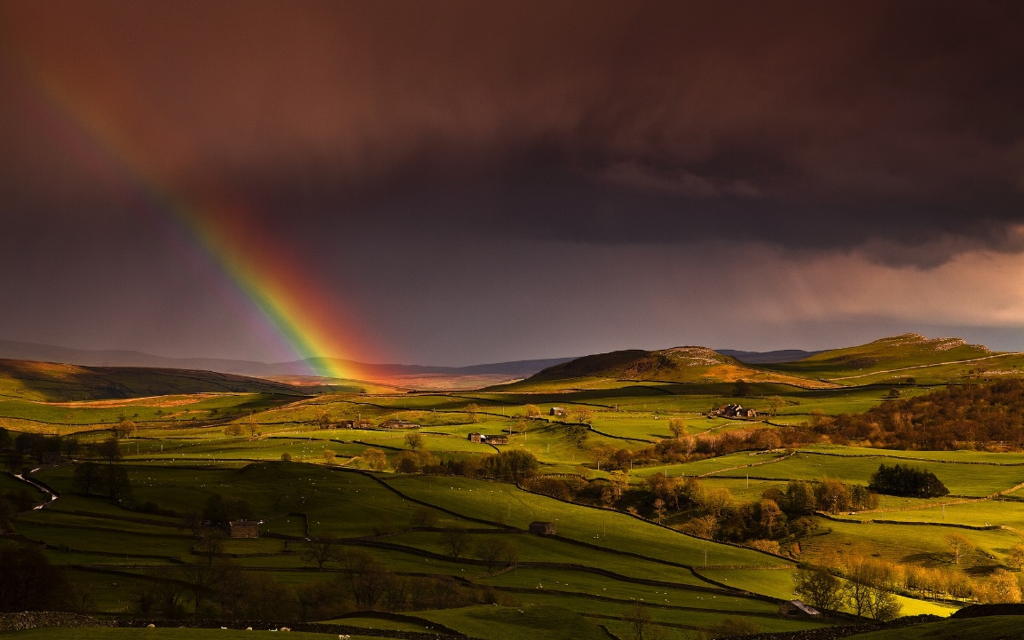
William Wordsworth, 1770 - 1850

Slide 13
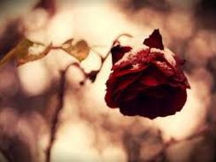
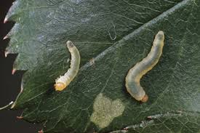
William Blake, 1757 - 1827

Slide 14
Romanticism
Used art as an expression of the mystical/divine
Relied heavily on symbolism
Particular interest in archetypal symbols

Slide 15
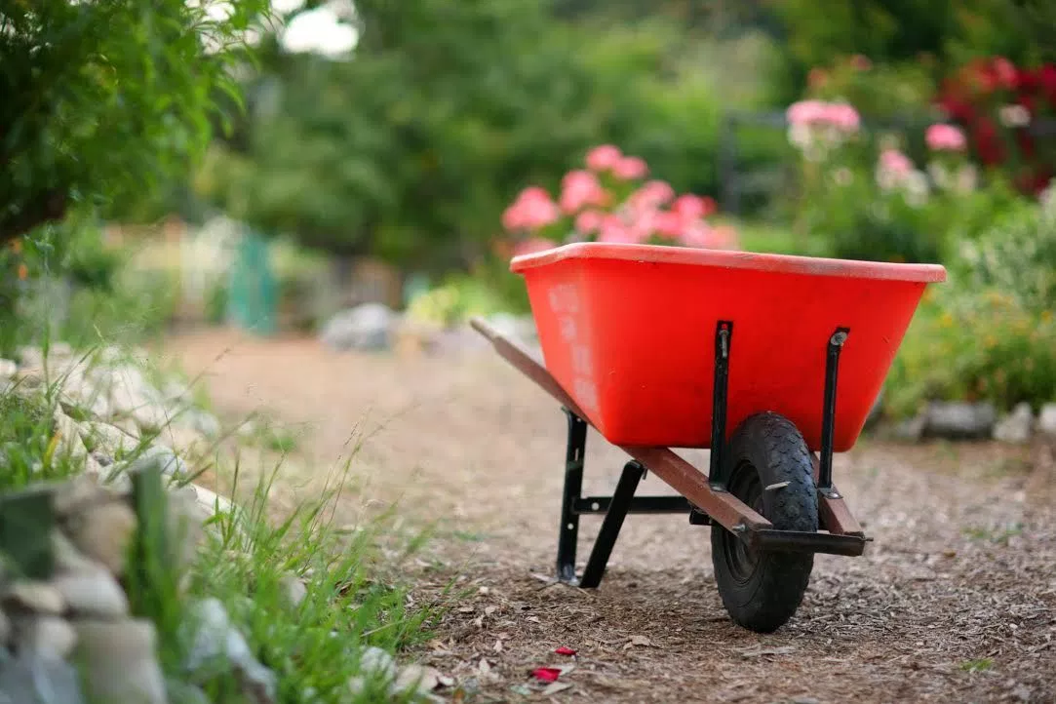
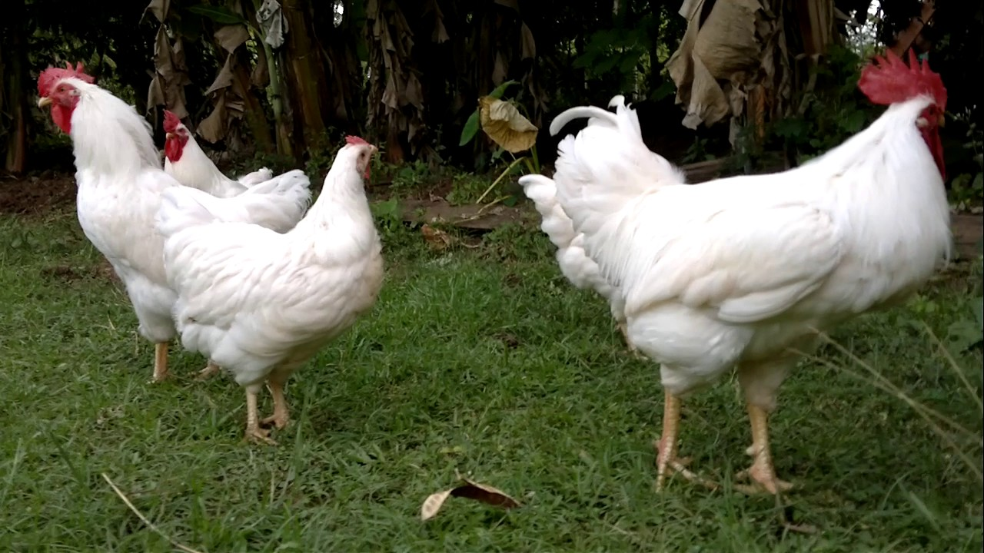
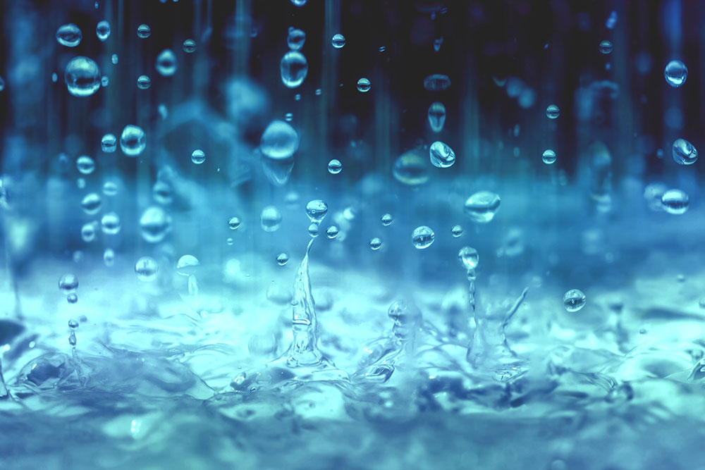
William Carlos Williams, 1883 - 1963

Slide 16
Modernism
Believed traditional art forms were obsolete
Experimented with form
Drew attention to the process of creation
“The Red Wheelbarrow” focuses on objective description
The poem’s form and its meaning are the same
Images are beautiful and worthy subjects without being imbued with symbolic meaning

Slide 17
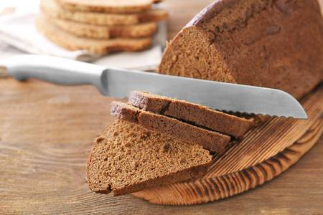
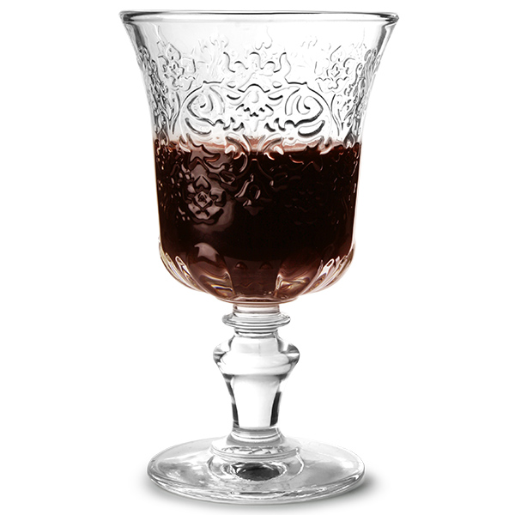
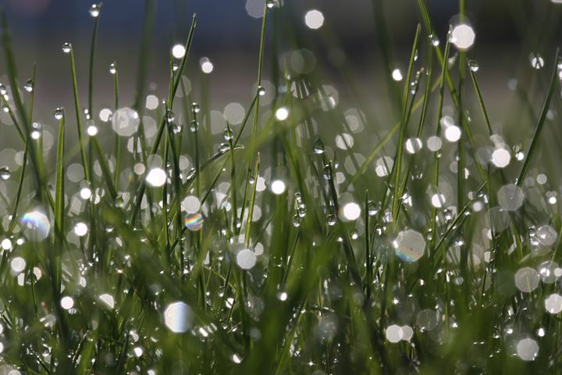
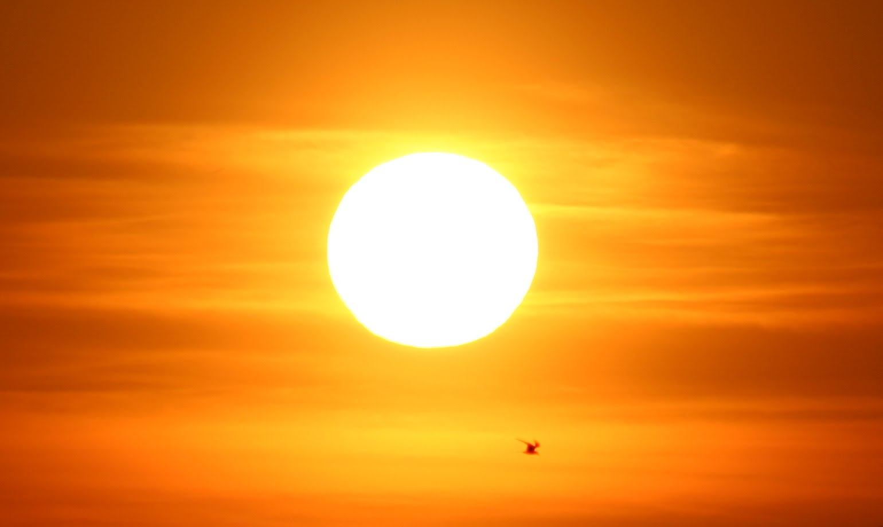
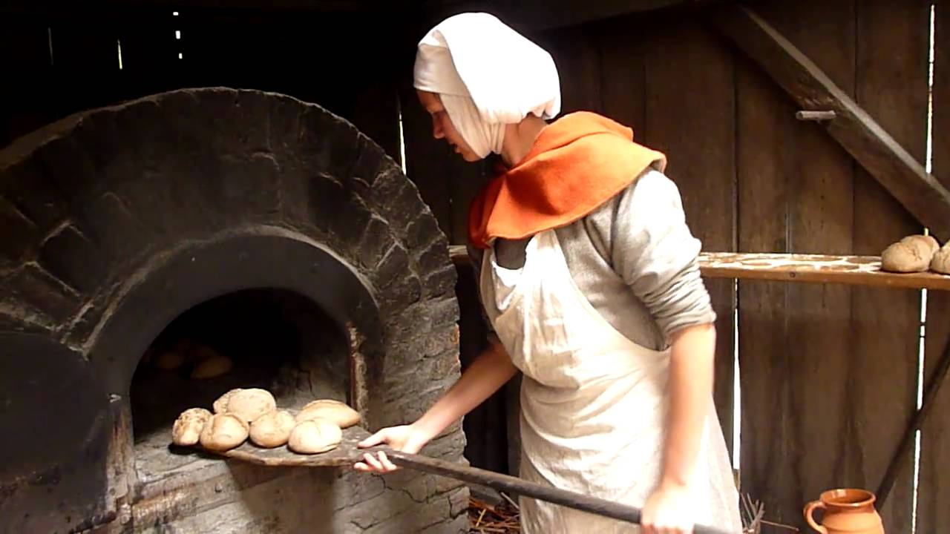
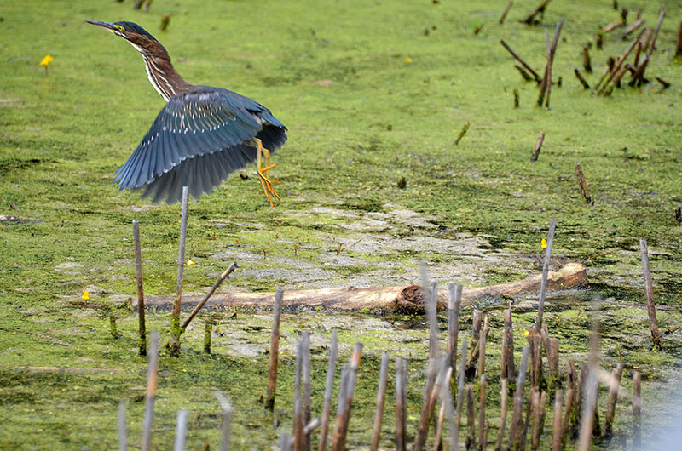
Billy Collins, 1941-

Slide 18
Post-modernism
Outright rejection of the methods of previous eras
Often treat these ideas with sarcasm or irony
“Litany” uses images sarcastically
Deliberately forms them as metaphors to suggest symbolism, but the meaning is impossible to interpret
The overwhelming number of images is meant to create a feeling of confusion in the reader, taking aim at the “arduous” task of interpreting symbolism

Slide 19
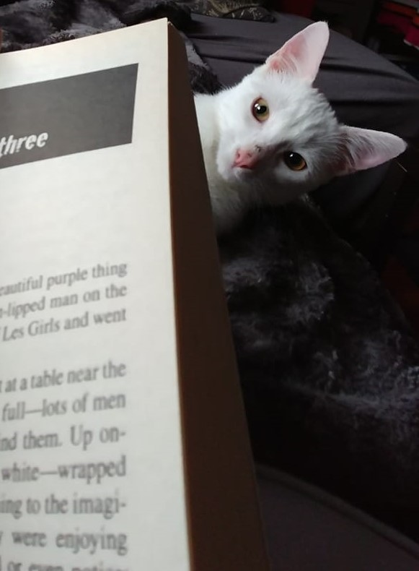
Any questions?

