Slide 1


Guide to Using Graphic Elements in Word
Kimberly Young

Slide 2


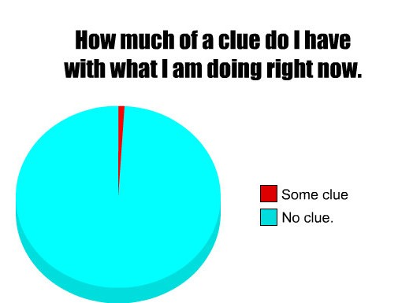
When to use graphics
How to create and use different graphics
  Tables
  Bar graphs
  Pie charts
  Photos
  Documents
Accessibility for readers with visual disabilities
How Communications uses your graphics

Slide 3
Is this graphic adding something important to the report?
Notes:
This is the most important thing that I want you to remember when this presentation is over. Any graphic that is being added to the report needs to be giving us new, important information. Relevance is key.

Slide 4
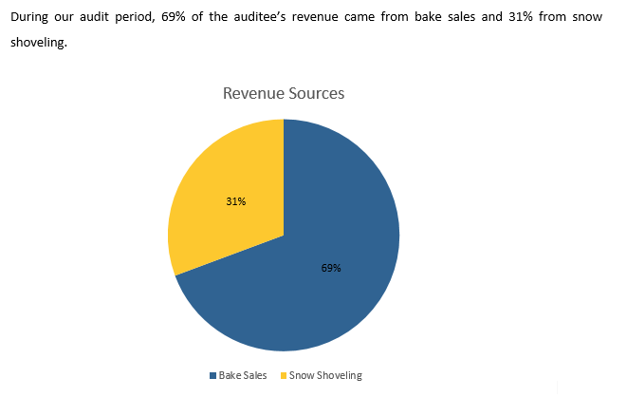
Examples
The graph gives the same information that is in the text.
Notes:
This graphic gives the exact same information that is in the text of the report.

Slide 5
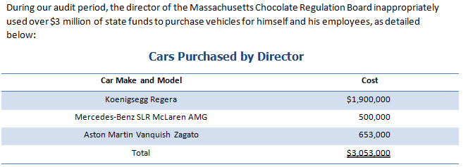
Examples
The graph gives some extra information, but it isn’t really relevant.
Notes:
This gives a little bit of extra information (types of cars) but isn’t totally relevant to the finding.

Slide 6
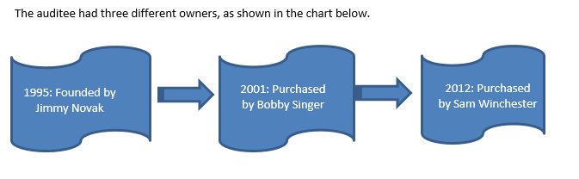
Examples
The graph gives extra information, but it could be more easily conveyed in the body of the text.
Notes:
This gives additional information, but could be more easily described in text format.

Slide 7
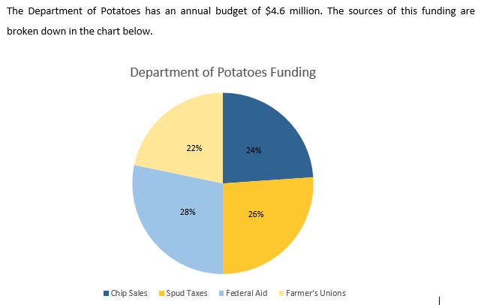
Test Yourself
This chart provides new information that is relevant.
Notes:
This chart adds new information that is relevant.

Slide 8
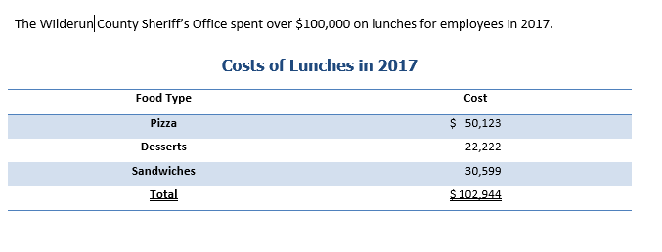
Test Yourself
This table adds new information, but it isn’t relevant.
Notes:
This table adds information, but it isn’t relevant.

Slide 9
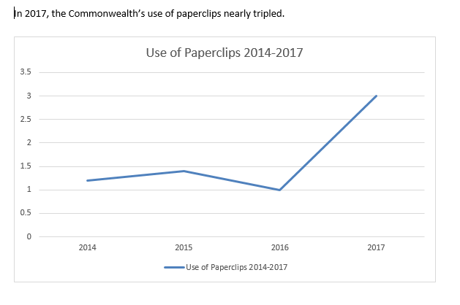
Test Yourself
This chart gives no new information.
Notes:
This adds no additional information.

Slide 10
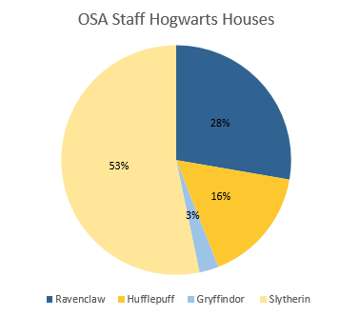
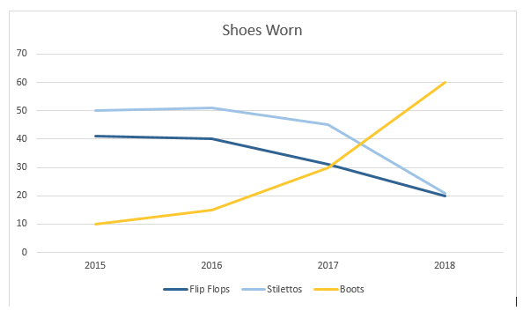
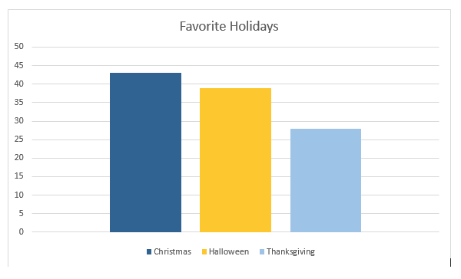
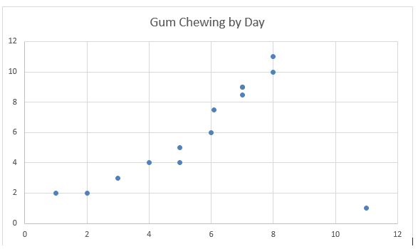
Types of Graphs/Charts
Bar Graph: Compare groups, see changes over time
Pie Chart: See relationship between
parts of a whole
Line Graph: Compare changes over time
for multiple groups
Scatter Plot: Show correlation, see
outliers

Slide 11
So how do we make graphics?

Slide 12
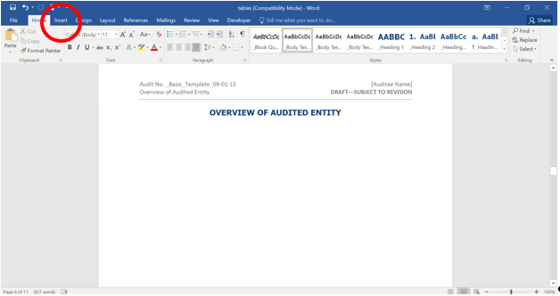
Tables
Notes:
This first step will apply to tables, charts, and graphs. In Word, in the bar at the top of the page, click on the Insert tab

Slide 13
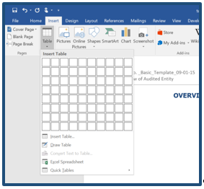
Notes:
Next, click on Table. A drop-down menu will appear. This drop-down will allow us to build a table with the number of rows and columns that we need.
Note: Be sure to take into account header rows and total rows, if they are needed

Slide 14
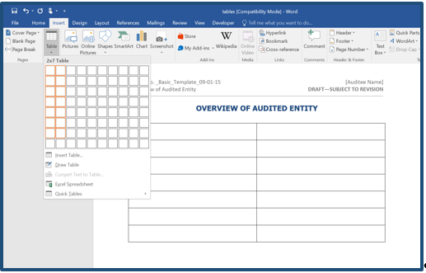
Notes:
Drag the mouse to highlight the appropriate number of cells. Clicking in the bottom-right cell you’ve highlighted creates the table:

Slide 15
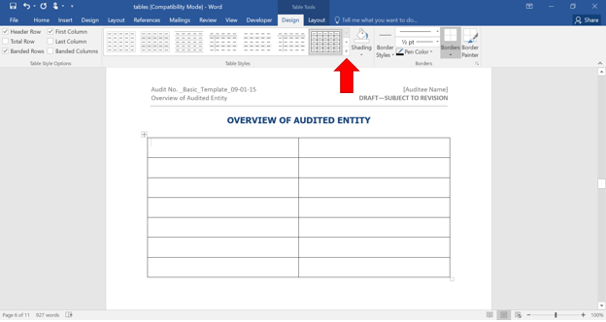
Notes:
The first step to making an OSA-approved table is changing its style. To do this, we first need to go to the Design tab, located under Table Tools.
Hint: If these tabs aren’t visible, try clicking somewhere on the table. This should make the tabs appear.
Now we should see a wide menu with many different table styles. To get to the one we want, click on the drop-down option in the bottom-right corner of the box, as illustrated below

Slide 16
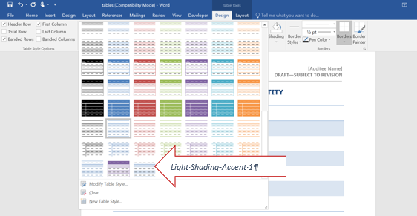
Notes:
This will bring up an even bigger list of style options. Choose “Light Shading – Accent 1”.
After clicking this option, our table should have the correct colors and borders

Slide 17
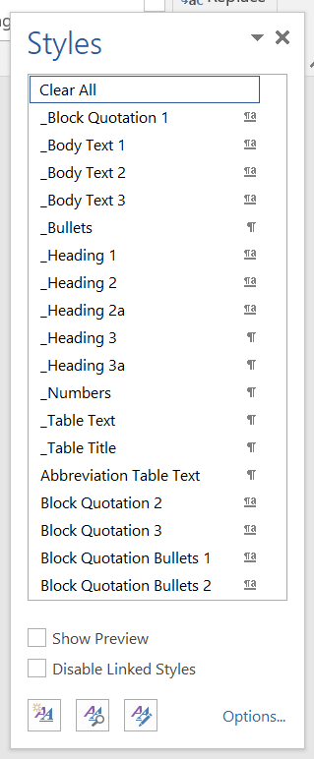
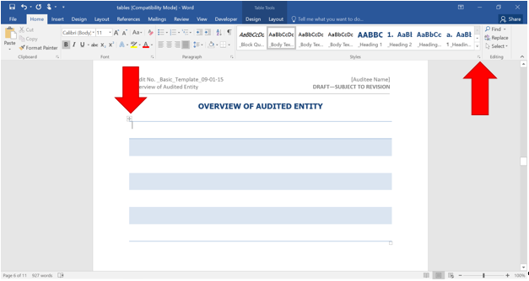
Notes:
However, there’s still one more aspect we need to change to make our table fit the OSA standard: text style.
To do this, we first need to highlight our entire table by clicking the box in its upper-left corner. Then, in the Home tab, look for the section labeled Styles and click the drop-down in the bottom-right corner.
This drop-down will give us a list of all of OSA’s text styles. For a table, choose _Table Text

Slide 18
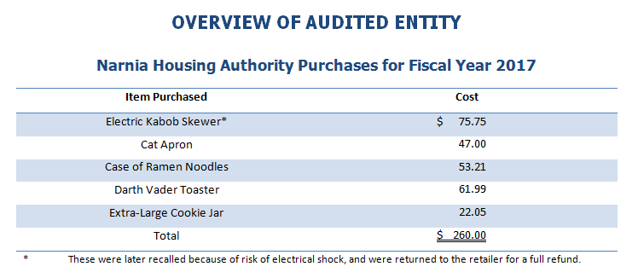
Table title
Headings
Table Notes
$ Signs
Totals
* (asterisk)
† (dagger)
‡ (double dagger)
§ (section mark)
|| (parallels)
# (number sign, or pound)
Notes:
This example has all of the things that we need for a correctly formatted table. We have a table title and headings, which we talked about. I’m going to talk here about a few things that Editing always takes care of, but these are things that are important in making the table look just right. Note the way that we’ve included a table note. If you want a note in your table, it shouldn’t be a footnote. It should be a table note directly under the table using symbols instead of numbers. Editing always checks and fixes these things, but if you’re interested, these are the correct symbols. Also note that there are only $ on the first and total rows. Speaking of totals, note that the total is double underlined (a subtotal would be single underlined).

Slide 19

Some notes on using tables
If you create your table in Excel, do not paste the table into the report as a picture
  No longer read by screen reader
  Also makes it impossible for us to edit it in Word
If you use something in a table that came from another source, this information must be cited.
Notes:
How to know if it’s in as a picture: double click on it and see if you can edit it.

Slide 20
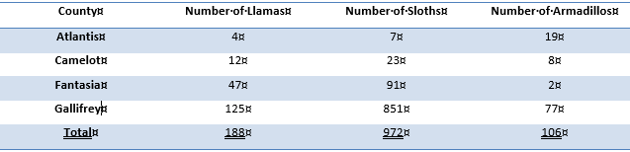
Test Yourself
No table title!
Notes:
Table is missing a title

Slide 21
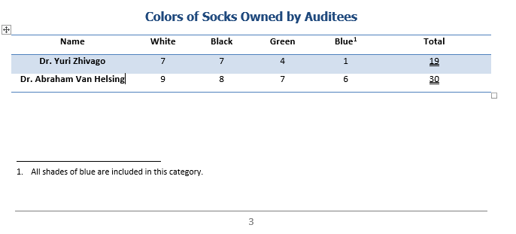
Test Yourself
This should be a table note, not a footnote!
Notes:
Uses footnote instead of table note.

Slide 22
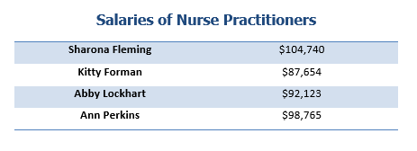
Test Yourself
Header row is missing!
Notes:
Table is missing a header row. This is also a nice example of what a table should look like when there is not total row.

Slide 23
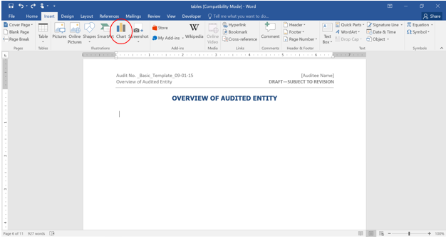
Bar Graphs
Notes:
For any type of chart, we’ll start by clicking on Chart in the Insert tab.
This will bring up a dialogue box with all of the chart options listed along the left side. For a bar graph, click on Columns

Slide 24
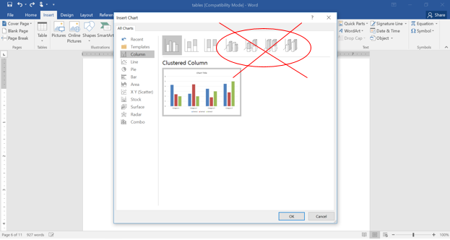
Notes:
As we can see in the picture below, along the top of the box, there will be several options for bar graphs. Toward the end of the list, we’ll see some very fancy-looking options with awesome 3-D effects: DO NOT USE THEM!!! They may look super-cool, but they do not fit OSA standards.

Slide 25
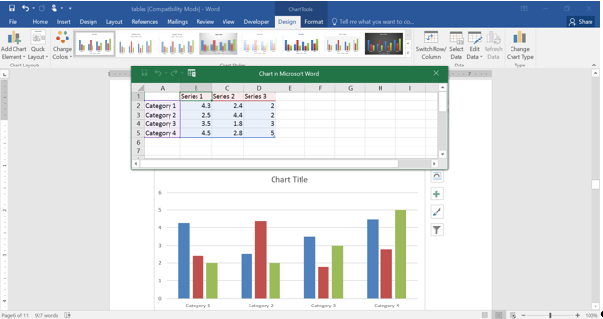
Notes:
After we choose the graph type that best fits our needs, Word will automatically bring up an Excel spreadsheet where we can input our data.
As you can see in the above photo, the default labels are all generic (Series 1, Category 1, etc.). Make sure that you replace these in the Excel spreadsheet with the correct labels. You can also use more/less rows/columns if you need more. Also, don’t forget to change the title of the chart. You can do this after closing the Excel pop-up box.

Slide 26
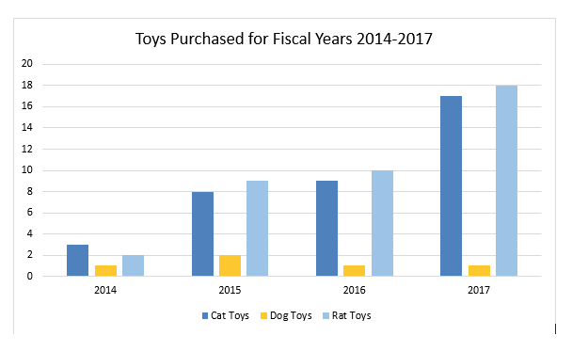
Notes:
Once our data is in, Word will generate our chart. However, the default color scheme is not the OSA standard. You can at this point change the colors so that they are using the standard colors we now use, but you don’t have to. There isn’t currently a template for them, so Editing can handle that for now!
Note the labels on the axis to transition to next slide.

Slide 27

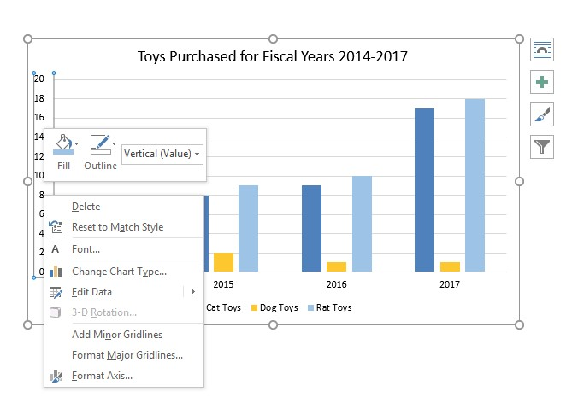
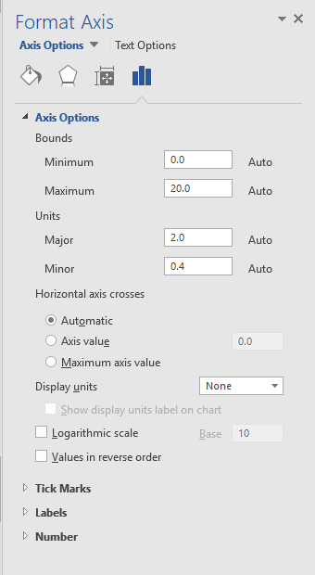
Notes:
It is important to have any axis labeled so that the reader can understand the chart. If you want to change the default labels, right click on the axis. The box that pops up will give you the option “format axis” That will bring up this box on the right side of the page. There you can make any changes that you need. Note however, that the axis should start at 0. The reader expects the axis to start at 0, and doing otherwise will create a graph that is misleading.

Slide 28
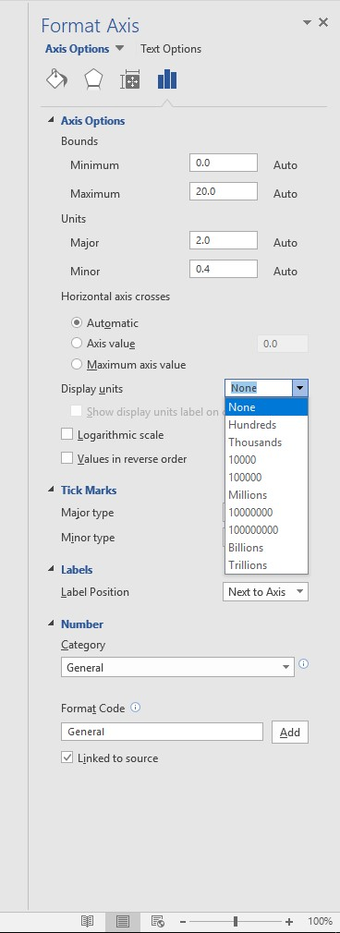
Notes:
One thing you can do with your axis is add a label telling us what the axis represents. One thing you can do is change the units that are displayed, as you can see here. This can be especially helpful if the numbers are very high.

Slide 29
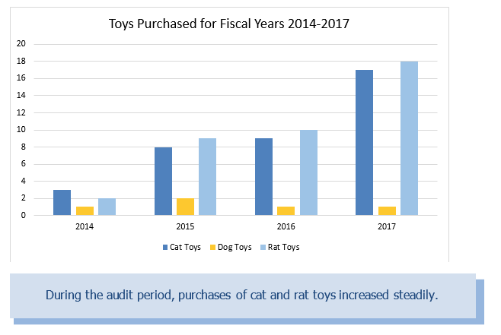
Axis labels
Title
Grid lines
Axis starts at 0
Caption
Notes:
Note that we have a title, axis labels, and axis that starts at 0. Also, note that we have grid lines running across the chart. This is to make it easier to read the chart. Also, note that we’ve included a caption. This relates to accessibility for readers with visual impairments, which we’ll get to in a bit. For now I’ll just say that it’s very helpful to include a caption when there’s a graph or chart that gives the major take-away point. This is also a great way to test whether the chart is really necessary. If you can’t sum up in one sentence why you put in in there, you probably don’t need it in the report.

Slide 30
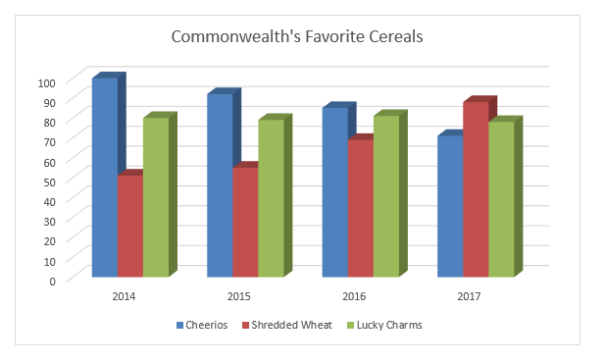
Test Yourself
3D effects!
Notes:
Uses 3d bars and colors that don’t fit OSA standards.

Slide 31
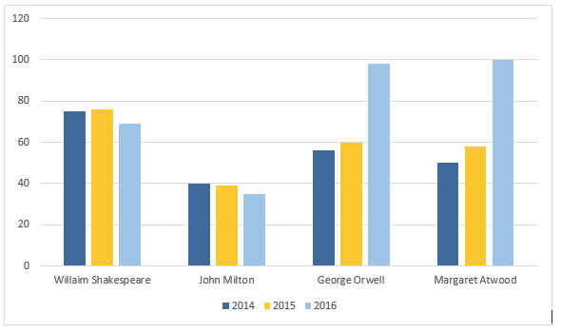
Test Yourself
Missing table title!
Notes:
Missing Table Title

Slide 32
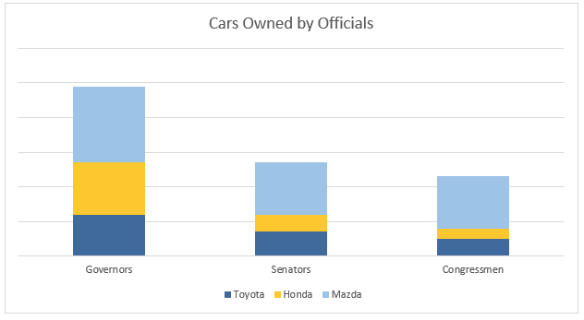
Test Yourself
Missing labels!
Notes:
Missing labels for vertical axis

Slide 33
Pie Charts
The steps for creating a pie chart are almost identical to those for creating a bar graph.
First, go to the Insert tab and click Charts.
From the list of options on the left side of the dialogue box, choose Pie. DO NOT choose one of the options with 3-D effects.
Then, insert the data in the spreadsheet and update the color scheme to fit OSA standards if you want (but you don’t have to).
Note that the title of the chart appears at the top of the second column in the spreadsheet.

Slide 34
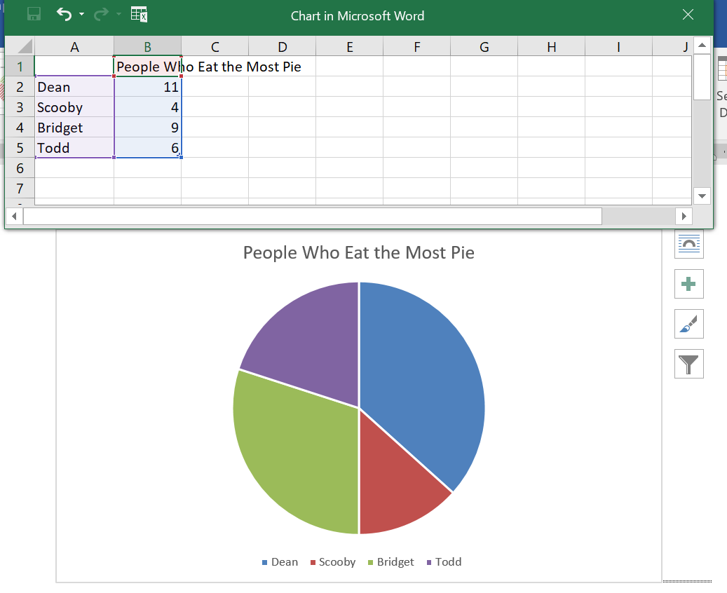
Notes:
Right here is where you’ll see the space to change the table’s title.
Notice here that there’s a space between the slices of the pie.

Slide 35
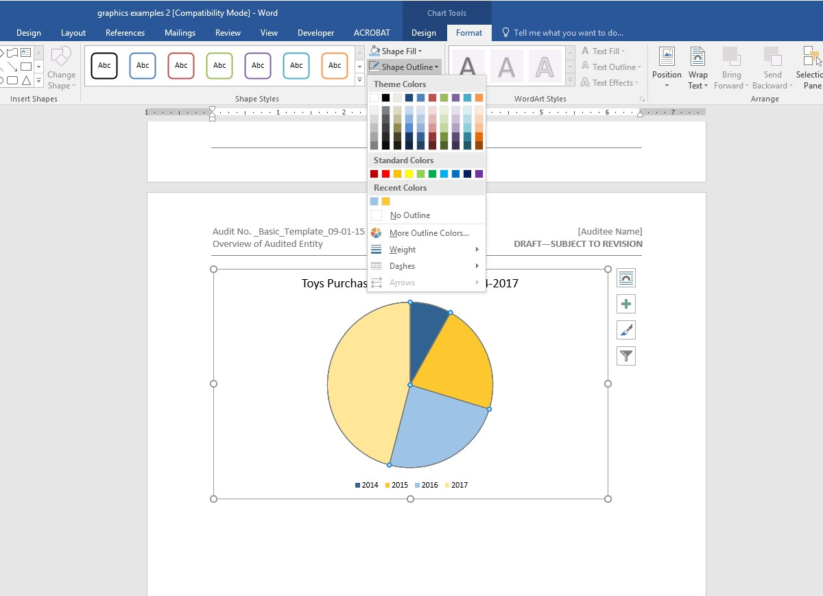
Notes:
The default style places white space between the sections on the chart, which is not standard OSA style. To fix this, go to the Chart Tools tab and click the Format tab. Note that if chart tools aren’t showing up, you can click anywhere on the chart and they’ll appear. Click on the option for Shape Outline (in the Shape Styles area) and choose No Outline, as shown here.

Slide 36
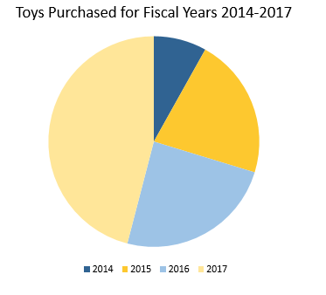
Notes:
While this is a perfectly nice chart, now we’re going to talk about something extra that we can add that is especially useful in a pie chart: labels

Slide 37
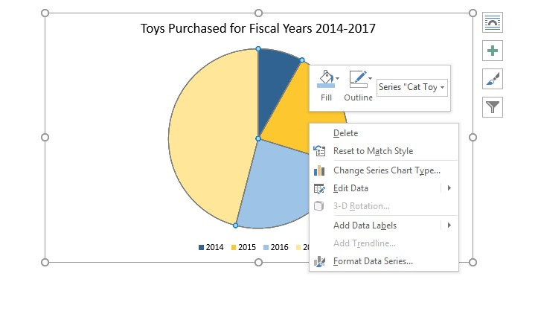
Notes:
To add labels to our chart, right-click on the chart and select Add Data Labels. This will label the chart with simple numbers. To change them to percentages, right-click again and select Format Data Labels.

Slide 38
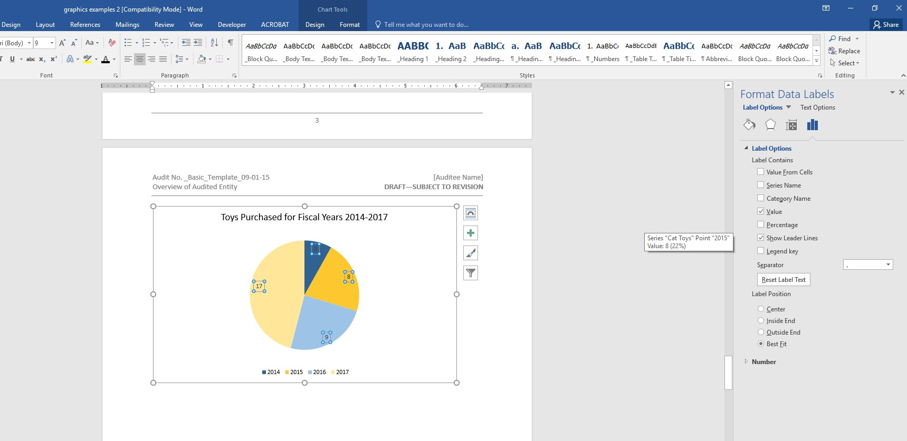
Notes:
This will bring up a menu with options for changing our data labels. We can select “percentages” and de-select “value.” You could also have both checked if you want and both will be displayed on the chart. There are also other options to create different types of labels.

Slide 39
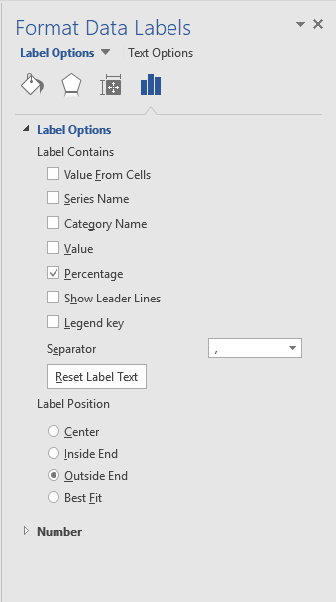
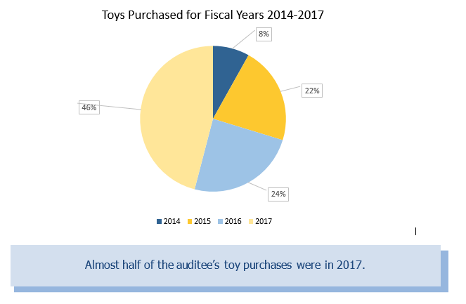
Notes:
For example, the previous example showed the percentages inside the chart, but another option is to use leader lines. To make your chart look like this, right click on the chart and select format data labels. This will bring up this box again. You can see an option for show leader lines. You’ll also want to go down to label position and select outside end to make the chart look like this.

Slide 40
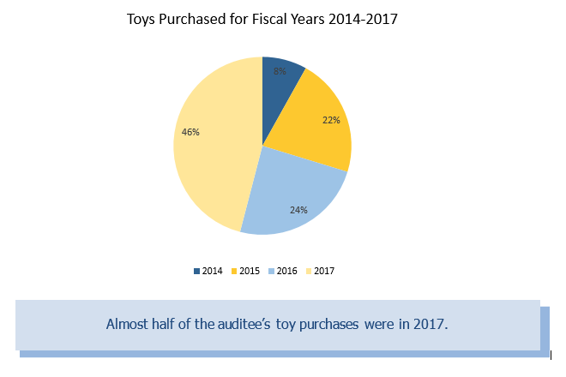
Title
Legend
Caption
Notes:
This chart has a title, as well as a legend. This is important for understanding the chart. Note that for this chart, we’ve used a slightly different caption. Most likely, if we’re using a pie chart, we’re more interested in the relationships specific categories have to the whole than in the amounts. Thinking about why we chose the type of graphic that we did can help us determine what to include in our caption.

Slide 41
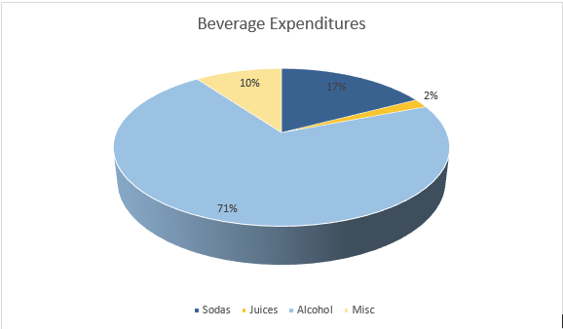
Test Yourself
3D effects!
Notes:
Uses 3D format

Slide 42
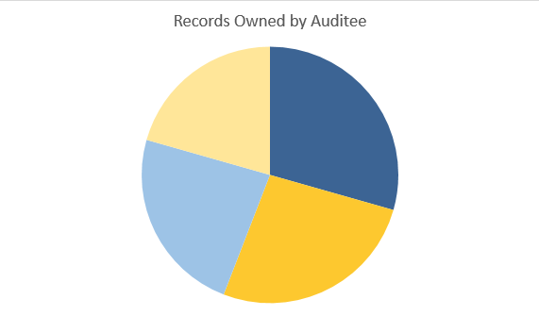
Test Yourself
Missing legend/labels!
Notes:
Missing labels

Slide 43
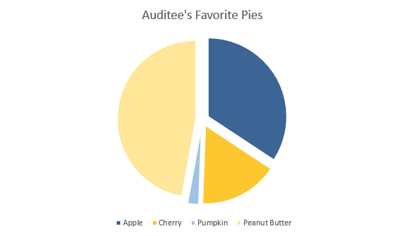
Test Yourself
Extra space!
Notes:
Spaces between slices

Slide 44
Photos
To insert photos, follow these steps:
Go to the Appendix.
Create a table with two columns, and as many rows as we need (one row per photo). Keep this table plain, without any styles or formatting.
Once the table has been created, insert the photos in the left column by using the “Insert” option and type the captions into the right column.
Note that if you have an odd size photo that doesn’t fit well in a table, call up Editing and we will assist you.
Notes:
In some cases, a finding might be easier to understand if we include photographs or scanned documents. These types of graphics are acceptable according to OSA standards; however, as with any other graphic, make sure that photos and documents are relevant to the report and add something to the text.
For both photos and documents, an important OSA rule to remember is to always put these graphics in an appendix rather than in the body of the report. Because these graphics take up a lot of space, they can distract from the finding if not placed in an appendix.
When using photographs, it is important to include captions that describe what is in the photos and give the reader an idea of why the photo is being included.

Slide 45
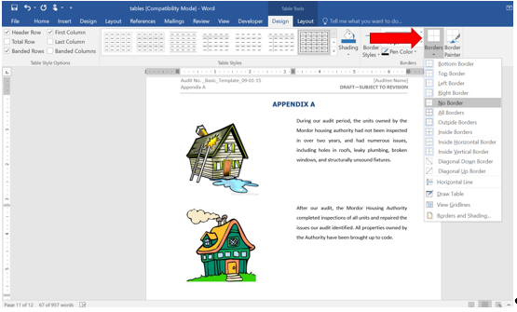
Notes:
After our photos and captions have been added to the table, navigate to the Table Tools tab and click on Design.
Hint: If these tabs aren’t visible, click on the table and they should appear.
Click on the drop-down labeled Borders and select No Borders. This will make the outlines of the cells invisible.
Note: The entire table must be highlighted/selected before we can remove the borders.

Slide 46
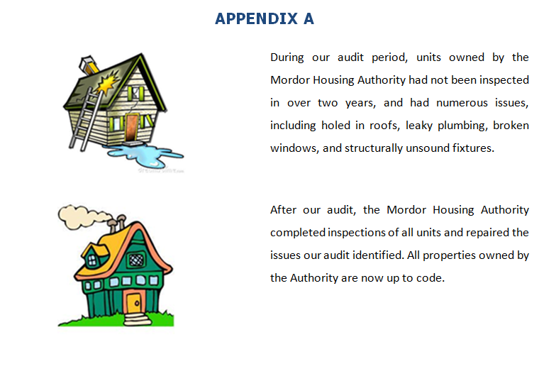
Notes:
This is an example of how the finished product should look.

Slide 47
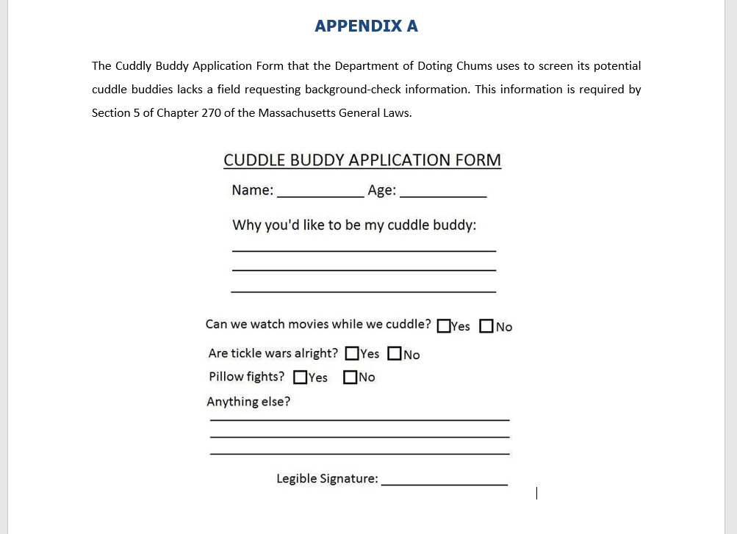
Documents
P
A
G
E
M
A
R
G
I
N
S
Notes:
Including a document in the report follows similar rules, but with a slightly different format than photographs. We should still place the image in an appendix and include a caption that describes the document and tells readers what they should know about it. However, because a document is likely to be larger than a photograph, we wouldn’t use a table format.
As this example illustrates, one easy way to include a caption for this type of graphic is to write a brief paragraph before the image that provides the necessary information.
Note that in this example, the caption directs the reader by pointing out exactly what aspect of the document is problematic, explaining why we’ve chosen to include it.
One way to avoid having to include a caption for visually impaired readers is to actually copy/paste or type the text into the report instead of using an image, if it’s possible.
One other thing to note: do not change the page margins, even if the document doesn’t fit. Just shrink the document instead.

Slide 48


Accessibility
Notes:
Office on Disability informed us that we are not up to par according to the Americans with Disabilities Act. They noted that it’s important that our reports are accessible to visually impaired readers so that everyone has equal access to the information on state agency websites. There are also liability issues at stake. For these reasons, OSA is being proactive about making reports accessible.

Slide 49
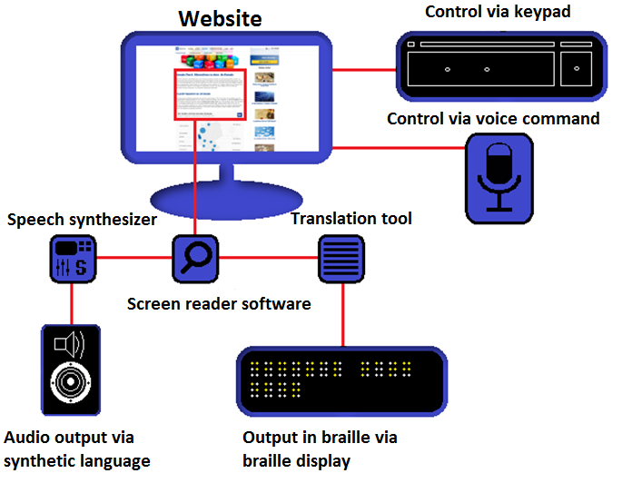
Accessibility
Screen Readers
Source: 1&1 Digital Guide
Notes:
Screen readers are software programs that allow blind or visually impaired users to read the text that is displayed on the computer screen with a speech synthesizer or braille display. The tough part about working with screen readers is that they can only pick up text. If there is an image on the page, the best it can do is to read the alternate text provided by whoever made the website, if there is any. For older OSA reports, the accessibility team has to create its own alternate text to make the report accessible. That means that if you put a graphic in a report without any kind of caption, one of your colleagues (who knows little about the audit) has to figure out what you wanted to say with your graphic.

Slide 50
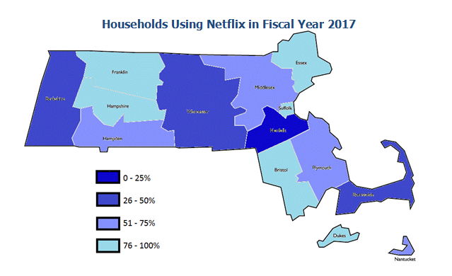
Accessibility
Notes:
Most of the time maps are problematic. They are not at all easy to make accessible. If you want to include a map, really think about what it’s adding to the report.

Slide 51
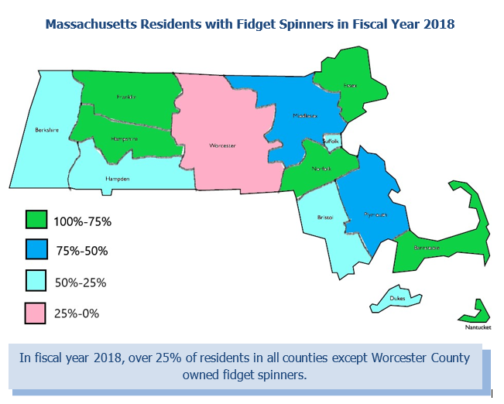
Accessibility
Notes:
However, sometimes maps can be useful. If the map can be easily summed up in a short caption, go ahead and use it!

Slide 52

Accessibility
A majority of consumers use either Netflix or Hulu streaming services.
Notes:
Pie charts are hard to translate, but captions can help. The best way is to use a text box like this to sum up the takeaway from the chart.
However, note that while the caption is useful for helping the reader understand the main point of the text, it still can’t give them all of the detailed information that the graphic does. For this reason, it is still important to use such graphics sparingly.

Slide 53

How can we caption this?
Supernatural viewership steadily increased during the audit period.
Dr. Who had the steadiest viewership during the audit period.
Sherlock viewership dropped significantly during the audit period.

Slide 54

How can we caption this?
Despite a critical chair shortage, the Chair Department had the second-lowest budget during the audit period.
Almost half of the county’s budget went to the Rat Department.
Although it is the smallest department in the county, the Yoga Department received over a quarter of the county’s budget.

Slide 55


Accessibility
Make your point with
words!
Notes:
Left: colors are a problem. Right: possible solution.
A tip that will help with this and with every other graphic: make your point with words. A screen reader can only pick up words, so if you’re using text to make your point, you know that you’re in good shape.

Slide 56

A final note…
Notes:
Remember coworkers who need to make these fully accessible. A lot of work goes into that step of the process, so keeping these tips in mind is important.

Slide 57

Questions?

