Slide 1
Personal branding
Kimberly Young

Slide 2
Notes:
10 Most recognizable logos in the world
What do they all have in common?
Not only do they make us think of a particular brand; they also bring to mind specific qualities and characteristics that the brand is known for.

Slide 3
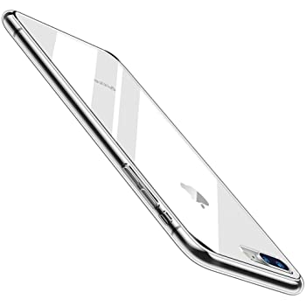
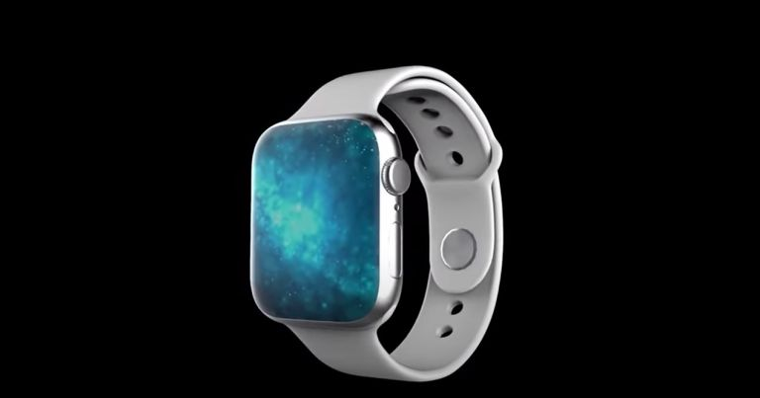
Apple wants to be known for sleek, clean machines
Notes:
Modern design of Apple’s logo reflects the company’s desire to be known for sleek, clean, minimalist product designs
Original apple logo contained a rainbow spectrum, a nod towards Apple’s computer Apple II which was the world’s first computer with color display.

Slide 4
Your brand needs to say something about
WHO YOU ARE
Notes:
Most important rule of personal branding: your brand needs to reflect you and what unique things you can offer.

Slide 5
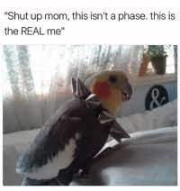
Uncover the Real You
What distinctive, beneficial traits can you offer?
What are your values, passions, goals, and strengths?
What unique experiences have you had?
The answers to these questions will show you how to become uniquely in-demand in your industry.
However, be honest with yourself, because only an authentic brand will succeed.

Slide 6
Uncover the Real You
DO THIS | NOT THAT
DO work your quirks. Understand what makes you stand out and use it. | DON’T think of yourself as your job title. If you do, you’re a commodity, not a brand.
“So you’re a little weird? Work it! Own it! Better to be a nerd than one of the herd!”
-Mandy Hale, NY Times best-selling author
Commodified: Meets the basic need
Customized: Delivers extra value
Branded: Creates unique experience
Notes:
Your goal is to move from being a commodity, to being branded. Do this by delivering extra value and creating something unique
If you only define yourself by your job title, you need to make your brand more personalized

Slide 7
Understand Perceptions
Identify the people in your network who are the keys to your success and discover how they think of you.
What words or ideas come to mind when they think about you?
Then, adjust how you present yourself so that every word and action is on-brand.
Notes:
Start where you are: find out how people currently think of you so you can change your behavior and presentation to match how you WANT them to think of you

Slide 8
Your Brand Community: The 5 Ds
Disciples
Decision-makers
Discoursers
Decision-makers: hiring managers, senior leaders
Doyens: thought leaders in your field
Disciples: employees, mentees
Defenders: mentors, close family, friends
Discoursers: authors, speakers, bloggers
Doyens
Defenders
Notes:
You need people from all of these groups to be part of your community; have at least a few names in each of these categories

Slide 9
The 3 Ps
Purpose
Performance
Success
Perception
Notes:
Purpose: what drives you
Performance: technical skills, soft skills
Perception: what people think about you
All three of these pieces are vital to creating a successful brand that showcases what you can do.

Slide 10
Deliver Your Brand
Communication is the cornerstone of relationships, so tell your brand story through a variety of media
Everything you do should support your brand.
Your story should include your accomplishments, values and passions, strengths, unique attributes, quantifiable facts, and testimonials/awards.
Notes:
The more focused your brand identity is, the easier this will be

Slide 11
Forms of Communication
Listening
Long-form writing
Email
Public speaking
Telephone
In-person / discussion
Texting / Instant messaging
Video
Social media
Notes:
Think about which form is the right one for the situation
Make sure you develop skills in all of them

Slide 12
The 6 Content Buckets
Accomplishments
Superpowers
Quantifiable facts
Values & passions
Differentiation
Validation
Notes:
What you share online should encompass these 6 buckets
Accomplishments: what have you done?
Values/passions: what matters to you?
Superpowers: what are your signature strengths?
Differentiation: what is appealing about your background, work, story, personality?
Quantifiable facts: sales figures, budgets, number of presentations, etc.
Validation: quotes, awards, testimonials, accolades

Slide 13
The Digital-First Phenomenon
First impressions are often digital, so your virtual and in-person brands should be consistent.
Think about how you look on Google:
Are the results for your name plentiful, relevant, and diverse?
Do you stand out from others who share your name?
Are accolades from others part of your Google presence?

Slide 14
Your Google Quotient
Volume
How much content do you have on the web?
Relevance
Does your content matter to stakeholders?
Purity
Does the content that appears refer to you?
Diversity
Do you have video, images, presentations, documents?
Validation
Do others validate what you’ve said about yourself?
Notes:
Consider all factors when examining how you show up on google

Slide 15
LinkedIn: Your First Impression
LinkedIn allows you to make connections, be part of important conversations, highlight your expertise, feature your accomplishments, and learn about topics relevant to your career.
LinkedIn is often the first result when people Google your name, so make your profile remarkable.

Slide 16
LinkedIn is your…
Agent: delivers your first impression
Business developer: connects you with people who need what you offer
Professional association: allows you to be part of communities and conversations
Publicist: lets you showcase your point of view
Graphic designer: paints a 3D portrait of who you are
Reference check: allows other to validate your accomplishments
Mentor: helps you learn and grow

Slide 17
LinkedIn: Your First Impression
There are 3 easy ways to create a dazzling LinkedIn profile:
Invest in a professional headshot.
Make people want to read more by adding keywords and personality to your headline.
Put some pizzazz into the first three lines of your summary. In the body, include your specialties and endorsements in addition to the basic facts.

Slide 18
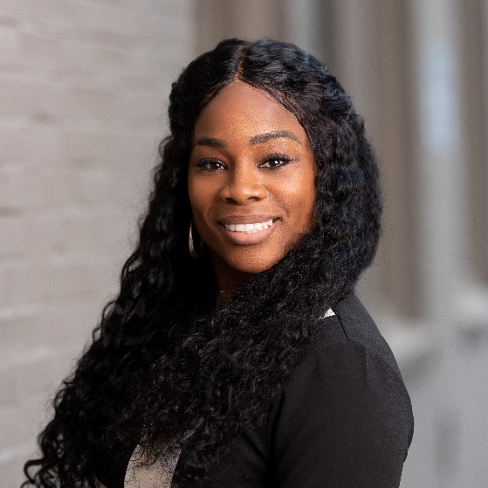
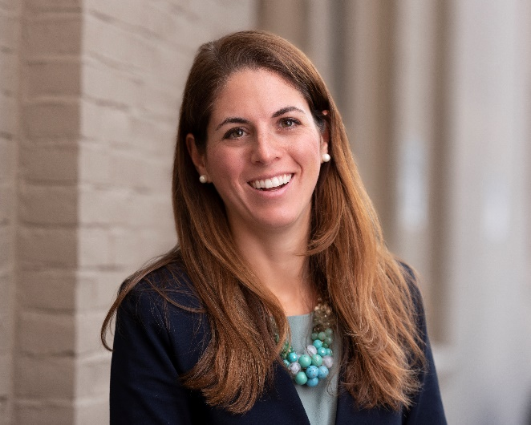
The Power of Pictures
LinkedIn profiles with headshots get 21 times more views.
Your headshot should be professional and current, showing you facing forward, smiling, and posing in front of a good background.
Notes:
Background should be neutral
Use a professional, not a selfie!
No one else (including animals) should be in your photo
Smile!
Choose professional clothing, but don’t be afraid to show a little personality

Slide 19
Your First Line
Purpose
Promise
Punctuated list
Point in time
Passion
Provocative phrase
Notes:
Use one of these 6 categories to create your opening line. Examples:
Purpose: People are my business
Promise: I accelerate your business through the power of people
Punctuated list: Lifelong Learner. Loyal Corporate Citizen. Curious Questioner
Point in Time: I was working at a startup in 2005 when I first learned about project management
Passion: Five, Seven, 83. Those are the number of languages I speak, countries I’ve lived in, and major cities I’ve visited.
Provocative phrase: My business is going downhill--fast

Slide 20
The Power of Pictures
You can also use social media to share images such as infographics you’ve created that relate to your personal brand.

Slide 21
Image Tools
Free/low-cost image sources:
Pexels
Unsplash
Pixabay
iStockPhoto
Photo editing tools:
Canva
PicMonkey
Fotor
Adobe Spark
PhotoFunia
PIXLR

Slide 22
Personal Brand Identity
As part of your visual branding, build your personal brand identity system by choosing colors, fonts, textures, and images to represent your brand.
Take time to think about what each element conveys, and use them consistently across all communication media.
Notes:
The colors and font in the Baskin Robbins logo suggest fun, youthfulness, etc.
The number “31” is also hidden in the logo, reflecting the number of flavors

Slide 23
Rich Media Content
Video is the communication medium of the future, so use it to engage with your audience.
Videos help build trust and engagement, and there are many tools to help you produce quality footage.
Consider using videos for team updates, event invitations, your bio, and pitches and proposals. Using video is an easy way to set yourself apart.

Slide 24
Rich Media Content
Ways to use video:
Team updates
Invitations
Video bios
Vlogs
Proposals
Fun Fact: According to a research report, a 1 minute video is worth 1.8 million words!

Slide 25
Build a Following
“Your network is your net worth.”
-Porter Gale: author, speaker, and entrepreneur
The first step to making sure that your brand message reaches a large audience is to assess your current on- and off-line networks.
Make sure that you’ve added all of your contacts on LinkedIn and join social media groups to diversify your network.
The larger your network is, the more visible your brand message will be.

Slide 26
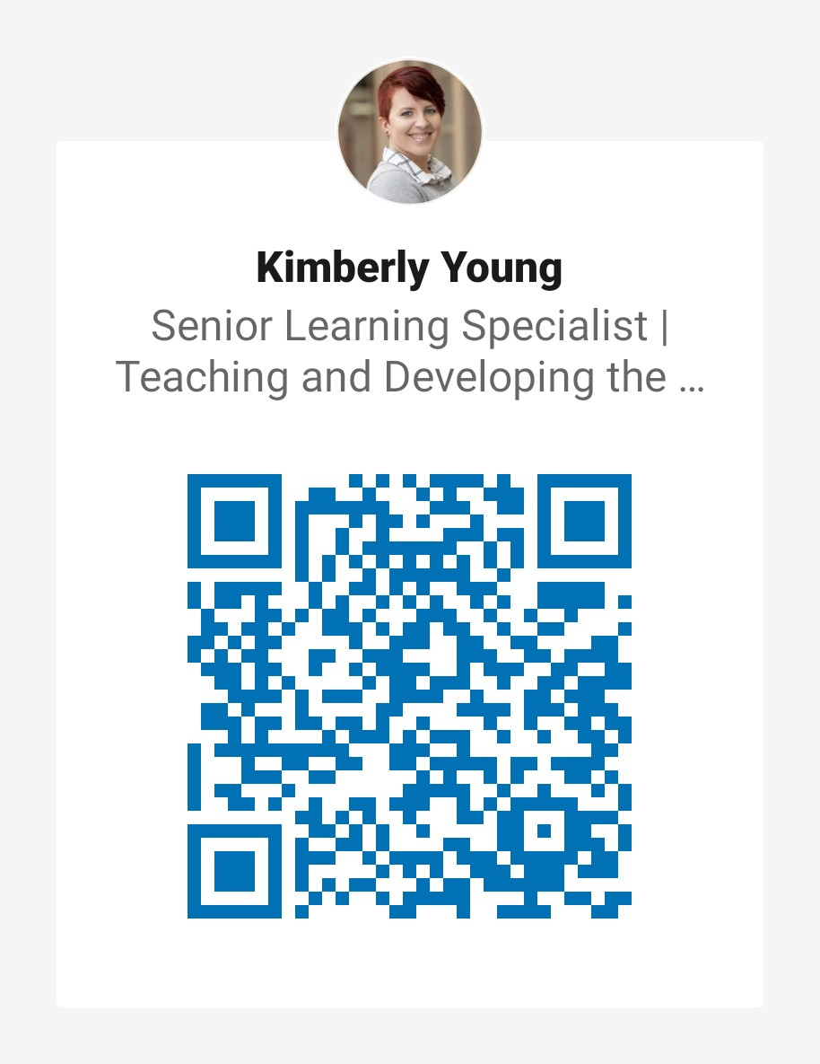
Build a Following
DO THIS | NOT THAT
DO accept connections from anyone who meets your criteria, even if you don’t know them well. | DON’T shut out unexpected opportunities by being too restrictive.
Whenever you meet someone, add them on LinkedIn
Add your LinkedIn to your email signature
Join groups

Slide 27
Build a Following
Create and share valuable content with your followers.
Be sure to share content in each of these areas:
Updates about your new work and activities
Original blogs, articles, videos, and infographics
Relevant posts created by others
Reminders to check out your old work
Notes:
Infographic with examples on the next slide

Slide 28
Build a Following
Update
LinkedIn posts
Create
Blog posts
Slide deck
Tweets
Curate
Share posts
Comment on posts
Restate
Re-share
Quote yourself

Slide 29
Build a Following
As you work to build your brand, regularly evaluate the metrics on your social media to make sure the content you’re sharing is resulting in more followers and engagement.
Notes:
You can track this yourself by paying attention to the reactions to your posts

Slide 30
Maintaining Your Brand
Presenting at one meeting or conference each year can turn into a year of social media posts.
Record your speech and turn it into shareable clips.
Have someone take photos you can share.
Turn the speech into blog posts.
Share quotes from your speech and information you learned from polling the audience.
It only takes a few minutes per day for your network to see you as visible, valuable, and available.
Notes:
Maintaining a brand doesn’t have to be exhausting. One presentation can turn into many, many posts.

Slide 31
Branding Tips
Your message should be clear and focused.
Every day, more than 100,000 articles are uploaded to LinkedIn, and 576,000 hours of video are uploaded to YouTube.
Keep learning.
If you are actively learning every day, you’ll develop a reputation for being a progressive trend-setter.
Make friends with technology.
The most visible innovations stem from technology.
Notes:
Need a way to make yourself stand out from the crowd. Being clear and focused is an important aspect of making your message stand out
Stay on top of what is happening. If you’re not on the forefront, why would anyone need to follow you?
Using the latest tech makes you a trendsetter and helps you get your message out to the most people

Slide 32
Questions?

