Slide 1
Communicating and leading virtually
Kimberly Young

Slide 2
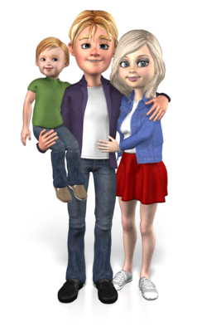
Notes:
There are a lot of reasons why you might find yourself trying work with others without ever sitting in the same room—telecommuting, new partnerships, family obligations, illness (including the big one: COVID)

Slide 3
Notes:
All of this can be a little scary, because we’re in new territory that many were not prepared for. Especially in a field like banking, we’re accustomed to doing business face-to-face. People are often hesitant to stray from the way things are usually done.

Slide 4
Notes:
However, if we see this as a chance to learn to communicate in new ways, this new world can be an opportunity! The world is becoming increasingly digital, so it’s important to keep up with digital trends if we want to stay ahead of the game.

Slide 5
Today’s Topics
Preparing for virtual communication
The “human factor” of communicating virtually
Getting the job done even when you’re not seeing your customers in person

Slide 6
Preparing for Communication

Slide 7
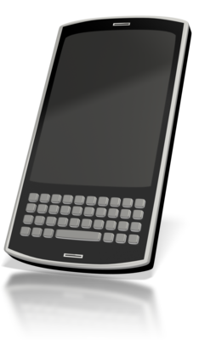
Notes:
Remember that no matter where or how you’re working, you always have a variety of media available: phones, email, instant messaging, virtual/video media, web conferences, and Teams. Some of these might only be used within your team, but many can be used to communicate with customers also.

Slide 8
Preparing for Communication
Establish guidelines for when a particular channel should and should not be used
Just like you shouldn’t break up with a boyfriend or girlfriend over text, there are certain rules for professional virtual communication that need to be set!
Notes:
There are certain topics that are more appropriate for certain channels. Your team should have specific guidelines to govern which channels to use in which situations. To create a more seamless customer experience, try to be consistent, but leave room for flexibility.

Slide 9
Sender
Message
Channel
Receiver
Notes:
You may not think the channel of communication matters, but the type of communication matters; the channel can be a source of external “noise” that affects how the receiver gets the message.
Noise is anything that can potentially affect/disrupt your message, changing the meaning. This can be subtle, or more significant.

Slide 10
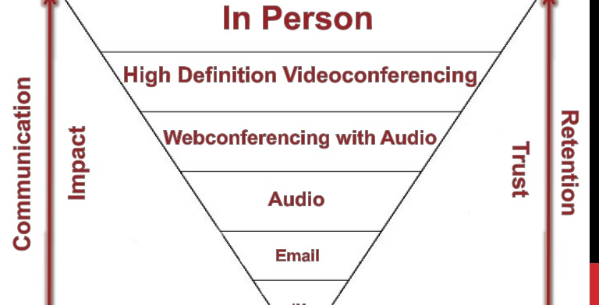
Notes:
This graph gives some good information that can help decide which communication channel to use.
Ask yourself these questions:
How impactful do you need the communication to be? How much do you need them to retain what you say? How much do you need them to trust you?

Slide 11
Virtual Space
Physical Space
Self
Notes:
You must prepare your physical space, your virtual space, and yourself, especially during video communication (everything should be comfortable for you and the other person). There are a lot of things to think about that could affect how your conversation goes. Let’s look at a few.

Slide 12
Preparing for Communication
Have all technology/other materials close at hand
Make sure the lighting is good
Light should be in front of or beside you, but never behind
Think about your wardrobe
Maintain a professional look
Think about other objects that are around you/behind you
Clean, neutral, professional
This is also an opportunity to build on a personal/company brand
Notes:
Natural lighting is best if possible, as it is softer than lamps or other types of lights.
According to videographers, “people with lighter skin and hair colors tend to look more authoritative in darker clothing shades because of the contrast in tonalities — while darker hair or skin tones have the same result when combined lighter colors”
You can use your background to build a personal brand by having books behind you, a particular piece of art, etc. If you plan to use your background as part of your brand, remember to be consistent so that people can easily associate the background with your brand. If “personal branding” isn’t your thing, try to make your background represent Salem Five!

Slide 13
Preparing for Communication
Think about the angle of your camera
Should be set up so camera is at eye level
Prepare and test your audio set up
Test equipment to make sure you know how it works
Eliminate distractions
Don’t have your email open or that article you’ve been meaning to read, silence your phone, etc.
You need to be listening even more closely to really hear what the other person is trying to say
Notes:
Avoid having your camera placed too low; this is a common mistake and one that is certain to make the viewer think that you’re a tech novice.
Make sure your listener can here you and vice versa; also assess background noise
Technological difficulties happen, but try to fend them off with preparation.
When we aren’t in the same room as others, the temptation to multitask is strong. Are any of you currently checking your email or scrolling on your phone? Try to avoid this temptation, as it can be a serious hindrance to good communication.
Think about other things that could distract you, like colleagues interrupting (or if you’re at home, kids and pets)

Slide 14
Preparing for Communication
Communicating virtually can feel uncomfortable for some people, so take time to compose yourself
Try to take some deep breaths, do power poses, or close your eyes for a few seconds
Notes:
You don’t want to project an image of discomfort; it’s not very professional.
Find a way to relax that works for you.
Caped woman is a good example of a power pose.

Slide 15
Communication

Slide 16
Virtual communication is all about remembering that there’s a real, live person on the other side of the phone/computer.
Notes:
Have you ever scrolled through the comments on a YouTube video and been surprised by how rude and angry some people are?
This is an unfortunate side effect of the digital revolution. When you communicate in ways that aren’t face-to-face, it’s easy to forget that you’re talking to a real person!

Slide 17
Notes:
Communication in a digital world feels “faceless.” This can be dangerous.
In a study of x-ray technologists, techs were asked to review a set of x-rays. Later, they reviewed the same x-rays, but with a photo of the patient attached. 80% of the findings in the review with a photo were not reported the first time around, suggesting a more meticulous review when there was a face.

Slide 18
Communicating
The advances of our current communication landscape have improved convenience, efficiency, and our ability to connect (in the literal sense) with others anywhere in the world.
They have also put up barriers when it comes to making human connections with those we interact with.
Notes:
There are a lot of new opportunities presented by digital communications, but we must be careful to avoid taking away the kind, welcoming, community-based style of relationship-building that is so vital to Salem Five.
A survey conducted by cosmetics firm Dove and Twitter found that in 2014 over five million negative tweets were posted about beauty and body image

Slide 19
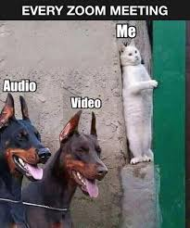
Communicating
Some people might feel intimidated about speaking in a video or phone meeting, so check in to make sure you are all on the same page
Share information equally, transparently, and in a timely manner
Make sure no one is left out in the communication loop
Notes:
While some people have no filter when communicating digitally, others can feel intimidated or uncomfortable.
It can also be easy to forget to share information with people when you aren’t seeing them in person regularly.

Slide 20
Communicating
Ask open-ended questions. Always take a step back to understand the other person's perspective and pressures and give them benefit of the doubt
It’s also extremely important to actively listen to the answers
Notes:
Be careful of solution-based thinking; just because the situation seems like one you’ve dealt with before doesn’t mean you shouldn’t listen to the customer’s full story.
All of these things on the chart are important, but I want to highlight a few:
2-Think hard about how your customer is feeling
4-be careful not to interrupt people (especially because of audio lag)
5-don’t try to speed things along by anticipating what others will say; always listen closely and actively, then take a moment to answer if needed
8-think ahead to determine if your listener has any barriers that will make this form of communication harder

Slide 21
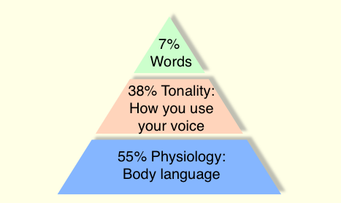
Communicating
It’s harder to “read between the lines” when we don’t have body language to help, so think carefully about your tone and word choice
This is especially true on the phone, where everything needs to be communicated verbally
specificity is key
Notes:
Have you ever gotten a text message reply or email that immediately sent you into a panic because you though the sender was angry at you, but then it turns out that everything was fine? This is because in digital media, we can’t rely as easily on tone, facial expressions, and body language to interpret the message.

Slide 22
Communicating
Think creatively and figure out the ways to make people feel connected and appreciated even though the forum is now virtual
Some people struggle to get across the same authority, professionalism, and compassion in a virtual communication
Think about the things that you normally do to get this across
Notes:
Things may feel informal when communicating digitally (and in some cases, that can be ok). However, when communicating with your customers, it’s important that you still give the impression that you are a professional who knows what you’re doing.
What do you normally do to seem professional, authoritative, and compassionate? How can you translate those things to a distance-communication situation?

Slide 23
Posture
Tone
Eye contact
Volume
Inflection
Notes:
Posture-Make sure you’re still sitting up straight; makes you look better on camera and actually makes you sound better on the phone
Tone- Make sure your tone of voice remains professional
Eye contact-Make eye contact with the camera; you can use googly eyes or small photos on either side of the camera to help!
Volume-Project your voice, but resist the urge to speak too loudly
Inflection-Add a bit more inflection and pitch variety to your voice as you speak. Your voice may sound a bit flat or monotone over the phone or through speakers.

Slide 24
Notes:
Display empathy by asking about them, their family, and their health before talking business
Be positive, optimistic, and upbeat

Slide 25
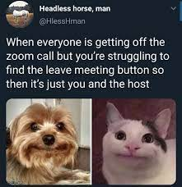
Communicating
Let customers know a little audio/visual delay is expected and to inform you of any problems
Ask if there’s anything they want to be sure to cover in the meeting
Be careful talking about confidential information before getting permission in case others are present
Notes:
Prepare customer for potential issues-they should know what to do if the tech fails
Make sure you’re on the same page throughout.
Be aware of any potential listeners that you can’t see; always ask permission before stating confidential information.

Slide 26
Communicating
Take some time to learn about preferences
Do certain people prefer phone vs. email? Talking in the morning vs. the afternoon? How can differences be accommodated?
Do they need additional support for virtual needs?
Avoid stereotyping: don’t assume that all older folks will be uncomfortable with virtual communication, or that no young people know how to talk on the phone

Slide 27
Communicating
Ask for feedback on how things are going: what would make virtual communication better/easier for others?
Make sure that you are actively listening and showing empathy in ways that work for the forum (this is especially challenging over the phone)
Pay attention for cues about their emotions and respond appropriately
Recap the conversation before ending
Notes:
If you receive feedback, be sure to act on it.

Slide 28
Getting the Job Done

Slide 29
Getting the Job Done
Be transparent with your customers and set clear goals and action items
Establish upcoming steps or actions that you each need to take
Notes:
This is especially important for customers who are less accustomed to this type of communication. Let them know what will happen next and follow up with them afterwards.

Slide 30
Getting the Job Done
Customer | Date contacted | Topic discussed | Channel | Follow up
Jake Peralta | 9/11/2020 | Financial planning | Email | 9/18/2020
Amy Santiago | 9/12/2020 | Mortgage referral | Teams meeting | 9/21/2020
Raymond Holt | 9/13/2020 | HELOC | Phone call | 9/17/2020
Rosa Diaz | 9/13/2020 | Aviation referral | Email | 9/23/2020
Keep your commitments. Do what you say you are going to do. Keep your promises.
Customers should know within what timeframe they should expect a response
Team members should understand and execute this expectation
Developing a communication plan for your customers can be an invaluable tool to help you stay on track
Notes:
Keeping your commitments may sound obvious, but keeping your word is absolutely essential to earn trust.
Try creating a chart of your communications. Include how you will make contact as well as how often and what information you need to provide.

Slide 31
Getting the Job Done
Make sure that each communication is meaningful and contains important information
If you send too many messages without useful content, you run the risk of your customer becoming frustrated or ignoring your communications altogether
Notes:
Does anyone have certain companies or people whose emails they immediately delete without reading because they often send out meaningless junk.
Don’t be that guy.

Slide 32
Notes:
Now is not the time to be stifled by the way things have always been done: think outside the box!

Slide 33
Questions?

