Slide 1
Business Storytelling
Kimberly Young

Slide 2
Notes:
When I was in 9th grade, we got an assignment for a research project. The teacher passed around a hat filled with slips of paper and on those slips of paper were different diseases. Whatever disease we picked out of the hat is what we would research and present to the class.

Slide 3
Hey guys, I got polio!
Aw man, I got tuberculosis!
Notes:
Of course, for the rest of the day all you could hear in the hallways was stuff like “Hey guys, I got polio” or “Aw man, I got tuberculosis!”

Slide 4
Notes:
When I was in 9th grade, we got an assignment for a research project. The teacher passed around a hat filled with slips of paper and on those slips of paper were different diseases. Whatever disease we picked out of the hat is what we would research and present to the class.

Slide 5
Notes:
Unfortunately for my friend Megan, her presentation hit a snag when she passed out from nerves and hit her head on the chalk tray.

Slide 6
Notes:
That was the day I discovered that talking in front of people is really scary for a lot of people, and I was actually in the minority of people who kinda love standing up there, telling people what I know.

Slide 7
Notes:
If I really think about it, this was probably the day that started me on my path toward becoming a training specialist.

Slide 8
What’s with the awkward tale from your youth?
Business Storytelling
Notes:
You’re all probably thinking right now, “what’s with the awkward tale from your youth?”
Well, this is an example of what we call “business storytelling.”

Slide 9
Business storytelling is…
sharing your messages in ways that engage audiences and drive them to take a desired action (purchase a product, subscribe to services, ask more questions, etc.)

Slide 10
Why tell stories?
Makes your business stand out
Expresses your vision
Builds your brand
Demystifies business jargon
Inspires and motivates
Solidifies abstract concepts

Slide 11
EMAIL,
SOCIAL MEDIA, PHONE CALLS, TEXTS,
NEWS,
CAT MEMES
YOUR MESSAGE
Notes:
A recent study found that the average human attention span has fallen from 12 seconds in 2000 (or around the time smartphones hit the scene) to eight seconds today. ... In comparison, scientists believe that the goldfish has an attention span of nine seconds.

Slide 12
Notes:
This means that unless your message stands out from all of the noise, your listener is going to be too distracted and bored to pay much attention.

Slide 13
So how do I create a story?
The Process

Slide 14
Who is your audience?
Who would benefit from hearing this?
Who do you want to hear this?
Who will react the strongest?
A story to motivate your employees may be very different than a story to convince your potential customers to buy your product.

Slide 15
What is your core message?
What events in your life make you believe in the idea you are trying to share?
When did failures in your career lead to a success?
What lessons did a mentor share?

Slide 16
entertaining
educational
universal
organized
memorable
Notes:
Entertaining: Good stories keep the reader engaged and interested in what’s coming next.
Educational: Good stories spark curiosity and add to the reader’s knowledge bank.
Universal: Good stories are relatable to all readers and tap into emotions and experiences that most people undergo.
Organized: Good stories follow a succinct organization that helps convey the core message and helps readers absorb it.
Memorable: Whether through inspiration, scandal, or humor, good stories stick in the reader’s mind.

Slide 17
What medium should you use?
There are lots of different mediums out there.
Think about which one makes the most sense for your story.
Are visuals important?
Are sound important?
Are you better at a keyboard than in front of an audience?

Slide 18
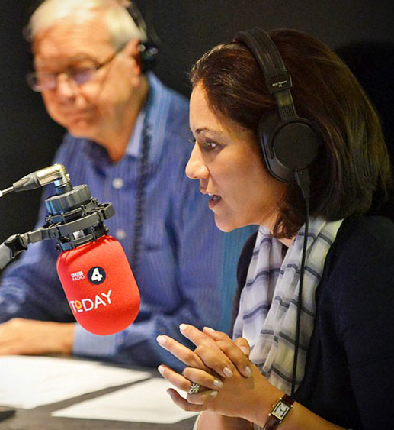
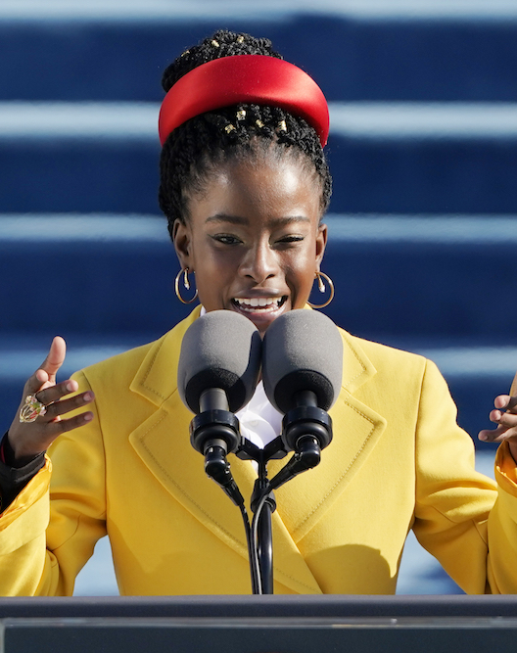
Different mediums
Notes:
A written story is told through articles, blog posts, or books. These are mostly text and may include some images. Written stories are by far the most affordable, attainable method of storytelling as it just requires a free word processor like Google Docs … or a pen and paper.
A spoken story is told in person, like a presentation, pitch, or panel. TED talks are considered spoken stories. Because of their “live”, unedited nature, spoken stories typically require more practice and skill to convey messages and elicit emotions in others.
An audio story is spoken aloud but recorded — that’s what sets it apart from the spoken story. Audio stories are usually in podcast form, and with today’s technology, creating an audio story is more affordable than ever. (For a great story-driven podcast, check out The Growth Show!)
A digital story is told through a variety of media, such as video, animation, interactive stories, and even games. This option is by far the most effective for emotionally resonant stories as well as active, visual stories … which is why it’s also the most expensive. But don’t fret: video quality doesn’t matter as much as conveying a strong message.

Slide 19
What type of story should you use?
Be careful making yourself the hero.
Highlight a struggle.
What lessons have you learned hat got you to where you are?

Slide 20
Story types
Incite action
Tell people about yourself
Convey your values
Foster community or collaboration
Impart knowledge
Notes:
These are some basic story types. Your story can potentially serve multiple purpose, but one should be at the forefront.
... incite action, your story should describe a how a successful action was completed in the past and explain how readers might be able to implement the same kind of change. Avoid excessive, exaggerated detail or changes in subject so your audience can focus on the action or change that your story encourages.
… tell people about yourself, tell a story that features genuine, humanizing struggles, failures, and wins. Today’s consumer appreciates and connects to brands that market with authenticity and storytelling is no exception.
… convey values, tell a story that taps into familiar emotions, characters, and situations so that readers can understand how the story applies to their own life. This is especially important when discussing values that some people might not agree with or understand.
… foster community or collaboration, tell a story that moves readers to discuss and share your story with others. Use a situation or experience that others can relate to and say, “Me, too!” Keep situations and characters neutral to attract the widest variety of readers.
… impart knowledge or educate, tell a story that features a trial-and-error experience, so that readers can learn about a problem and how a solution was discovered and applied. Discuss other alternative solutions, too.

Slide 21
How do I make a story?

Slide 22
Step to make a story
Define your mission / brand personality
Make it appealing / human
Choose your main characters
Add details/visuals
Activate
Keep it consistent

Slide 23
Notes:
A good story contains three key components:
Characters. Every story features at least one character, and this character will be the key to relating your audience back to the story. This component is the bridge between you, the storyteller, and the audience. If your audience can put themselves in your character’s shoes, they’ll be more likely to follow through with your call-to-action.
Conflict. The conflict is the lesson of how the character overcomes a challenge. Conflict in your story elicits emotions and connects the audience through relatable experiences. When telling stories, the power lies in what you’re conveying and teaching. If there’s no conflict in your story, it’s likely not a story.
Resolution. Every good story has a closing, but it doesn’t always have to be a good one. Your story’s resolution should wrap up the story, provide context around the characters and conflict(s), and leave your audience with a call-to-action.

Slide 24
Some aspects to consider
origin story
the stakes
a hero
a mentor
a villain
obstacles
challenges faced
challenges overcome
a journey
a victory
a moral

Slide 25
What should my listener do?
It’s important to end with some sort of call to action.
What do you want your listeners to do as a result of hearing your story?

Slide 26
Notes:
My story from the beginning of this presentation was aimed at getting you to think about what got you into your current business in the first place. Origin stories are a great way to engage your listener and help them relate to you and your business.

Slide 27
So how do I make my story successful?
Tips & Tricks

Slide 28
Remember your parameters
Who is telling the story?
Why is the story being told?
When and where is the story taking place?
Who are the people in the story?
What are the people trying to achieve?
What challenges are faced?

Slide 29
Be authentic
Don’t go over-the-top
Celebrate the human component of your business
Create an emotional connection

Slide 30
Keep your brand at the forefront
Be consistent in colors, style, tone
Every story should contribute to your brand message

Slide 31
Know your outcome
What is the listener supposed to gain from listening to this story?
Is there a feel-good moment at the end?
Is there a lesson to be learned?
Is there a touch of humor?

Slide 32
Don’t forget your freshman composition class
Remember the 5 Cs: your story should be complete, compelling, clear, concise, and consistent
Choose your words carefully
Keep your paragraphs short
Mix up your sentence lengths
Try to stick with active voice as much as possible
If you can place “the zombies” after the verb, it’s not active voice!
Keep your tone conversational

Slide 33
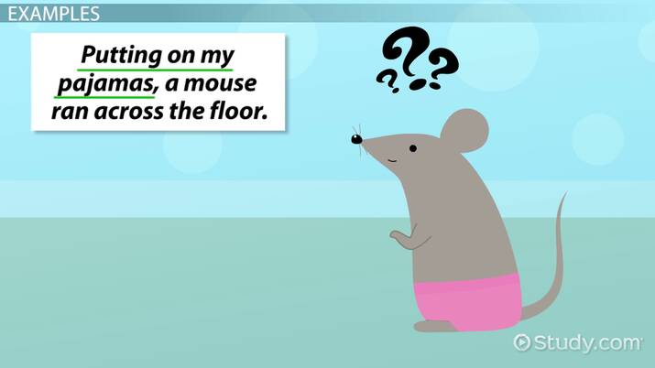
Don’t forget your freshman composition class
Mind your subject-verb agreement
Is there many reasons to try brussels sprouts? No, there are many reasons to try this tasty vegetable!
Watch out for commonly confused words
You should lay a towel down before you lie on the sand.
Keep track of your pronouns/modifiers.

Slide 34
Activity
Take 2 minutes to write down adjectives that you would use to describe your business’s values.
Get into your breakout room.
Tell your partner how you got started in your business / line of work.
Brainstorm together: how can you reframe your origin story so that it illustrates one of the adjectives on your list.
Be prepared to share!

Slide 35
Questions?

