Slide 1
CRITICAL THINKING
KIMBERLY YOUNG

Slide 2
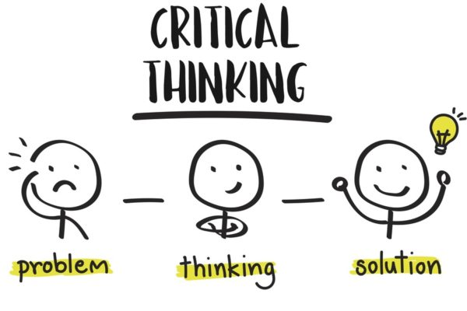
Critical thinking is…
the objective analysis and evaluation of an issue to form a judgment

Slide 3
CRITICAL THINKING INVOLVES…
Gathering, organizing, and evaluating information
Asking questions
Making inferences
Formulating and weighing options
Testing and verifying conclusions

Slide 4
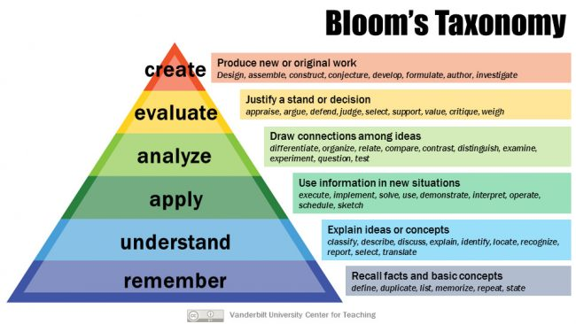
THE THINKING TRIANGLE

Slide 5
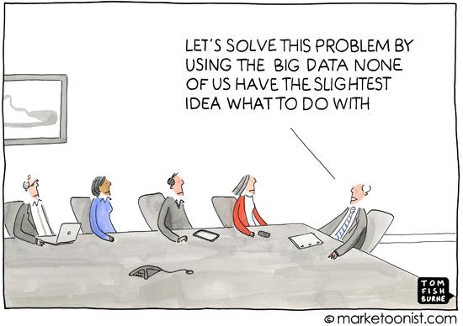
ANALYSIS
Steps to analysis:
1. Break the item you are analyzing into its component parts.
2. Consider each item individually, thinking about what it could mean.
3. Think about how the implications relate to the whole.
4. Use your understanding of each part to draw a conclusion about the whole.

Slide 6
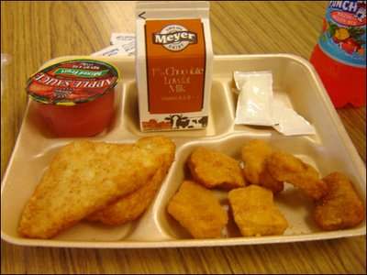
Notes:
Look at the different components of this lunch. What does each suggest about the person eating it? When you put it all together, what conclusions can you draw?

Slide 7
Notes:
Look at each component of this room. What does each suggest about the person who designed it? What conclusions can you draw by putting it all together?

Slide 8
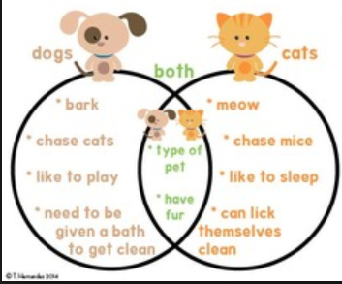
COMPARING AND CONTRASTING
When more than one item needs to be analyzed, it is important to be able to distinguish the similarities and differences between them.
How are the items alike?
How are they different?
What do the similarities and differences suggest?

Slide 9
Notes:
Break down the components of the lunch on the right and draw a conclusion about the person eating it.
How do they compare/contrast with the person on the left?

Slide 10
Notes:
Break down the components of the room on the right and draw a conclusion about the person living there.
How do they compare/contrast with the person on the left?

Slide 11
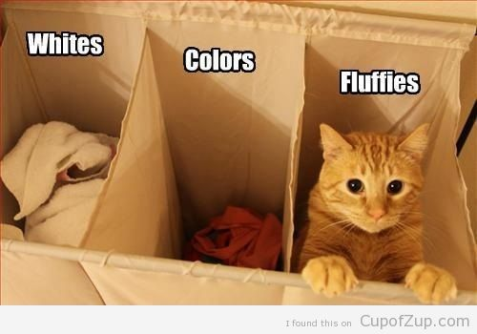
ORGANIZING
One of the most useful applications of your analysis is your ability to organize based on your findings.
After breaking down your items and comparing/contrasting them, you will better be able to classify and group them in a way that makes sense to you.

Slide 12
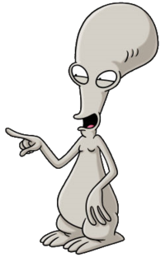
Roger
Garfield
Dora
SpongeBob
Mickey
Linda
Notes:
What components of these characters could we use to put them into groups?

Slide 13
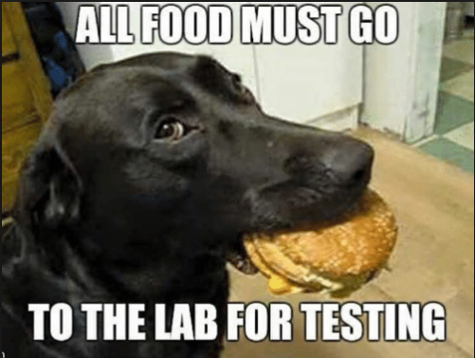
TESTING AND EVALUATING
After we have broken down, compared/contrasted, and organized information, it is time to test and evaluate our conclusions.
We can do this in two ways:
Looking at additional information
Putting a plan into action and evaluating the results

Slide 14
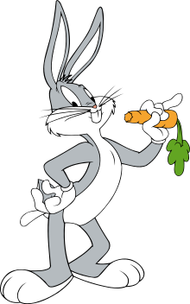
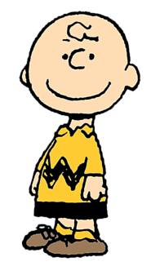
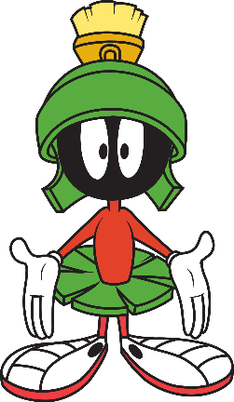
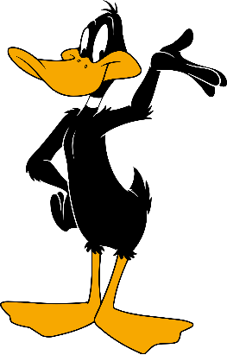
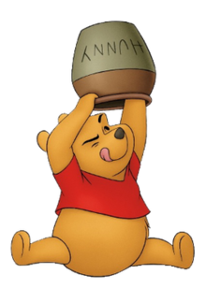
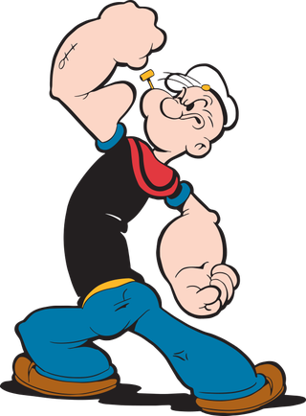
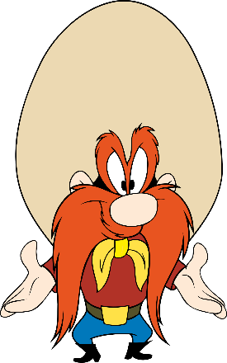
Roger
Garfield
Bugs
Charlie
Marvin
Dora
Winnie
Daffy
Patrick
Popeye
Mickey
Spongebob
Linda
Sam
Kodos
Notes:
Now that we’ve added more characters, does our original organization/grouping still work?

Slide 15
HOW MIGHT WE ANALYZE IN OUR WORK?
In the following task, our job is to decide which employees to assign to each task using our critical thinking / analysis skills.
Employees can be assigned to more than one task if we think that is best. Employees can work alone or in groups. Employees can be assigned to no tasks.
First, we’ll see descriptions of 3 tasks.
Then, we’ll see basic information about our 6 employees.

Slide 16
Tasks:
Perform reconciliations on 60 accounts for the fiscal year
Due date: 1 week
Research local vendors and make inquiry calls
Due date: 3 weeks
Create a presentation for upper management outlining the group’s progress and achievements this year
Due date: 2 weeks

Slide 17
Employees:
Brandon
Accountant
BS in Finance
Former Treasury Analyst
Not currently a member of
any project
Kayla
Accountant
MA in Business Management (minor in art
history)
Recent graduate
Has worked on numerous
projects in the past
Mikayla
Auditor
MA in Finance (minor in
sociology)
Former paralegal
Currently part of 2 research
projects
James
Clerk
BS in Communications
Former payroll specialist
Currently assisting 1 team
project
Isaac
Analyst
MA in Communications
Former accounting manager
Not currently working on a
project
Jin
Manager of Finance
MBA
Recently promoted
Currently overseeing 1
project

Slide 18
THINGS TO REMEMBER…

Slide 19
Define and remember your purpose
What questions are you attempting to answer? What problems need to be solved?
Analysis often requires assumptions
Are your assumptions justified?
Analysis should be based on evidence
Did you gather enough data? Are there other sources you could use?
Reasoning is always done from a specific point of view
Does your reasoning contain any biases?
Analysis has implications
What will be the potential consequences of your conclusions and decisions?

Slide 20
Define and remember your purpose
What questions are you attempting to answer? What problems need to be solved?
Analysis often requires assumptions
Are your assumptions justified?
Analysis should be based on evidence
Did you gather enough data? Are there other sources you could use?
Reasoning is always done from a specific point of view
Does your reasoning contain any biases?
Analysis has implications
What will be the potential consequences of your conclusions and decisions?

Slide 21
Any questions?

