Slide 1
Building your network
Kimberly Young

Slide 2
Pick a Table
TABLE 1
TABLE 2
TABLE 3
Notes:
Which group of people would you most want to sit with at a networking event? Cannot change seats or leave table.
Table 1:
Elon Musk: engineer, industrial designer, and technology entrepreneur best known as CEO of Tesla
Ashton Kutcher: actor, producer, and entrepreneur known for That 70s Show and activist against human trafficking
Barack Obama: 44th president of the US, former community activist and senator
Bill Nye: science communicator, television presenter, and mechanical engineer known as Bill Nye the Science Guy
Margaret Atwood: poet, novelist, literary critic, essayist, teacher, and environmental activist best known as author of The Handmaid’s Tale
Table 2:
Jeff Bezos: industrialist, media proprietor, and investor best known as president of Amazon.com
Lady Gaga: singer, songwriter, actress, and activist known for album Bad Romance and advocate for numerous causes supporting disadvantaged youth
Mike Pence: Vice President of the US, former attorney and governor
Stephen Hawking: theoretical physicist, cosmologist, and author known for work on quantum theory
JK Rowling: author, film producer, television producer, screenwriter, and philanthropist best known as author of Harry Potter
Table 3:
Sheryl Sandberg: CEO and philanthropist, known as CEO of Facebook and first woman on its board of directors
Leonardo DiCaprio: actor, producer, and environmentalist known for roles like Titanic and activist for climate change prevention
Ruth Bader Ginsberg: lawyer and jurist, second female Supreme Court Justice
Neil Degrasse Tyson: astrophysicist, cosmologist, planetary scientist, author, and science communicator known for PBS Nova series
Stephen King: author of horror, supernatural fiction, suspense, and fantasy novels with many film and TV adaptations

Slide 3
What is networking and why does it matter?

Slide 4
What is Networking?
Network: a group of people who exchange information, contacts, and experience for professional or social purposes.
(The Oxford Dictionary)
Network to make new friends, develop you current career, explore new career options, obtain referrals or sales leads, or simply to broaden you professional horizons.

Slide 5
What is Networking?
It is important to focus on networking as an exchange of information, contacts, or experience.
In any industry or career level, networking helps you make connections in a personal way and build relationships to discover and create mutual benefits.

Slide 6
What is Networking
Succeeding in business is all about making connections.
–Richard Branson
One of the biggest networking faux pas is treating every exchange as a transaction.
Many jump to figuring out what they can get out of someone.
It leaves the other person feeling used and disrespected.
Flip interactions from transactional to relational.

Slide 7
What is Networking?
Relationships are long-term.
They take time to nurture.
People want to help people they know, like, and trust.
Don’t wait until you need something to start building relationships.

Slide 8
What is Networking
When you begin networking, think about what you can do to help the people that you meet.
People want to help those who have helped them.

Slide 9
Why Does Networking Matter?
Building a network has many benefits:
Finding people with skills that can help you grow your business
Finding new customers/contacts
Gaining important and insightful career advice
Staying on top of trends and news in your industry/community
Exchanging ideas
Meeting likeminded people who can become great friends

Slide 10
Why Does Networking Matter?
95% of professionals consider face to face communication vital for long term business.
Companies earn $12.50 for every dollar invested in face to face meetings.
28% of business will be lost if your contact is strictly online.
41% of professionals believe that face-to-face marketing at business events is the most effective way of finding customers.
For every 10.43 ideas an online meeting generates, there are 13.36 that come from real-life communication.
55% of communication depends on your facial expressions and posture.
Sources: LinkedIn, GreatBusinessSchools.org, Oxford Economics Study

Slide 11
Finding networking opportunities

Slide 12
Begin where you are.

Slide 13
Begin where you are
No matter your age or experience, you already have a network:
current or former classmates
current or former teachers/professors
previous co-workers
family
childhood friends
Go to those who already know, like, and trust you and ask them if they can connect you to whomever it is you’re looking to meet:
professionals in a certain field
people in a certain area

Slide 14
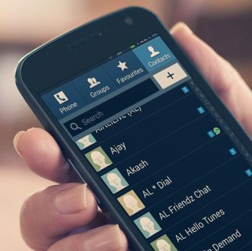
Begin where you are
Leverage social media and the contacts you have stored in your phone to help spur your memory.
Set up calls (by voice or video) or in-person meetings to catch up.
Emails can work too, depending on the circumstances.

Slide 15
One of the best ways to begin networking is by joining an organization.

Slide 16
Organizations
There are numerous organizations that you can join that will allow you to network with others.
Chambers of Commerce, Rotary, or North Shore Women in Business are just a few options.

Slide 17
Organizations
When you’re first starting out, spread your net wide with local organizations.
Join numerous newsletters and go to a lot of events.
Then, decide which are best for you.
When you choose, go deep there:
Volunteer, take a leadership role, have one-on-one meetings with people you meet.
See how you can grow a reputation as someone to know in that community by being someone of service, who offers value, and follows through.

Slide 18
Organizations
Many communities also have organizations specifically for young professionals that are just entering the professional world and are looking to start building a network.
Meetup is one option for finding such organizations. This site is blocked on work computers, but you can still access it from your home computer or phone!
You can also find organizations specific to your industry.
E.g., Massachusetts Bankers Association

Slide 19
Organizations
Community service organizations are another great way to get involved and meet people.
Any organization where you can volunteer is a great way to meet new people who share the same interests and passions that you do.
Examples include Citizens Inn Peabody, United Way, and Leap for Education Salem.

Slide 20
Organizations
Volunteering has the added benefit of built-in shared interests with the people working with you, making for an easy icebreaker when you’re trying to start up a conversation.
Volunteer organizations also offer the opportunity to learn new skills that can help you in your career and life.
Rotary is a great example of a service organization you can join.

Slide 21
Networking often takes place at events designed specifically for building your network.

Slide 22
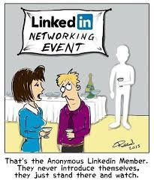
Events
If you are involved in an organization, many of them hold regular networking events that you can attend.
Even if you aren’t a member, you can follow their social media or sign up for their newsletters to find out about networking events.
Signing up for your local Chamber of Commerce newsletter is a must if you want to build a network in your local community.

Slide 23
Events
Remember that boards and members are going to be different for every organization and event, so going to a variety will help you meet lots of different types of people.
You can also look for workshops, conferences, or trainings that will help you develop particular skills that will be useful in your career, and network with other participants at the same time.

Slide 24
Many professionals start building their networks by finding a networking mentor.

Slide 25
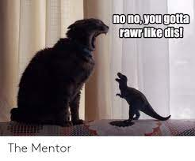
Mentors
Starting to build your network isn’t always easy, so it doesn’t hurt to find a colleague who already has a broad network and ask them to be your networking mentor.
They can offer good advice for events to attend and how to hold conversations.
Most importantly, they can make introductions at events to facilitate your initial meetings with new contacts.

Slide 26
Mentors
If you choose a mentor who is actively involved in an organization that interest you, this will make it easier for you to become involved.
If your mentor is a board member, there’s a good chance that when the time comes for them to step down, you will be next in line for their seat.
“Mentoring is a brain to pick, an ear to listen, and a push in the right direction.” — John Crosby

Slide 27
Creating your “elevator pitch”

Slide 28
What is an elevator pitch?
An elevator pitch is a quick synopsis of your background and experience.
The reason it's called an elevator pitch is that it should be short enough to present during a brief elevator ride.
A good elevator pitch helps you introduce yourself to career and business connections in a compelling way.

Slide 29
Finding your purpose
The first step in creating your elevator pitch is determining why you are trying to network with other professionals.
Start by answering these questions:
Why are you looking to grow your network?
Remember that the main objective is to make your job easier and more successful.
Who is your ideal customer and what do they need?
This can be specific to you personally, your branch, your team, your business line, etc.

Slide 30
Finding your purpose
Spend a few minutes discussing these questions with a partner:
What are your primary goals in building your network?
Who is your ideal customer and what do they need?

Slide 31
Formatting your elevator pitch
Often, people fall into the trap of wanting to offer too much information up front.
E.g., “I can do so many things for you!”

Slide 32
Formatting your elevator pitch
A better approach is to offer a short, clear, specific statement of what you can offer.
This will capture the listener’s attention and stick in their memory.
This will also ensure that when the specific need you mentioned in your elevator pitch comes up for them or someone they know, you are the first person who comes to mind.
You can use your later conversations to more casually mention other things that you can potentially offer when the person expresses a need.

Slide 33
Formatting your elevator pitch
The ideal format for an elevator pitch is:
“I do X for Y.”
For example:
“I help businesses get money so they can grow.”
“I create materials for businesses to help them market their brand.”
“I help customers achieve their financial goals.”

Slide 34
Formatting your elevator pitch
It’s time to write your own elevator pitch!
Spend 5 minutes writing a draft in the form “I do X for Y.”
Then, you’ll work with a group to workshop and refine your elevator pitch.

Slide 35
Providing examples
One of the best ways to supplement your elevator pitch is by providing examples:
When specifically have you provided this service for someone in the community?
Have you done this for a business your new acquaintance might be familiar with? Or one that is similar to the business of the person you’re talking to?
How did your expertise help them?

Slide 36
Providing examples
To prepare for networking, think about what makes you remarkable:
what you are good at
what you like to do and what you don’t
professional and volunteering experience
stories that perfectly describe you as a person
don’t be afraid to talk about things you still need to improve

Slide 37
Have conversations to build your network

Slide 38
A common problem people face when networking is feeling awkward or nervous having conversations with new people.

Slide 39
Dealing with nervousness
1. Think back to your purpose.
You are networking to make your job easier.
Your day job is filled with things that you wouldn’t normally do in your free time; this is just another one of those tasks.

Slide 40
Dealing with nervousness
2. Remember that everyone has a similar purpose.
A large part of social awkwardness comes from the fear that people don’t want to hear what you have to say.
In a networking event, everyone is there to meet people and build their networks.

Slide 41
Dealing with nervousness
3. Get out there often.
The more you do it, the more you’ll be part of the community.
People will know you and you’ll know them, and things will get more comfortable.
Never pass up an opportunity to network!
"Courage starts with showing up and letting ourselves be seen." - Brene Brown

Slide 42
Dealing with nervousness
4. Know how to get out of a bad conversation.
Sometimes, you just aren’t going to click with a person, and that’s ok.
The key is knowing strategies to get out of the conversation and move on.
E.g., “I just saw someone come in that I really wanted to talk to.”
What are some
other ways to
end a conversation?

Slide 43
An important part of having good conversations is picking the right person to talk to.

Slide 44
Picking the right people
You won’t be the only one not engaged in conversation; find someone else who is grabbing a drink or otherwise not engaged.
Introduce yourself and ask them what they do.
Give your elevator pitch.
Remember that you’re all there for the same reason!

Slide 45
Picking the right people
If you spot someone you know already engaged in a conversation with a group of 2-3 people, drift over and politely get involved in the conversation.
This will prompt the person you know to make introductions.

Slide 46
Picking the right people
Ideally, you shouldn’t spend more than 10 minutes talking to the same person at an event before moving on.
In more casual networking settings, spending more time with one or two people is ok.
However, be respectful and be present in the moment, not looking for someone you think is ‘better.’

Slide 47
To have good conversations, stay informed.

Slide 48
Stay informed
To have good conversations while networking, stay up-to-date on your industry.
Read the news, subscribe to relevant daily newsletters, and keep up with your industry’s movers and shakers.
Try searching for industry terms on social media to find the key people to follow.

Slide 49
Stay informed
If you want to create a broad network, you’ll have to meet people outside of your industry.
This means that it’s also important to keep informed about what’s going on in your local community.
Who are the people who are most active in your area?
What are they doing to make a difference?
What are local issues that need to be addressed?

Slide 50
The best way to keep a conversation going is by asking the right questions.

Slide 51
Asking the right questions
You want to find out how you can be of service; you can’t do this if you don’t know what your new acquaintance needs!
Ask thoughtful questions about their business and what the business’s challenges are.
This will make you seem interested in them and their business, and also better position you to offer help that will really matter to them.

Slide 52
Asking the right questions
Not everyone is going to have a polished elevator pitch; asking questions will help you to hone in on what heart of their business is really about.
This will allow you to know how you can help them better.
It will also allow you to get to know what is the most important to them.

Slide 53
Asking the right questions
Find a shared interest or cause-building a network doesn’t always have to be purely shop talk.
This is especially true if the person’s business is a nonprofit or something related to a cause.
Having a broad network can help in ways that you wouldn’t necessarily expect.
Finding out about a person’s interests and passions can help build connections that feel more like friendships, and can still be very beneficial in your career and life.

Slide 54
Asking the right questions
If you’re talking about shared interests and causes, act excited!
Passionate people want to build connections with other passionate people.
You want people to know, trust, and like you.

Slide 55
Asking the right questions
Remember that most people enjoy talking about themselves, their business, and their passions.
Asking good questions is a great way to get people to want to be part of your network.
“You could be the next person to succeed if you choose to learn from successful people instead of being envious of them. Moreover, aren't they successful because they learned and continue to learn from others?” ― Edmond Mbiaka

Slide 56
Asking the right questions
Spend 5 minutes asking a partner questions about themselves to learn about their job, goals, needs, and interests.
Then, switch so your partner can ask you questions.
For the final 5-10 minutes of the activity, brainstorm with your partner:
What do you have in common?
How might you be able to help each other?

Slide 57
Going from “acquaintance” to “part of your network”

Slide 58
One great way to deepen your connection with someone is by making introductions.

Slide 59
Making introductions
If you meet someone and you think they would make a great connection for someone else you know, make the introduction.
Both parties will remember that you were the one who brought them together, especially if the relationship ends up being mutually beneficial.
This can also be a great way to get your colleagues at the bank involved in the organizations that you are part of.
If a colleague can offer something to a new connection that you can’t, this is even better for Salem Five and ultimately, for you!

Slide 60
Making introductions
Another option is to invite your customers to attend networking events with you, especially if you think there’s a good chance you’ll be able to make an introduction to someone else.
Often, customers running smaller businesses aren’t able to pay for tickets to networking events, so if there’s an extra seat at a Salem Five table, you can invite them as your guest.

Slide 61
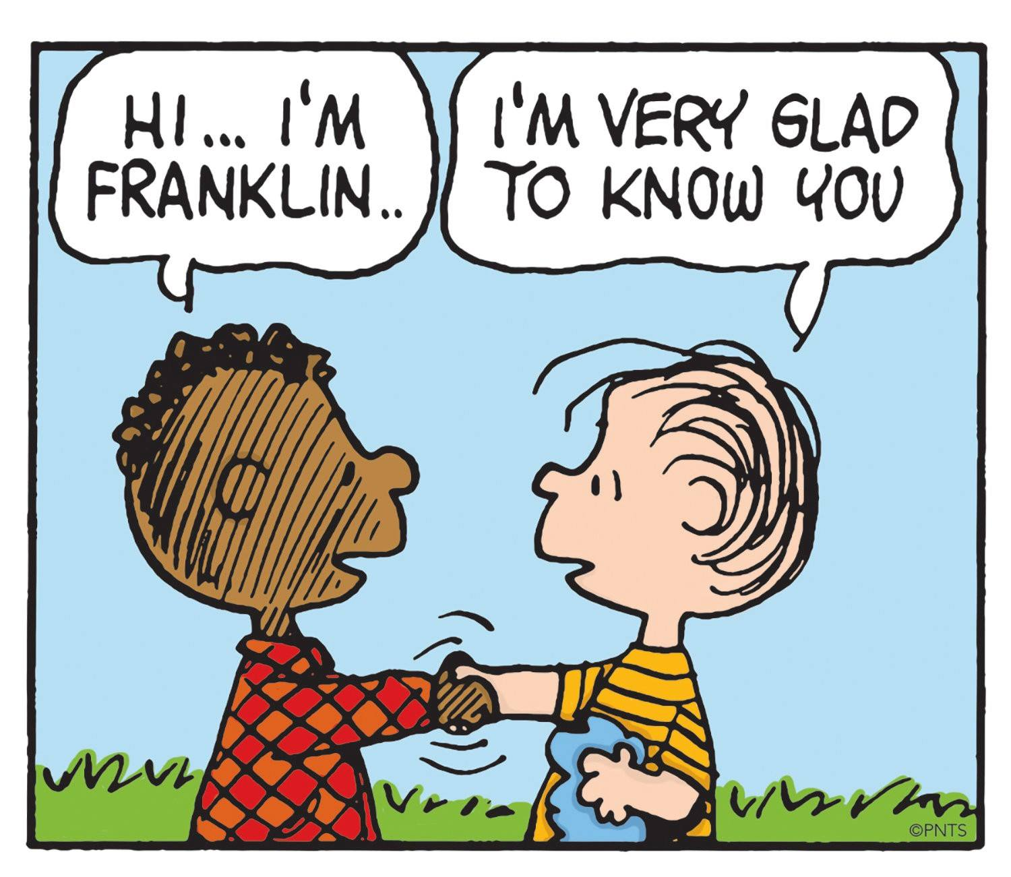
Making introductions
Introduce your partner from the last activity.
What is their elevator pitch?
What services can they offer that may be able to help other people in the room?

Slide 62
Another way to build your relationship is to offer assistance.

Slide 63
Offering assistance
“Unless someone like you cares a whole awful lot, nothing is going to get better. It’s not.”
– Dr. Seuss
Never ask for someone’s business in a networking situation.
Your goal is to show them what you can offer them so they will want to give you their business or build a relationship with you.
Make “telling your story” the goal.
What will your audience gain by investing in your story?
What will your audience lose if they ignore your story?

Slide 64
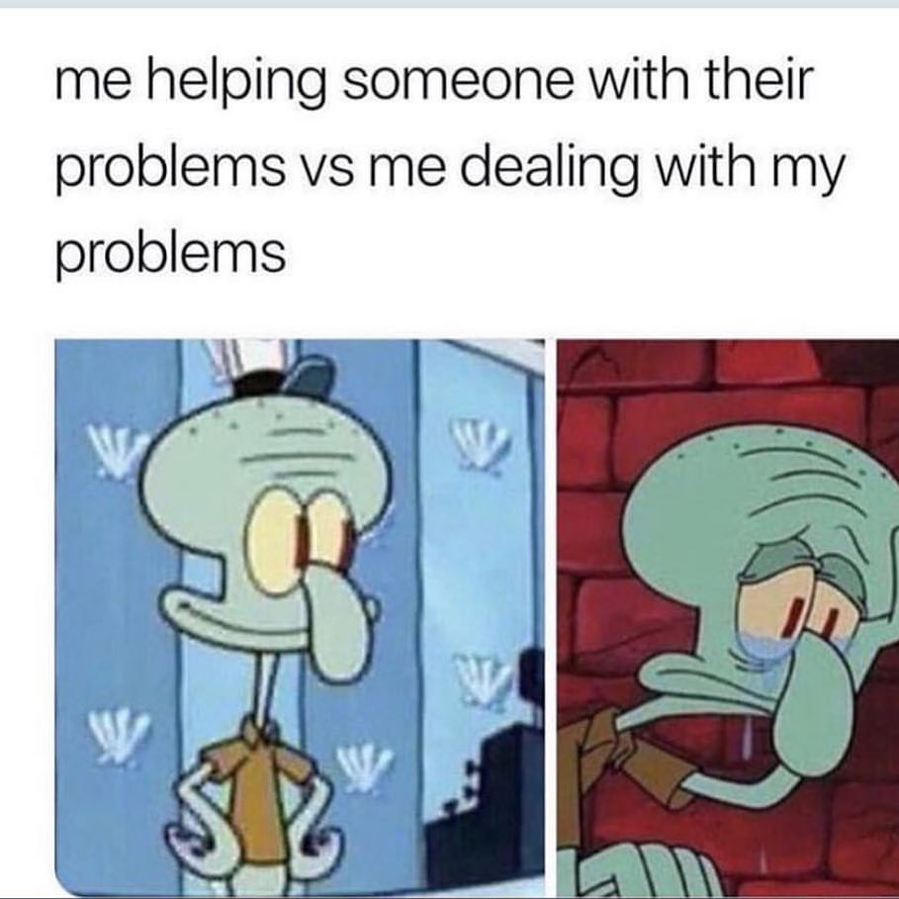
Offering assistance
There are 2 ways you can help; keep both in mind when talking to someone you hope to build a relationship with:
Removal of a pain—what problems do they have that you can potentially solve?
Addition of a benefit—how could you make things better for them?

Slide 65
Offering assistance
Let’s brainstorm!
What are some ways that we, as members of the banking industry, can offer assistance to other professionals?

Slide 66
Going from “new acquaintance” to “part of your network” doesn’t have to be complicated.

Slide 67
Keep it simple
When you meet someone who you think will be a great member of your network, ask them to meet outside of the formal networking event for lunch or coffee.
This will allow you to have more one-on-one time to get to know each other.

Slide 68
Keep it simple
Try the Dance Card technique:
For each person you want to build a relationship with, write down:
who the person is
two to three main points that you want to convey to them or ask them about
Basic framework to get you started:
What do they need to know about you or your business?
How can you help them?
What help do you want to ask them for?

Slide 69
Let’s review

Slide 70
Joining organizations , volunteering, and attending events are great networking opportunities.
Make sure that you have a focused elevator pitch. Be prepared to back it up with examples!
Do your best to push past your nerves by remembering why networking matters.
Find the right person to talk to and ask thoughtful questions to get to know them and their business. Be prepared to politely end the conversation if it isn’t going anywhere.
Be on the lookout for shared interests and causes.
Make introductions and offer assistance to make a new acquaintance part of your broad network.

Slide 71
Time to network!
We will now practice all of our skills by doing a group “networking event.”
Your goal is to circulate around the room, introduce yourself to different people, give them your elevator pitch, and chat with them to get to know them, their business, and their needs to make them part of your network.

Slide 72
Remember…
The more you get out there, the easier it gets!
Never say no to a networking opportunity!

Slide 73
Any questions?

