Slide 1
High-Involvement Planning
Kimberly Young

Slide 2
What is high-involvement planning?
High-Involvement Planning is a business planning process that involves the entire organization.
Individuals throughout the company meet to present data, discuss strengths & weakness, and evaluate progress toward benchmarks to develop growth and contingency plans.
Forward forecasting helps to project future financial outcomes.

Slide 3
Elements of high-involvement planning
Takes the planning process out of the boardroom and puts it into the hands of the people who actually execute the strategies.
Without this level of engagement, strategic business planning often has minimal results.
Getting employees involved
When everyone is involved in the strategic planning process, individual tasks become better aligned with the overarching company goals.

Slide 4
What topics are included in planning?
Industry/Market Intelligence
Competitive Intelligence
Customer Intelligence
Sales Performance
Annual Sales Plan
5-Year Sales Outlook
Growth and Contingency Plan

Slide 5
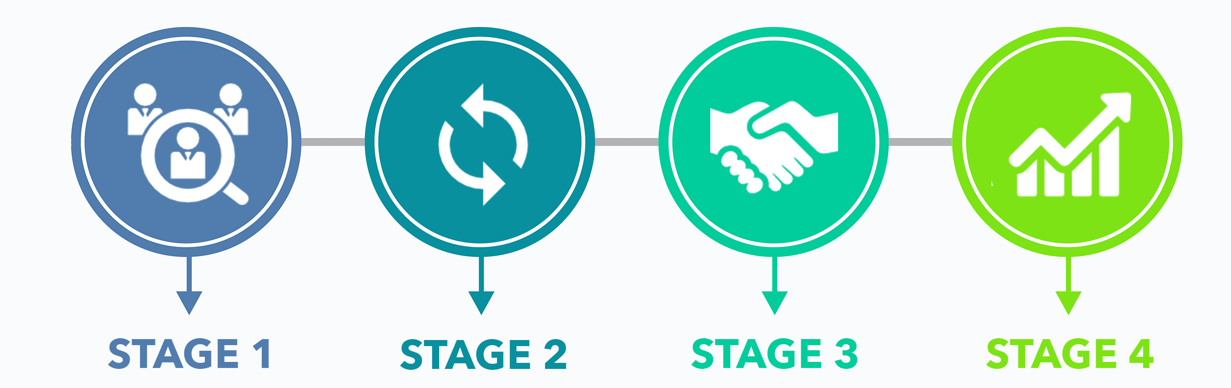
How High-Involvement Planning Accelerates Growth
The 4-Stage Process

Slide 6
Stage 1: Brainstorming phase
The leadership team reviews ideas, timelines, and expectations.
Individual team leaders narrow the list down to the top three ideas for their respective teams.
Duration: 2-3 months

Slide 7
Stage 1: Brainstorming phase
You are the director of a team at a paper airplane company.
Get into groups of 5. This is your leadership team.
Review the ideas on the first page of your handout and choose the top 3 initiatives that you’d like to focus on.

Slide 8
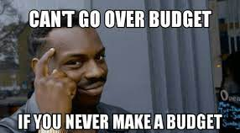
Stage 2: Budget outline phase
Team leaders share their team’s top three initiatives.
Criteria for “making the cut” is established by answering the following two questions:
1) Is the challenge strategic and does it move us closer to our 3-year picture and our 10-year vision?
2) Is it an urgent enough opportunity or challenge that it absolutely must be addressed?
The budget process begins – outline of financial plan
Duration: 1-2 months

Slide 9
Stage 3: budget revision phase
The management team discuss, debate, and ultimately decide on the top 1 to 7 goals for the upcoming year.
All team leaders revise and submit their projected budget to the finance lead.
Duration: 1 month

Slide 10
Stage 3: budget revision phase
Get into a new group of 5. This is your day-to day team.
Discuss which of the initiatives the leadership teams targeted you would like to focus on. Choose 1 goal.

Slide 11
Stage 3: budget revision phase
Flip to page 2.
Estimate how many paper airplanes you can make as a team in 10 minutes.
Use the questions on the worksheet to help you arrive at a realistic forecast.

Slide 12
Stage 4: financial projection phase
The finance lead consolidates the data from the team leaders into one main budget spreadsheet.
1-2 meetings are held to finalize the upcoming year’s financial projections.
If there are no major challenges, the goals and financial plan are set for the upcoming year!
Duration: 2 months

Slide 13
Stage 4: financial projection phase
Flip to page 3.
Use the numbers you forecasted to create a financial projection for the upcoming year.

Slide 15
PAUSE

Slide 16
Company Huddle!
Now that you’ve had some time to work, revise your initial forecast.
Use the questions on page 5 to help you.

Slide 18
Results
How close was your actual output?
Right on the money?
Over what you forecasted?
Under what you forecasted?

Slide 19
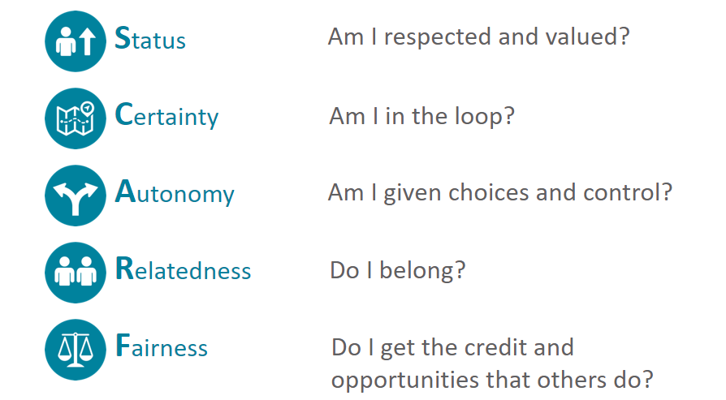
The effect on employee engagement

Slide 20
status
Builds a sense of respect and feeling valued, regardless of status or pecking order.
Allows employees of all levels to take an active part in the planning process.

Slide 21
certainty
Having access to the books, or company financials, can help give employees a sense of certainty.
Teaching forward-looking financials offers everyone the ability to predict what comes next.

Slide 22
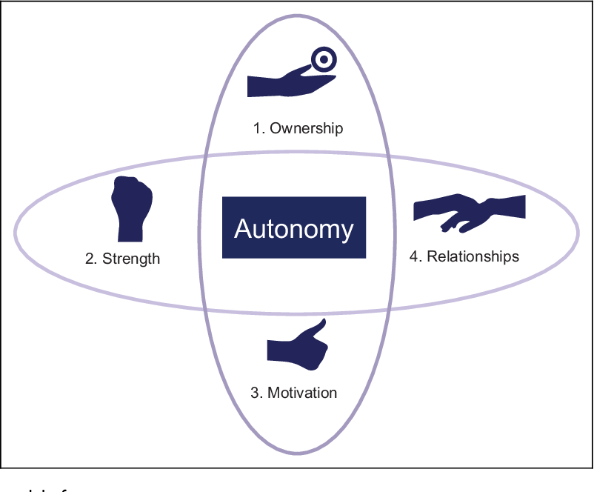
autonomy
Builds a sense of control over day-to-day operations.
Giving employees a sense of control encourages them to actively look for ways to improve the business.

Slide 23
relatedness
Shared goals help create “friend” or “in” groups.
Employees have a higher level of respect for those in their “in” group.
Managers get to know employees on both a professional and personal level.

Slide 24
fairness
When employees are able to help the company achieve better results, there will be more of a reward for everyone to share in the end.

Slide 25
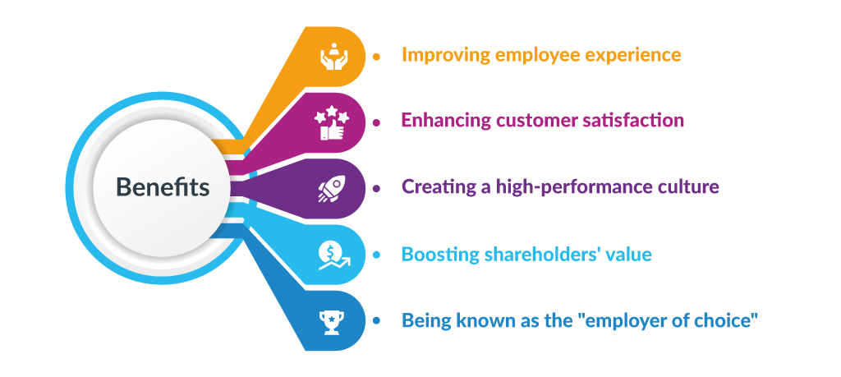
Benefits of high-involvement planning
Improved financial performance
Greater employee engagement
Improved individual performance
More positive business culture
Greater confidence
Improved sustainability

Slide 26
Remember:
When you work for an ESOP, it is your company!
HIP is one of your best opportunities to have a direct impact on the company’s future.

