Slide 1
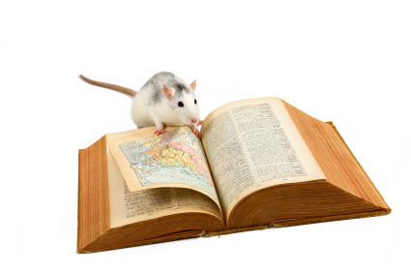
Section 1
Reading comprehension

Slide 2
As you read…
Circle any key terms
Jot notes in the margins about what is in each paragraph
Mark any places where the author expresses an opinion
Notes:
Think of this is making an outline as you read to make it easier to find the information you need.
Read quickly the first time.

Slide 3
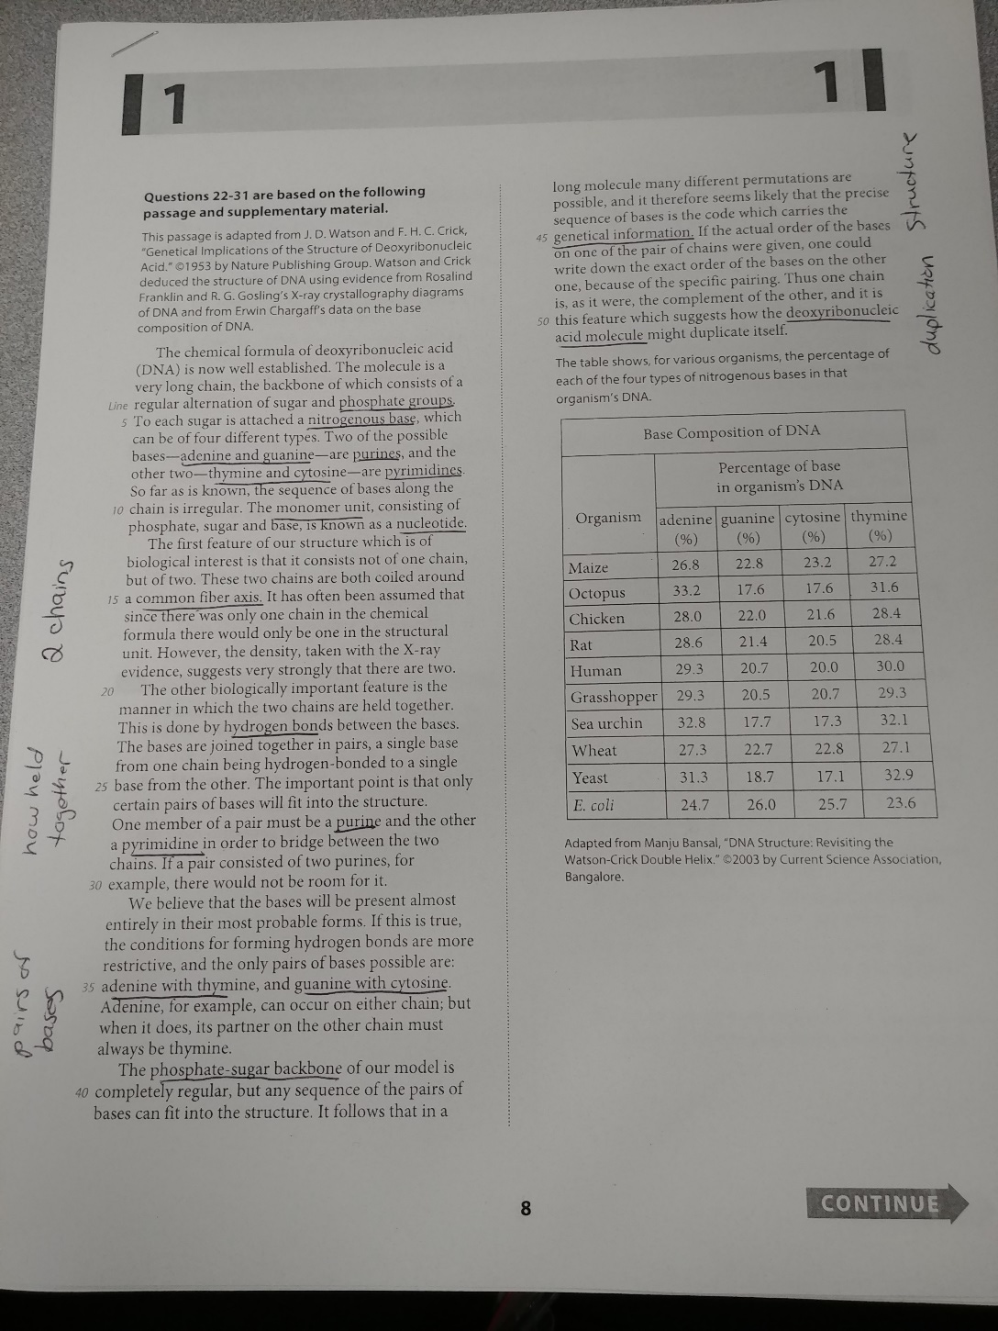
Notes:
Not lack of opinion markings. Suggests this is a neutral, informative text.

Slide 4
When you finish…
Write down the main idea of the passage in your own words.

Slide 5
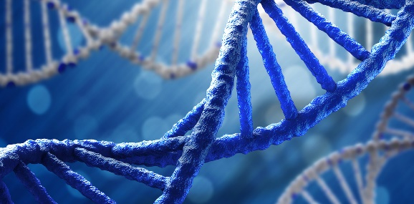
What is the main idea of this passage?
DNA is a long chain that alternates between sugar and phosphate groups, and a nitrogenous base is attached to each sugar.

Slide 6
22. The authors use the word “backbone” in lines 3 and 39 to indicate that
Tips and tricks:
Definition
questions
Don’t look at the answer choices right away.
Go back to the lines referenced in the text.
Reread the sentence before, the sentence itself, and the sentence after.
Decide what you think the word is trying to say in context.
Find an answer choice that matches.
Notes:
How to approach a question asking for a definition.

Slide 7
The chemical formula of deoxyribonucleic acid
(DNA) is now well established. The molecule is a
very long chain, the backbone of which consists of a
regular alternation of sugar and phosphate groups.
To each sugar is attached a nitrogenous base, which
can be of four different types.
What do
you
think?
Adenine, for example, can occur on either chain; but
when it does, its partner on the other chain must
always be thymine.
The phosphate-sugar backbone of our model is
completely regular, but any sequence of the pairs of
bases can fit into the structure. It follows that in a
long molecule many different permutations are
possible, and it therefore seems likely that the precise
sequence of bases is the code which carries the
genetical information.
formula
structure
sequence
Notes:
Make sure to read both referenced sections to get the full context.
What do you think: Note key words in both passages—clue to the meaning.

Slide 8
22. The authors use the word “backbone” in lines 3 and 39 to indicate that
A) only very long chains of DNA can be taken from an organism with a spinal column.
B) the main structure of a chain in a DNA molecule is composed of repeating units.
C) a chain in a DNA molecule consists entirely of phosphate groups or of sugars.
D) nitrogenous bases form the main structural unit of DNA.
Notes:
B focuses on structure

Slide 9
23. A student claims that nitrogenous bases pair randomly with one another. Which of the following statements in the passage contradicts the student’s claim?
Tips and tricks:
Picking a
statement
Key word: contradicts
Before looking at the passage, decide in your own words what the opposite of this opinion would be.
What are keywords letting you know this student’s opinion?
Go back to the passage and look at the 4 options and see which matches.
Notes:
Keyword: randomly

Slide 10
To each sugar is attached a nitrogenous base, which
can be of four different types.
So far as is known, the sequence of bases along the
chain is irregular.
What do
you
think?
The bases are joined together in pairs, a single base
from one chain being hydrogen-bonded to a single
base from the other.
One member of a pair must be a purine and the other
a pyrimidine in order to bridge between the two
chains.
Notes:
What do you think: what passage seems to suggest the opposite of random?

Slide 11
23. A student claims that nitrogenous bases pair randomly with one another. Which of the following statements in the passage contradicts the student’s claim?
A) Lines 5-6 (“To each . . . types”)
B) Lines 9-10 (“So far . . . irregular”)
C) Lines 23-25 (“The bases . . . other”)
D) Lines 27-29 (“One member . . . chains”)

Slide 12
24. In the second paragraph (lines 12-19), what do the authors claim to be a feature of biological interest?
Tips and tricks:
Finding
concrete
information
Don’t look at the answer choices yet.
Go to the section mentioned in the passage and find the answer in your own words.
What keywords should we look for in the passage?
Notes:
Keyword: biological interest

Slide 13
The first feature of our structure which is of
biological interest is that it consists not of one chain,
but of two. These two chains are both coiled around
a common fiber axis. It has often been assumed that
since there was only one chain in the chemical
formula there would only be one in the structural
unit. However, the density, taken with the X-ray
evidence, suggests very strongly that there are two.
What do
you
think?
Notes:
What do you think: what is the item of biological interest? (2 chains)

Slide 14
24. In the second paragraph (lines 12-19), what do the authors claim to be a feature of biological interest?
A) The chemical formula of DNA
B) The common fiber axis
C) The X-ray evidence
D) DNA consisting of two chains
Notes:
Keyword: biological interest

Slide 15
25. The authors’ main purpose of including the information about X-ray evidence and density is to
Tips and tricks:
“purpose”
questions
Scan the passage to find the relevant information.
Read the sentences surrounding the reference.
Ask yourself how the information relates to the main idea of the passage and that particular paragraph.

Slide 16
Scan the passage
and find a reference
to x-rays…
It has often been assumed that
since there was only one chain in the chemical
formula there would only be one in the structural
unit. However, the density, taken with the X-ray
evidence, suggests very strongly that there are two.
Ask yourself…
What is the main idea/topic of this paragraph?
How does the reference to x-rays relate to that?
Notes:
Main idea: 2 chains
Relationship: support

Slide 17
25. The authors’ main purpose of including the information about X-ray evidence and density is to
A) establish that DNA is the molecule that carries the genetic information.
B) present an alternate hypothesis about the composition of a nucleotide.
C) provide support for the authors’ claim about the number of chains in a molecule of DNA.
D) confirm the relationship between the density of DNA and the known chemical formula of DNA.

Slide 18
26. Based on the passage, the authors’ statement “If a pair consisted of two purines, for example, there would not be room for it” (lines 29-30) implies that a pair
Tips and tricks:
“implied”
questions
First, think about what the statement referenced implies about the subject of the sentence.
Look back at the passage for any additional information you may need.
Read the question carefully to know what it is asking.
Cross out any answer choices that seem illogical first.

Slide 19
One member of a pair must be a purine and the other
a pyrimidine in order to bridge between the two
chains. If a pair consisted of two purines, for
example, there would not be room for it.
What do
you
think?
Notes:
What do you think: what key pieces of info do we gain from reading a little more? (keyword: pyrimidine)

Slide 20
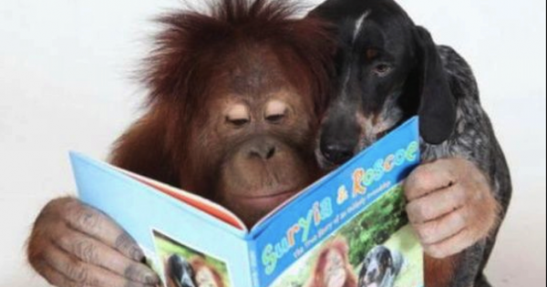
26. Based on the passage, the authors’ statement “If a pair consisted of two purines, for example, there would not be room for it” (lines 29-30) implies that a pair
A) of purines would be larger than the space between a sugar and a phosphate group.
B) of purines would be larger than a pair consisting of a purine and a pyrimidine.
C) of pyrimidines would be larger than a pair of purines.
D) consisting of a purine and a pyrimidine would be larger than a pair of pyrimidines.
Notes:
Note that we are finishing a sentence here.
Cross out choices that don’t deal with purines being larger

Slide 21
27. The authors’ use of the words “exact,” “specific,” and “complement” in lines 47-49 in the final paragraph functions mainly to
Tips and tricks:
“function”
questions
Similar to “purpose” questions, but more specific.
Don’t look at the answer choices.
Go to the section referenced.
Think about the main idea/topic of the paragraph.
Ask yourself how the sentence contributes to that main idea.
Then, then, ask yourself how these words contribute to the sentence’s purpose.

Slide 22
If the actual order of the bases
on one of the pair of chains were given, one could
write down the exact order of the bases on the other
one, because of the specific pairing. Thus one chain
is, as it were, the complement of the other, and it is
this feature which suggests how the deoxyribonucleic
acid molecule might duplicate itself.
What is the main topic of the paragraph?
How do these sentences relate to that idea?
What role do the referenced words play?
Notes:
Topic: duplication
Relationship: support
Purpose of the words: emphasis

Slide 23
27. The authors’ use of the words “exact,” “specific,” and “complement” in lines 47-49 in the final paragraph functions mainly to
A) confirm that the nucleotide sequences are known for most molecules of DNA.
B) counter the claim that the sequences of bases along a chain can occur in any order.
C) support the claim that the phosphate-sugar backbone of the authors’ model is completely regular.
D) emphasize how one chain of DNA may serve as a template to be copied during DNA replication.
Look at the first words of the answers. Cross out any that don’t match the purpose of the sentence.
Read remaining answer choices. Cross out any that don’t mention the main ideas of the paragraph.
Which remaining choice better reflects the purpose of the given words?

Slide 24
28. Based on the table and passage, which choice gives the correct percentages of the purines in yeast DNA?
Tips and tricks:
“missing
information”
questions
Read the question and the reference section carefully.
Determine what information needed to answer the question is missing.
Scan the rest of the passage to find the missing information.

Slide 25
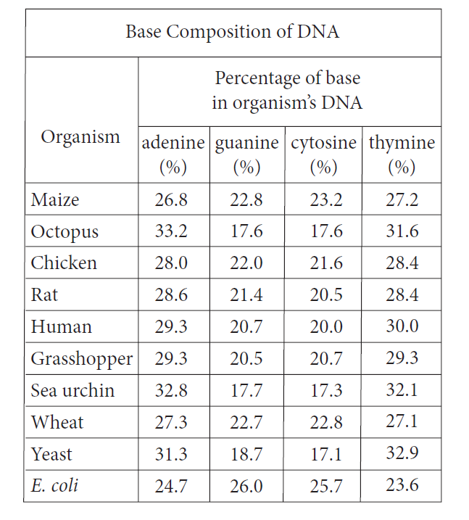
What is missing?
Which bases are purines
Two of the possible
bases—adenine and guanine—are purines, and the
other two—thymine and cytosine—are pyrimidines.
Notes:
Scan to look for references to purines and the names of the bases.

Slide 26
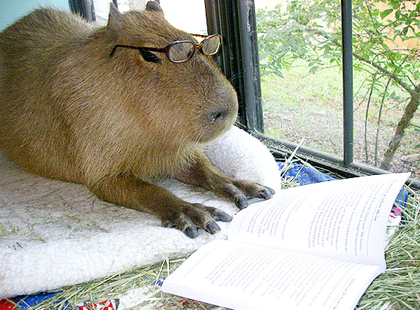
28. Based on the table and passage, which choice gives the correct percentages of the purines in yeast DNA?
A) 17.1% and 18.7%
B) 17.1% and 32.9%
C) 18.7% and 31.3%
D) 31.3% and 32.9%

Slide 27
29. Do the data in the table support the authors’ proposed pairing of bases in DNA?
Tips and tricks:
“either/or”
questions
These questions ask you to choose between 2 options (yes/no, true/false, same/different, etc.)
Don’t look at the answer choices.
Decide for yourself which answer is correct. (Go back to other passages for supporting information is necessary)
Eliminate incorrect answers.
Finally, look at the supporting explanations and decide which one pertains to the question.

Slide 28
What is missing?
The author’s proposed pairing of bases
The important point is that only
certain pairs of bases will fit into the structure.
One member of a pair must be a purine and the other
a pyrimidine in order to bridge between the two
chains. If a pair consisted of two purines, for
example, there would not be room for it.
We believe that the bases will be present almost
entirely in their most probable forms. If this is true,
the conditions for forming hydrogen bonds are more
restrictive, and the only pairs of bases possible are:
adenine with thymine, and guanine with cytosine.
Notes:
Scan to look for info about the pairings.
Examine those pairings in the chart. What do you notice when you compare the columns? (in each row, the numbers are similar to their mates)
So what does that tell us? (the pairs the author suggested do match up, so the answer is yes)

Slide 29
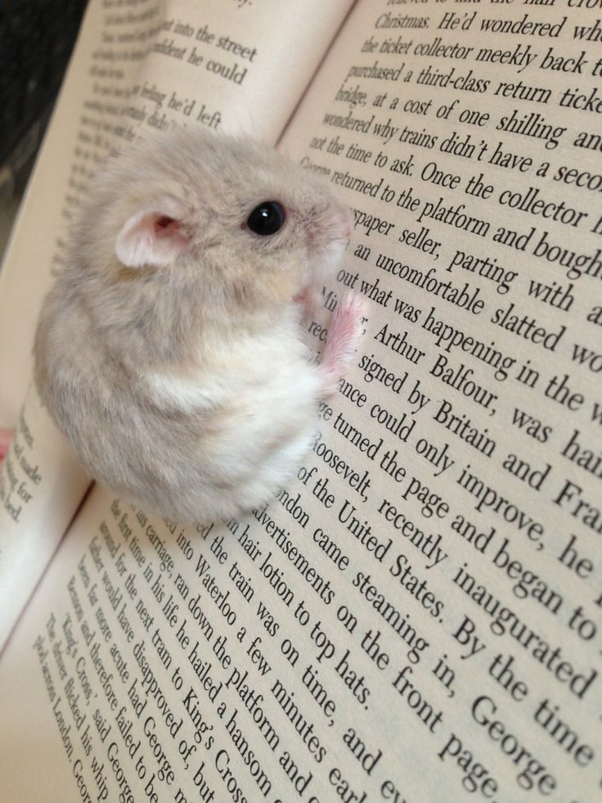
29. Do the data in the table support the authors’ proposed pairing of bases in DNA?
A) Yes, because for each given organism, the percentage of adenine is closest to the percentage of thymine, and the percentage of guanine is closest to the percentage of cytosine.
B) Yes, because for each given organism, the percentage of adenine is closest to the percentage of guanine, and the percentage of cytosine is closest to the percentage of thymine.
C) No, because for each given organism, the percentage of adenine is closest to the percentage of thymine, and the percentage of guanine is closest to the percentage of cytosine.
D) No, because for each given organism, the percentage of adenine is closest to the percentage of guanine, and the percentage of cytosine is closest to the percentage of thymine.

Slide 30
30. According to the table, which of the following pairs of base percentages in sea urchin DNA provides evidence in support of the answer to the previous question?
Tips and tricks:
Referring to previous questions
Look back to the previous question and recall the main idea of the question.
Look back to the passage to make sure you understand the context for the answer choices.
Choose the answer that supports your previous answer.

Slide 31
30. According to the table, which of the following pairs of base percentages in sea urchin DNA provides evidence in support of the answer to the previous question?
A) 17.3% and 17.7%
B) 17.3% and 32.1%
C) 17.3% and 32.8%
D) 17.7% and 32.8%
Notes:
Previous answer focused on closeness of numbers.

Slide 32
31. Based on the table, is the percentage of adenine in each organism’s DNA the same or does it vary, and which statement made by the authors is most consistent with that data?
Focus on one part of the question at a time; start with the simplest part.
Eliminate any answers that can’t be possible based on this part.
Refer to any passages referenced in the question; this will likely be more than one.
Tips and tricks:
Complex questions
Notes:
Look at different parts of question. First part is simpler.

Slide 33
Based on the table, is the percentage of adenine in each organism’s DNA the same or does it vary?
Varies
Notes:
Where do we need to look to answer first part of question?

Slide 34
31. Based on the table, is the percentage of adenine in each organism’s DNA the same or does it vary, and which statement made by the authors is most consistent with that data?
A) The same; “Two of . . . pyrimidines” (lines 6-8)
B) The same; “The important . . . structure” (lines 25-26)
C) It varies; “Adenine . . . thymine” (lines 36-38)
D) It varies; “It follows . . . information” (lines 41-45)
Notes:
Eliminate parts that say “same”

Slide 35
Which statement made by the authors is most consistent with that data?
Adenine, for example, can occur on either chain; but
when it does, its partner on the other chain must
always be thymine.
It follows that in a
long molecule many different permutations are
possible, and it therefore seems likely that the precise
sequence of bases is the code which carries the
genetical information.
Notes:
Only need to look at passages for our 2 remaining answer choices.
Which choice relates to the first part of the question?

Slide 36
31. Based on the table, is the percentage of adenine in each organism’s DNA the same or does it vary, and which statement made by the authors is most consistent with that data?
A) The same; “Two of . . . pyrimidines” (lines 6-8)
B) The same; “The important . . . structure” (lines 25-26)
C) It varies; “Adenine . . . thymine” (lines 36-38)
D) It varies; “It follows . . . information” (lines 41-45)
Notes:
Eliminate parts that say “same”

Slide 37
Questions on Section 1?

Slide 38
Section 2
Writing and language

Slide 39
Tips for writing and language passages
Read through the passage quickly the first time.
Jot down notes in the margins about the main ideas/topics for each paragraph.
When finished, determine the main idea for the entire passage in your own words.
Notes:
Knowing main topics of each paragraph can help determine what edits to make to sentences.

Slide 40
What is the main idea for this passage?
Greek yogurt has nutritional benefits, and although it can have some negative environmental impact, farmers can take steps to limit these consequences.

Slide 41
Pro tip: examining the answer choices can give you a hint about what to look for in the sentence.
NO CHANGE
ate
will eat
is eating
What is the difference?
Verb tense

Slide 42
1. Given these solutions as well as the many health benefits of the food, the advantages of Greek yogurt outdo the potential drawbacks of its production.
A) NO CHANGE
B) defeat
C) outperform
D) outweigh
Before looking at the answer choices, try filling in your own word by determining what should go there based on the context.
Then, eliminate answer choices that won’t work based on your reasoning.
Finally, plug in remaining answers and choose the best.
Word replacement

Slide 43
2. They can add it to livestock feed as a protein supplement, and people can make their own Greek-style yogurt at home by straining regular yogurt.
Which choice provides the most relevant detail?
A) NO CHANGE
B) supplement and convert it into gas to use as fuel in electricity production.
C) supplement, while sweet whey is more desirable as a food additive for humans.
D) supplement, which provides an important element of their diet.
First, eliminate any answer choices that contain errors or make no sense.
Be sure to put choices in the sentence
Refer to your main idea for the passage as well as for the individual paragraph.
Determine which answer choice most closely fits those main ideas.
Adding information

Slide 44
3. If it is improperly introduced into the environment, acid-whey runoff can pollute waterways, depleting the oxygen content of streams and rivers as it decomposes.
A) NO CHANGE
B) can pollute waterway’s,
C) could have polluted waterways,
D) has polluted waterway’s,
This type of question asks you to act as an editor by selecting which text to use to replace existing text.
First, identify any errors in the original. Eliminate answer choices that don’t correct that error.
Then, eliminate answer choices that introduce new errors.
Be sure to pay attention to the tense of the entire paragraph.
Remember, even if the original isn’t WRONG, there could still be a BETTER choice.
Sentence corrections
Notes:
B and D introduce punctuation errors
C changes the tense

Slide 45
4. Yogurt manufacturers, food scientists; and government officials are also working together to develop additional solutions for reusing whey.
A) NO CHANGE
B) scientists: and
C) scientists, and
D) scientists, and,
What type of question is this?
Language tip: in a list, separate items with commas, and always put a comma before the “and.” If an item in the list contains commas, then you separate the items with semicolons.
Notes:
Sentence correction
What is the problem with the original? (semicolon instead of comma after scientist.

Slide 46
5. If it is improperly introduced into the environment, acid-whey runoff can pollute waterways, depleting the oxygen content of streams and rivers as it decomposes.
To make this paragraph most logical, sentence 5 should be placed
A) where it is now.
B) after sentence 1.
C) after sentence 2.
D) after sentence 3.
These questions ask you to reorder sentences in the way that makes the most sense.
Sentences discussing similar topics should be placed together.
Notice things like cause/effect, compare/contrast, and transitions.
Try placing the sentence in each suggested location and determine what works best.
Organization
Notes:
What is sentence 5 talking about? (acid-whey damaging the environment)

Slide 47
The main environmental problem caused by the
production of Greek yogurt is the creation of acid whey
as a by-product. Because it requires up to four times
more milk to make than conventional yogurt does, Greek
yogurt produces larger amounts of acid whey, which is
difficult to dispose of. To address the problem of
disposal, farmers have found a number of uses for acid
whey. They can add it to livestock feed as a protein
supplement, and people can make their own
Greek-style yogurt at home by straining regular yogurt.
If it is improperly introduced into the environment,
acid-whey runoff can pollute waterways, depleting
the oxygen content of streams and rivers as it
decomposes. Yogurt manufacturers, food
scientists; and government officials are also
working together to develop additional solutions for
reusing whey.

Slide 48
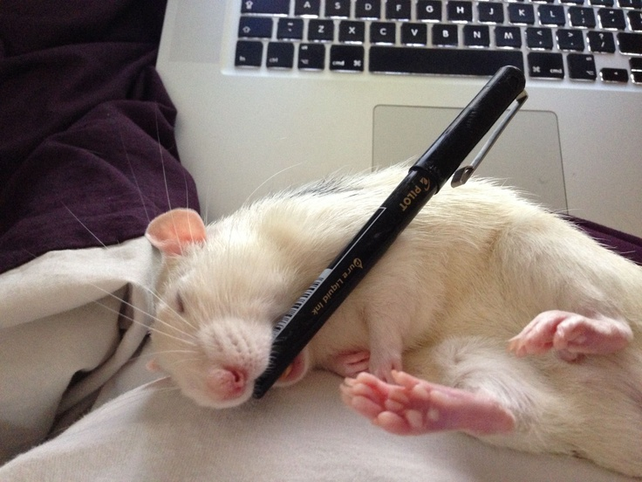
5. If it is improperly introduced into the environment, acid-whey runoff can pollute waterways, depleting the oxygen content of streams and rivers as it decomposes.
To make this paragraph most logical, sentence 5 should be placed
A) where it is now.
B) after sentence 1.
C) after sentence 2.
D) after sentence 3.
Notes:
What is sentence 5 talking about? (acid-whey damaging the environment)

Slide 49
6. Though these conservation methods can be costly and time-consuming, they are well worth the effort.
In this question, you’re asked not only to make a choice, but also to give your reason.
First, eliminate answers that are not factual
Then, consider:
Main idea of the passage
Topic of the paragraph
Placement/purpose of the sentence
In this case, it is the first sentence of the paragraph, so it should provide a transition from the last paragraph and establish the topic/main idea of this paragraph.
The writer is considering deleting the underlined sentence. Should the writer do this?
A) Yes, because it does not provide a transition from the previous paragraph.
B) Yes, because it fails to support the main argument of the passage as introduced in the first paragraph.
C) No, because it continues the explanation of how acid whey can be disposed of safely.
D) No, because it sets up the argument in the paragraph for the benefits of Greek yogurt.
Defending revisions

Slide 50
7. Nutritionists consider Greek yogurt to be a healthy food: it is an excellent source of calcium and protein, serves to be a digestive aid, and it contains few calories in its unsweetened low- and non-fat forms. Greek yogurt is slightly lower in sugar and carbohydrates than conventional yogurt is.
What type of question is this?
A) NO CHANGE
B) as
C) like
D) for
Language tip: prepositions are not interchangeable! Think about what relationship is implied by the preposition.
Notes:
Sentence correction: which preposition makes the correct relationship?

Slide 51
8. Nutritionists consider Greek yogurt to be a healthy food: it is an excellent source of calcium and protein, serves to be a digestive aid, and it contains few calories in its unsweetened low- and non-fat forms. Greek yogurt is slightly lower in sugar and carbohydrates than conventional yogurt is.
What type of question is this?
A) NO CHANGE
B) containing
C) contains
D) will contain
Language tip: pay attention to pronouns. If the pronoun isn’t needed to make the sentence clear, you can get rid of it.
Notes:
Sentence correction: which sentence uses the proper verb form?

Slide 52
9. Also, because it is more concentrated, Greek yogurt contains slightly more protein per serving, thereby helping people stay satiated for longer periods of time.
A) NO CHANGE
B) In other words,
C) Therefore,
D) For instance,
When doing a word replacement for a transition, the most important thing to think about is the relationship between the two sentences.
Is the author…
Adding new information?
Restating a point?
Drawing a conclusion?
Giving an example?
Providing a counterpoint?
What type of question is this?

Slide 53
Nutritionists consider Greek yogurt to be a healthy
food: it is an excellent source of calcium and protein,
serves to be a digestive aid, and it contains few
calories in its unsweetened low- and non-fat forms.
Greek yogurt is slightly lower in sugar and carbohydrates than conventional yogurt is. Also, because it is more concentrated, Greek yogurt contains slightly more protein per serving, thereby helping people stay satiated for longer periods of time.

Slide 54
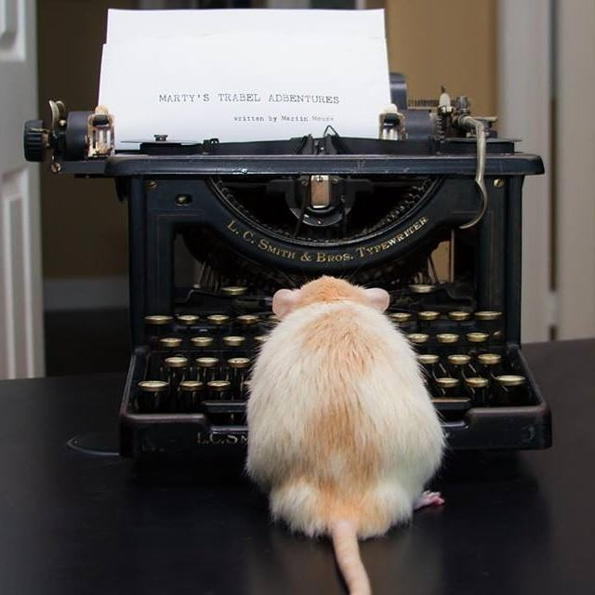
9. Also, because it is more concentrated, Greek yogurt contains slightly more protein per serving, thereby helping people stay satiated for longer periods of time.
A) NO CHANGE
B) In other words,
C) Therefore,
D) For instance,
Pro tip: don’t be afraid to choose “no change”! Sometimes, it is the correct answer!

Slide 55
10. Also, because it is more concentrated, Greek yogurt contains slightly more protein per serving, thereby helping people stay satiated for longer periods of time.
What type of question is this?
A) NO CHANGE
B) fulfilled
C) complacent
D) sufficient
Pro tip: don’t forget about connotation! “Unique” and “peculiar” have the same dictionary definitions, but very different connotations!
Notes:
Word replacement

Slide 56
11. Because consumers reap the nutritional benefits of Greek yogurt and support those who make and sell it, therefore farmers and businesses should continue finding safe and effective methods of producing the food.
A) NO CHANGE
B) it, farmers
C) it, so farmers
D) it: farmers
What type of question is this?
Notes:
Sentence correction
Error: 2 transition words
D introduces punctuation error

Slide 57
Questions on Section 2?

Slide 58
Recap
Reading comprehension
Mark up passages as you read them
Think about main ideas
Don’t look at answer choices before going back to the passage
Determine what type of question it is to know what steps to follow to find the best answer
Writing and Language
Mark up passages as you read them
Think about main ideas
Look at answer choices for hints about what to pay attention to
Determine what type of question it is to know what steps to follow to find the best answer
An answer can be right without being the best answer

