Slide 1


The 4 keys
Management wisdom

Slide 2
Who do you want to hire?
Tom
Joan
Michelle
Rob
Becca
Will
Master’s Degree
10 years experience
Great customer reviews
3 promotions in last 5 years
Excellent communication skills
High emotional intelligence
Notes:
Hand out fake money. Have participants bid on each employee in turn based on the given characteristic.

Slide 3

The 4 Keys
Give us a new perspective on a manager’s key activities:
  selecting candidates
  setting expectations
  motivating people
  developing employees
Notes:
What do these have to do with the employees I just asked you to bid on?

Slide 4


Conventional Tidbit #1
Choose an employee based on experience, intelligence, and motivation
Notes:
This common, conventional wisdom may have led you to bid highly on someone like Tom or Joan

Slide 5

The 4 Keys
1. When selecting someone, select for talent.
Notes:
When selecting someone, select for talent, not just experience , intelligence, and determination. This advice might lead you to choose someone like Becca or Will who have soft skills suggesting underlying talent.

Slide 6

Key #1
Research conducted by Harvard University, the Carnegie Foundation, and Stanford Research Center has all concluded that 85% of job success comes from having well‐developed soft skills.
  Leadership
  Teamwork
  Communication
  Problem-solving
  Work ethic
  Adaptability
  Interpersonal skills
Notes:
Soft skills are much more highly related to job success, and are much less likely to show up on a traditional resume.
These things are often personality traits, essential talents that people bring to the table that are sometimes harder to gauge.

Slide 7

Conventional Tidbit #2
Set expectations by defining the right steps.

Slide 8
The 4 Keys
1. When selecting someone, select for talent.
2. When setting expectations, define
the right outcomes.
Notes:
When setting expectations, define the right outcomes, not the right steps

Slide 9
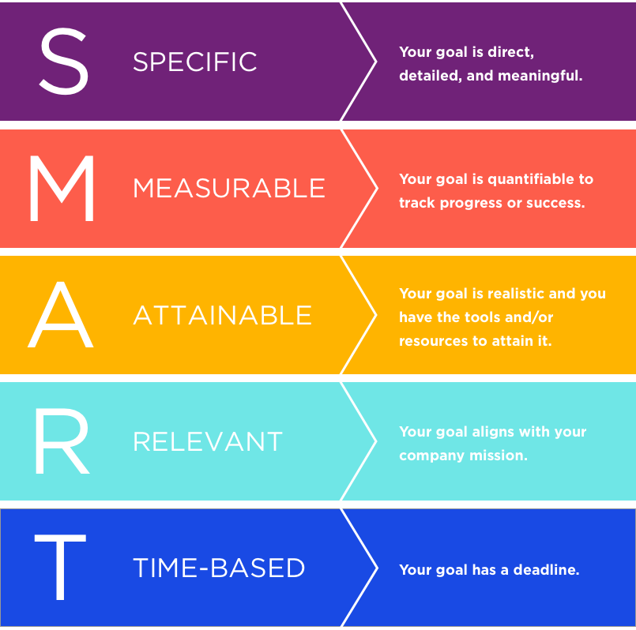
Key #2
The best goals focus on where you want to go, then work backwards to how you’re going to get there.
Having SMART goals and tasks makes work more meaningful and impactful for the employee.

Slide 10

Goal Exercise
Take a look at the top of your worksheet.
Spend about a minute jotting down the goals that you’re currently working on.
Notes:
We’ll come back to this in a few minutes

Slide 11

Conventional Tidbit #3
Motivate the person by helping them overcomes their weaknesses.

Slide 12
The 4 Keys
1. When selecting someone, select for talent.
2. When setting expectations, define
the right outcomes.
3. When motivating someone, focus on
strengths.
Notes:
When setting motivating someone, focus on strengths, not weaknesses

Slide 13

Key #3
Research reveals that 70-80% of leaders and employees benefit more from improving what they are doing right.
  feel more confident, self-aware and productive
  better return on investment

Slide 14

Let’s Practice!
Look back at the goals that you wrote down.
How can you re-frame those goals in a more positive, strengths-based way?
On the bottom of your worksheet, re-write each goal starting with
“I will increase…”

Slide 15

Conventional Tidbit #4
Develop the person by helping them learn and get promoted.

Slide 16
The 4 Keys
1. When selecting someone, select for talent.
2. When setting expectations, define
the right outcomes.
3. When motivating someone, focus on
strengths.
4. When developing someone, help them
find the right fit.
Notes:
When developing someone, help them find the right fit, not just the next rung on the ladder.

Slide 17

Key #4
A career fit leads to a fulfilling life.
It also aids you in doing very well in the field.
How do you find a path that fits?
  Find the overlap between what you’re good at, what you like, and what companies need.
  Think about work-life balance.
  Think about your values.

Slide 18

Fit exercise
Look at page 2 of your worksheet.
Circle the words that you think best describe you.
How can those terms help you determine career fit?
  Think about a company’s values.
  Thank about what you’ll be doing every day.
  Do these things align with the words you circled?

Slide 19
